Slide 1
A whistle-stop tour of latest developments
Beccy Whittle r.whittle@lancaster.ac.uk Instagram: @whittlebeccy (on behalf of a huge bunch of fantastic people without whom none of this would be possible!)

Slide 2
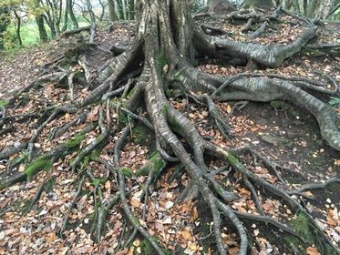
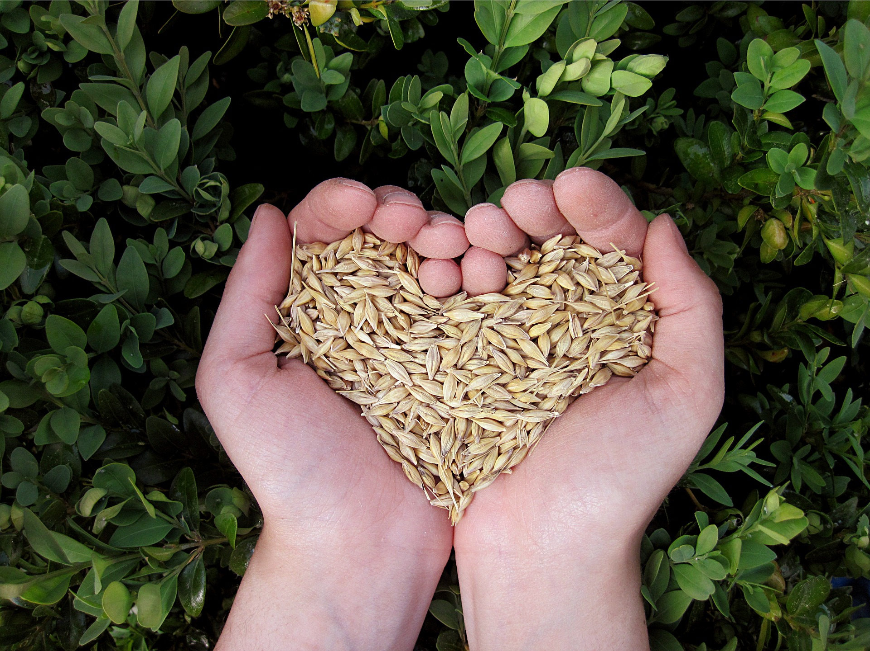
Just one year ago…
We held a strategy day in November 2019; our bronze funding was coming to an end and we had been asked if we wanted to go for silver...
We asked the room: “should we go forward from here? And if so, how?”
This is what happened next!

Slide 3
Key things we’ve done in 2020
Built a new website www.foodfutures.org.uk
Lancaster District Food Poverty Alliance became a key emergency response organisation during the pandemic
Northern Real Farming Conference (2 weeks, 500+ participants in over 60 sessions!)
Lancaster Health Festival (300 participants)

Slide 4
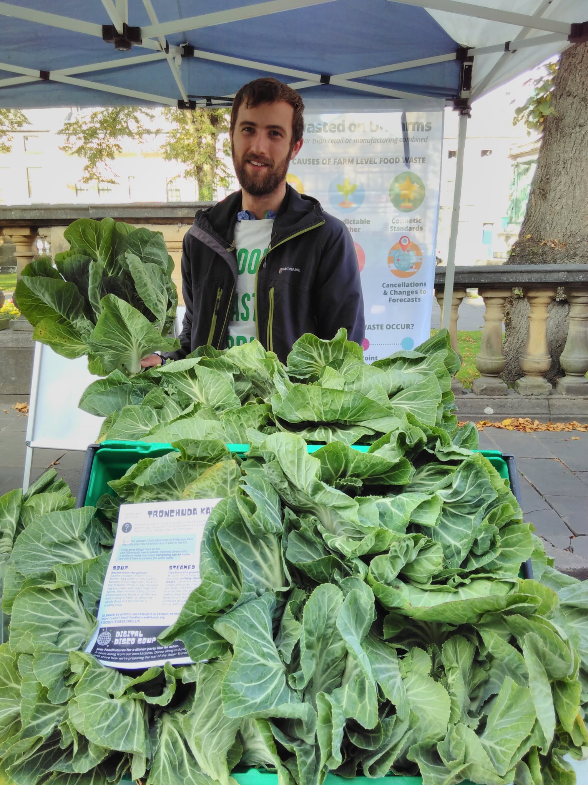
Key things we’ve done in 2020
Farm Start site coming on stream and Food Friends social lottery launched
Gleaning network established in September 2020: (165kg of tronchuda kale and 75kg of apples recued so far!)
New report on public procurement launched today in collaboration with N8 AgriFood partnership – will be fed into EFRA and could lead to a national campaign...

Slide 5
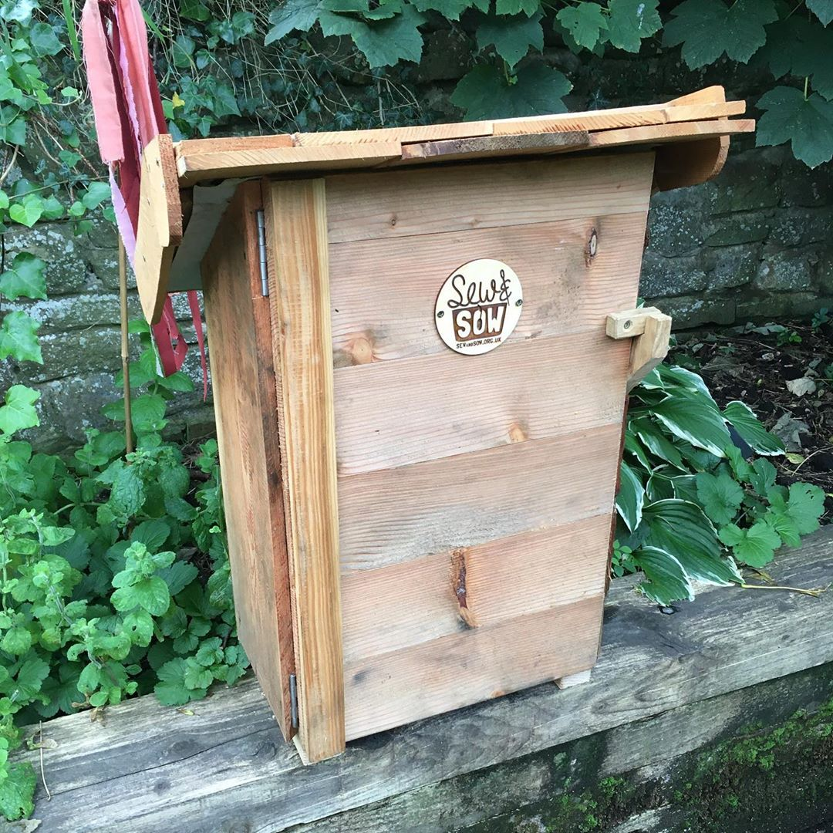
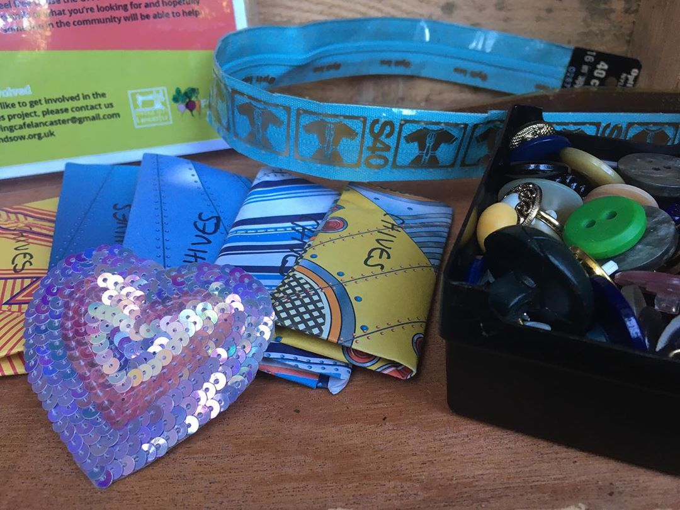
How?
Emphasis on developing a collaborative, inclusive and decentralised working culture
New and effective stakeholder partnerships
All skills, not just food skills
Lifestyle focused, aspirational marketing, including new magazine to be launched in 2021

Slide 6
What’s next?
Strategy development – our own and others’ (we have now been match funded by the city council and asked to feed into their 2030 strategy).
NRFC legacy work – continuing momentum with farmers and researchers seems especially important here.
FarmStart site #2
National campaign on procurement work
Scaling up growing with local schools and churches as part of Eden Project North and new Urban Agriculture Consortium (Lancaster is now one of 4 northern pathfinder cities)
More video work

Slide 7
Challenges
Capacity!
How to work with other networks and key stakeholders
Building a sense of collective ownership

