Slide 1
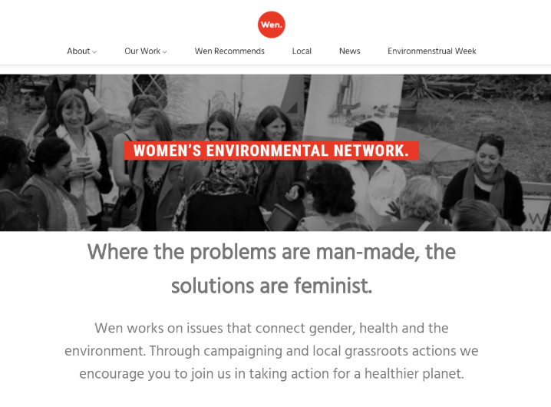
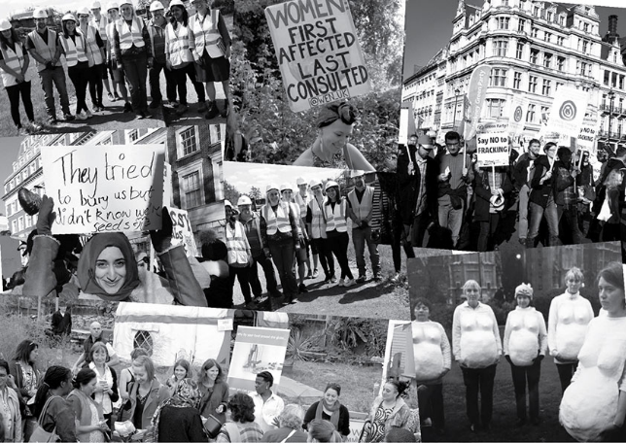
Wen
#WEN_UK

Slide 2
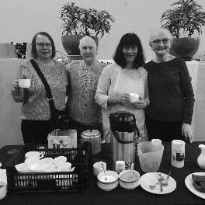
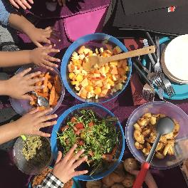
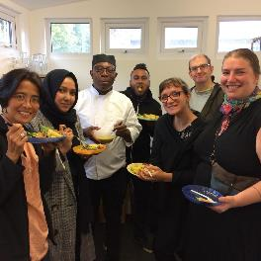
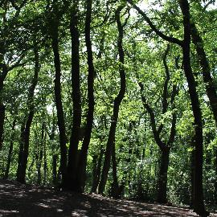
Partnership vision for food in Tower Hamlets
Celebrated
Nutritious food is a leading element of our streets, estates and neighbourhoods. People feel happier, healthier and proud of their communities.
Fair for All Everyone – including our vulnerable and low-income communities – can access nutritious, tasty, culturally-appropriate food with dignity.
Community-led Our communities are empowered to develop and share diverse food knowledge, resources and projects, and be part of a thriving local food economy.
Healthier for people and planet Our food system nurtures human health, supports animal, plant and soil welfare, avoids waste and reduces emissions contributing to climate change.
#TowerHamletsFood

Slide 3
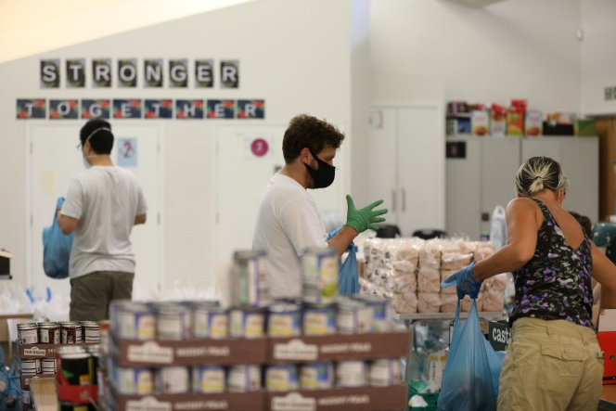
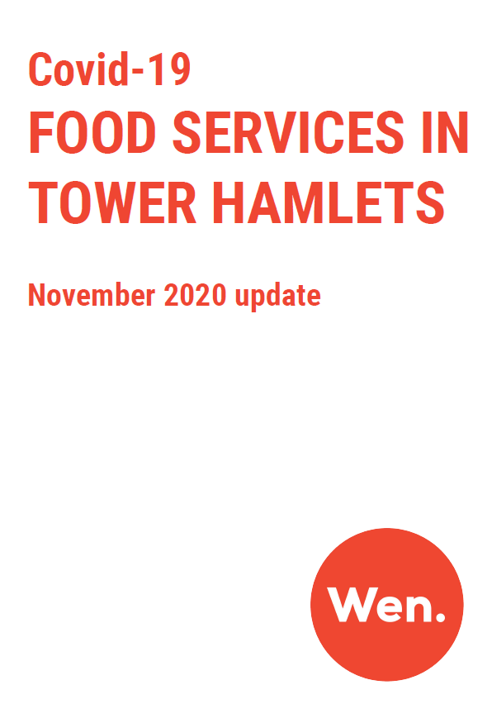
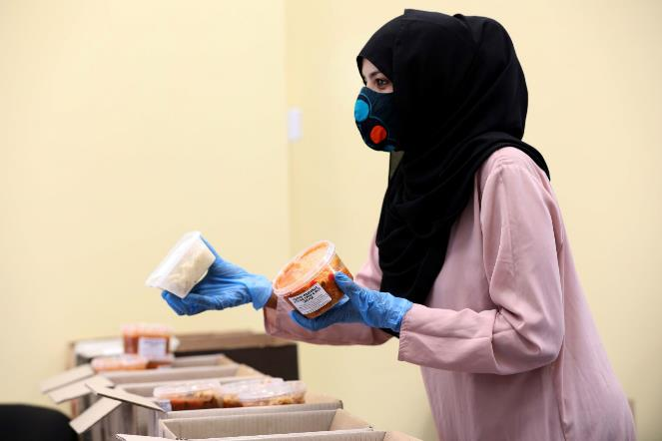
Covid response

Slide 4
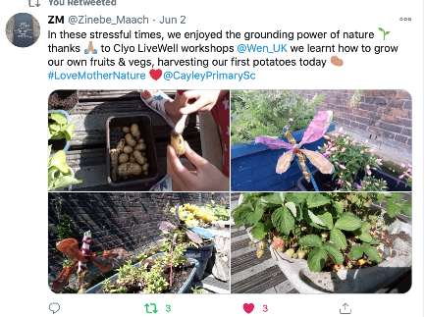
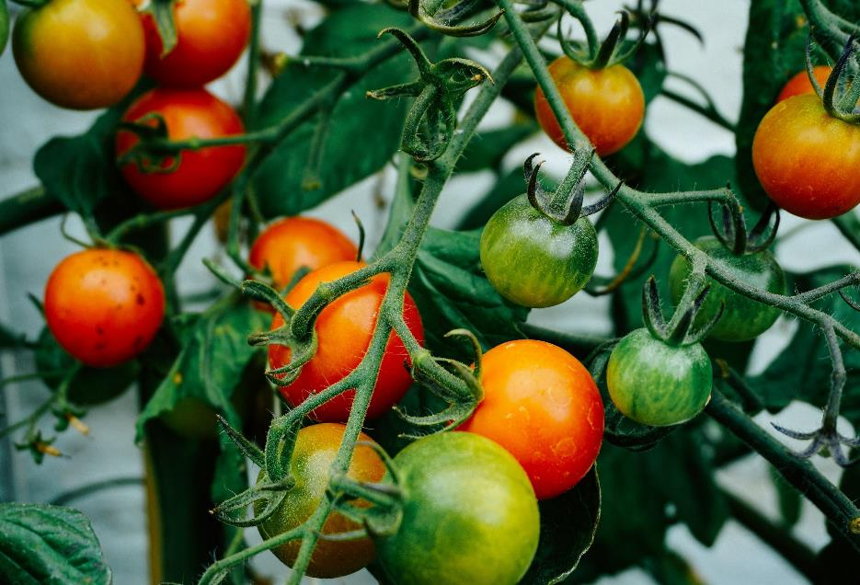
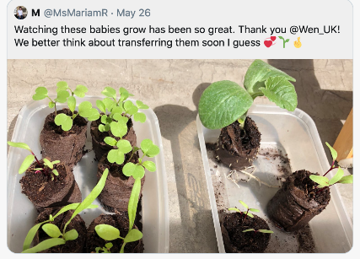
Covid response
WE’RE HERE TO HELP
YOU KEEP GROWING

Slide 5
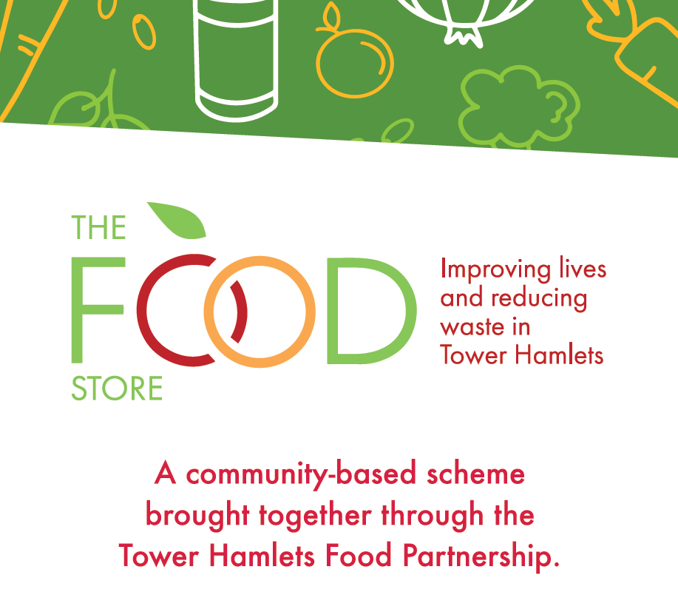
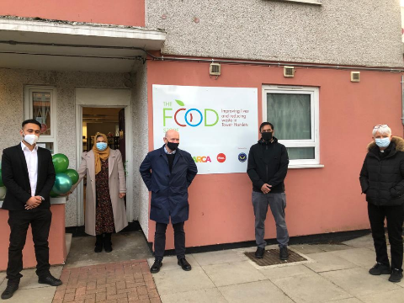
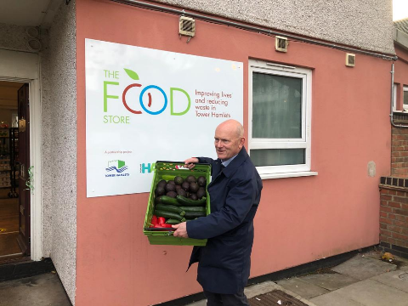
New food pantry

Slide 6
Just FACT
Tower Hamlets
Just Food and Climate
Transition
A community-led programme for an environmentally sustainable and socially just urban food system.

Slide 7
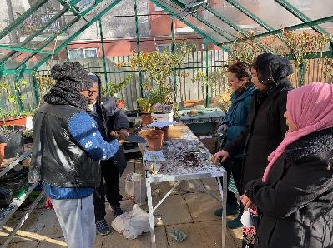
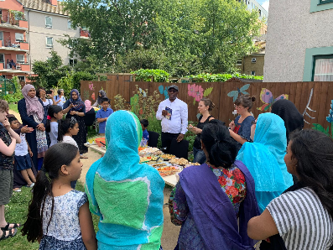
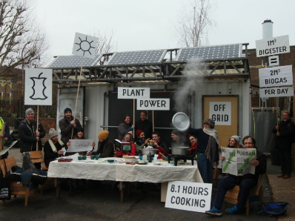
LIMBOROUGH FOOD HUB - FOOD AT THE HEART OF THE COMMUNITY
In spring 2021, Wen will coordinate the borough’s first Community Food Hub at Limborough House. This will be a space to connect, empower and nourish the local community through food. Running alongside the Food Pantry, The Hub will host an exciting programme of workshops, events and initiatives for residents, incorporating the community garden, greenhouse, workshop space and training kitchen.
Workshops and training... Events and celebrations...
Community initiatives... Food pantry
#TowerHamletsFood

Slide 8
Thanks!
Jo Wilson, THFP Coordinator
jo@wen.org.uk
@j_wils
@WEN_UK
#TowerHamletsFood

