Slide 1
The County Durham Food Partnership
Notes:
Hello, I’m Hannah Murray-Leslie and along with Peter Samsom (who’s here and hopefully will chip in on the chat as I talk) I co-ordinate Food Durham, The County Durham Food Partnership. We’ve been asked to share a bit about our experiences in County Durham; how we see the challenges and opportunities of operating a large unitary authority.

Slide 2
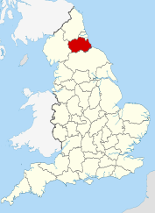
About County Durham
Our diverse geography includes rural North Pennines Area of Outstanding Natural Beauty in the west to the east Durham Heritage Coastline.
Population is 523,700. Non-white ethnicities make up 1.8% of the population with the two largest groups being Chinese and Indian.
Settlements are scattered towns and villages, a legacy of the mining industry whose decline left pockets of inequality and deprivation within the county.
Durham City is the largest settlement and has a population of 52,200, which represents 10% of the county's resident population.
Covid response has been strong – DCC / VCS & approx. 140 Mutual Aid Groups.
Notes:
For those who aren’t familiar with County Durham:
To the West are the North Pennines, Heritage Coastline to the East and in-between a dispersed population, mainly living in rural or ex-mining settlements. This provides both challenges and opportunities:
We’ve got high levels of deprivation; We’ve got Universal Credit and Covid so high demand for emergency food provision. But we also have a long and proud history of collective action and community cohesion.
Our health statistics are poor – the majority of people who are not working have long-term health problems and childhood obesity is well above the national average. There are lots of takeaways and fresh food deserts.
Our local food economy is not particularly developed; small producers need to sell at events all across the region. We have small-scale upland livestock and commodity arable agriculture (wheat, barley, oil seed rape etc) not much of the food produced here is consumed here and there isn’t really a recognisable Durham ‘food culture’

Slide 3
Food Durham
Organisations and individuals working together to achieve shared aims.
Hosted by Durham Community Action (DCA), a registered charity
Co-ordinated by two Food & Growing Co-ordinators (FTE 1.4)
Aims to make our food system Healthier, Green and Fairer and where every household has access to ‘good food’ – food that is safe, nutritious, of good quality and environmentally sustainable.
Notes:
Food Durham has existed formally since 2014. It is not a legal entity of its own – we’re hosted by Durham Community Action (DCA), a charity which provides infrastructure support for the VCS and the partnership is co-ordinated by two Food & Growing Co-ordinators. We spend most of our time like small spiders on a very big web - building relationships, making connections, developing partnership projects etc.

Slide 4
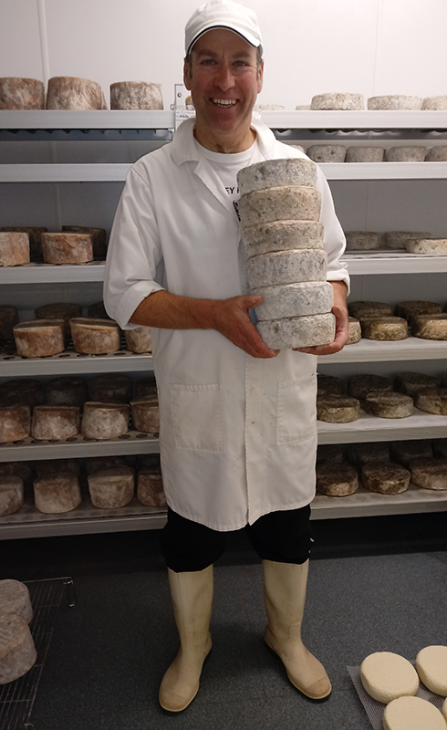
Development of Food Durham
2011: consultation via workshops, one to one meetings, and small group meetings.
2013: Launch of County Durham Food Charter
2014: Launch of Sustainable Local Food Strategy and the County Durham Food Partnership (Food Durham)
2020: Review of Sustainable Local Food Strategy
2017: Achieved Bronze Sustainable Food City Award
Advisory Board with broad representation
Themed Sub Groups
General Membership
Sustainable Food Places
Food Durham
Notes:
You can see from this slide that Food Durham had been working for some time before we put in for the Bronze Award – this was deliberate; we wanted to establish a food partnership driven by local need rather than following a ‘model’ developed by people working across cities. It also reflects the time it takes to build the relationships needed to embed a Food Partnership, and the constantly changing nature of the work (e.g. at the moment it is not possible to contact any of our public procurement group members)
Simon on the right there holding our partnership structure is a cheesemaker and the Chair of the Advisory Board which includes representatives of local food businesses; Durham County Council, Durham University Catering, NFU, NHS, Visit County Durham, South Durham Enterprise Agency and Durham CAB. We don’t really have much engagement with large-scale food businesses and distribution.
We manage some of our sub-groups directly: Community Growing and Public Procurement, and others belong to DCC: e.g. Healthy Weight Alliance; Environment in your Community.
With support from SFP we will shortly be launching a Community Good Food Network, aiming to create a space where people involved in grass-roots food projects can share ideas, support each other and explore the wider issues around good food.

Slide 5
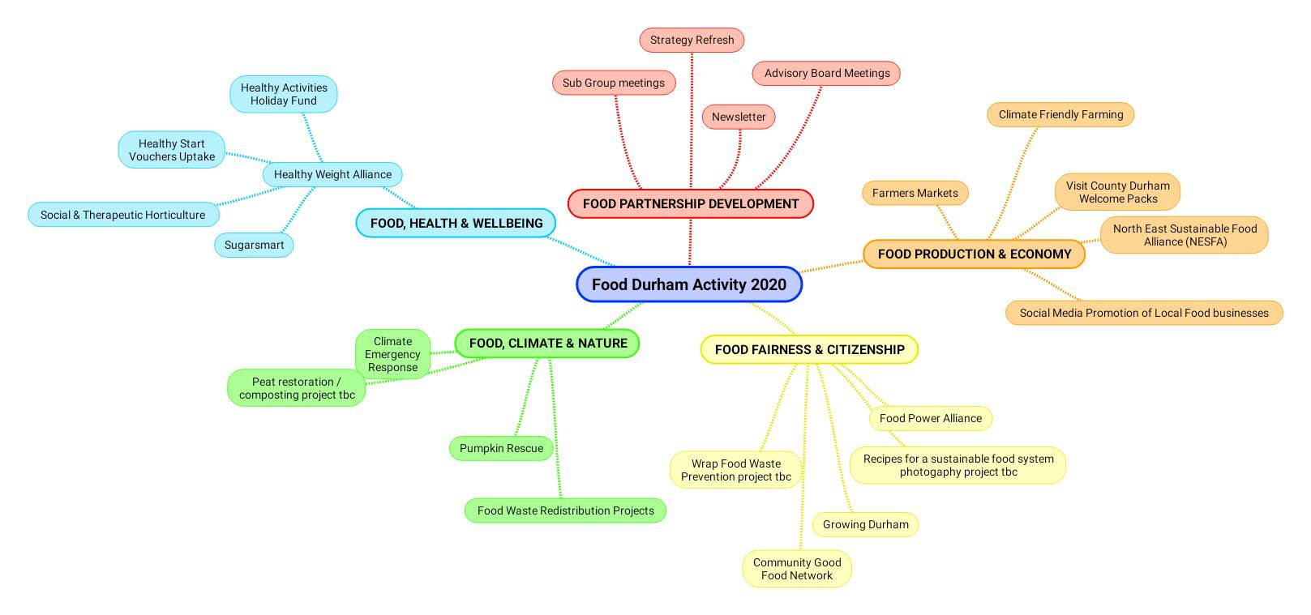
Notes:
This is just a quick mind-map I made to keep track of what we’re currently working on / developing under four key themes we identified whilst refreshing the Strategy.
It’s a snapshot and what you see are headlines – flowing out from each area of activity is another level of relationships with the people who actually deliver the work. In such a complex system it is impossible to do it on your own - like other food partnerships we rely on others to develop and deliver action, but perhaps a bit more so within this larger space.
There is so much great work taking place across sector and county, but connecting this up is a challenge. Just within Durham County Council we work with public health, strategic waste management, low carbon economy team, children’s services and catering. These people often have no other reason to come into contact with each other.
We know there are loads more things happening that we’re not even involved in – we sent out information about Pumpkin Rescue activities via holiday hunger networks which sparked a new contact with a community food project just down the road from our offices. We’re now talking about developing community leaf collection & composting on the estate linked to a potential project the North Pennines AONB on peatland restoration. But people rarely come to us, generally we have to earn our place at their table and I think this is something to do with the localism of our communities – people just get on with it and it can be difficult to connect and engage people in wider issues when they are busy and focused on their own thing.

Slide 6
Partnership Working
Essential Insights
Reaching new audiences
Access to expertise
Increased capacity
Sense of shared responsibiltiy
Responsive to opportunities
Building Community
Notes:
Working in partnership can be time consuming and a bit messy sometimes, it also can be fun and brings opportunities (see slide). Our formal influence is definitely limited but more and more we find people are interested in what we are doing - the trick is to connect things up and find ways to influence policy.
Our local authority is a massive player - if we can get things written in to their strategies and policies it makes a big difference because it influences decision making at a higher level. DCC developed its Sustainable Procurement Policy through its involvement with Food Durham, DCC Public Health has a Healthy Sustainable Food Policy and Food Durham was included in the Climate Emergency Response. Like making a tiny shift in the direction of a massive tanker, it takes time to see the impact but there’s no stopping it.

Slide 7
Notes:
Ultimately it’s all about relationships – like any food partnership we have to build connections and create reasons for people to engage with us to move the game on together. Its just that across a County there are more of them and they’re more spread out.

Slide 8
How does SFP help?
Opportunities to network and learn from other food partnerships.
Awards programme provide funding, structure and focus.
SFP support for NESFA work with other North East Food Partnerships to identify projects we can develop together on a regional level.
Encouragement and validation
National Campaigns
Notes:
I’ve nicked this photo from the SFP newsletter because Liz Charles who set up Food Durham is right in the middle with the wok. But it illustrates the networking bit that we love.
Re: Awards; the key issues are universal and we find it helpful to check back against these when planning and identifying gaps. But making the application is tough - the activity we need to capture is very spread out.
Facilitation support for NESFA has been an opportunity to develop new virtual learning techniques that support our local delivery and its a nice small forum in which to mull over some of the bigger issues that need regional solutions.
What can SFP could do to make things better for Food Durham?
Keep supporting us, keep involving us, keep listening and understanding our particular circumstances. The encouragement and validation are important.
Keep on with the national campaigning – greater public awareness of the issues means people are more receptive to working with us. But also understand that we are just tiny spiders!

