Slide 1
Building Food Resilience in Leeds
Sonja Woodcock
FoodWise Leeds, a driving force for good food in Leeds.
We encourage people to grow, buy, serve and eat healthy, sustainable food – and to help us build a locally-focused, high quality, low carbon, zero waste and above all fair food system for our city.

Slide 2
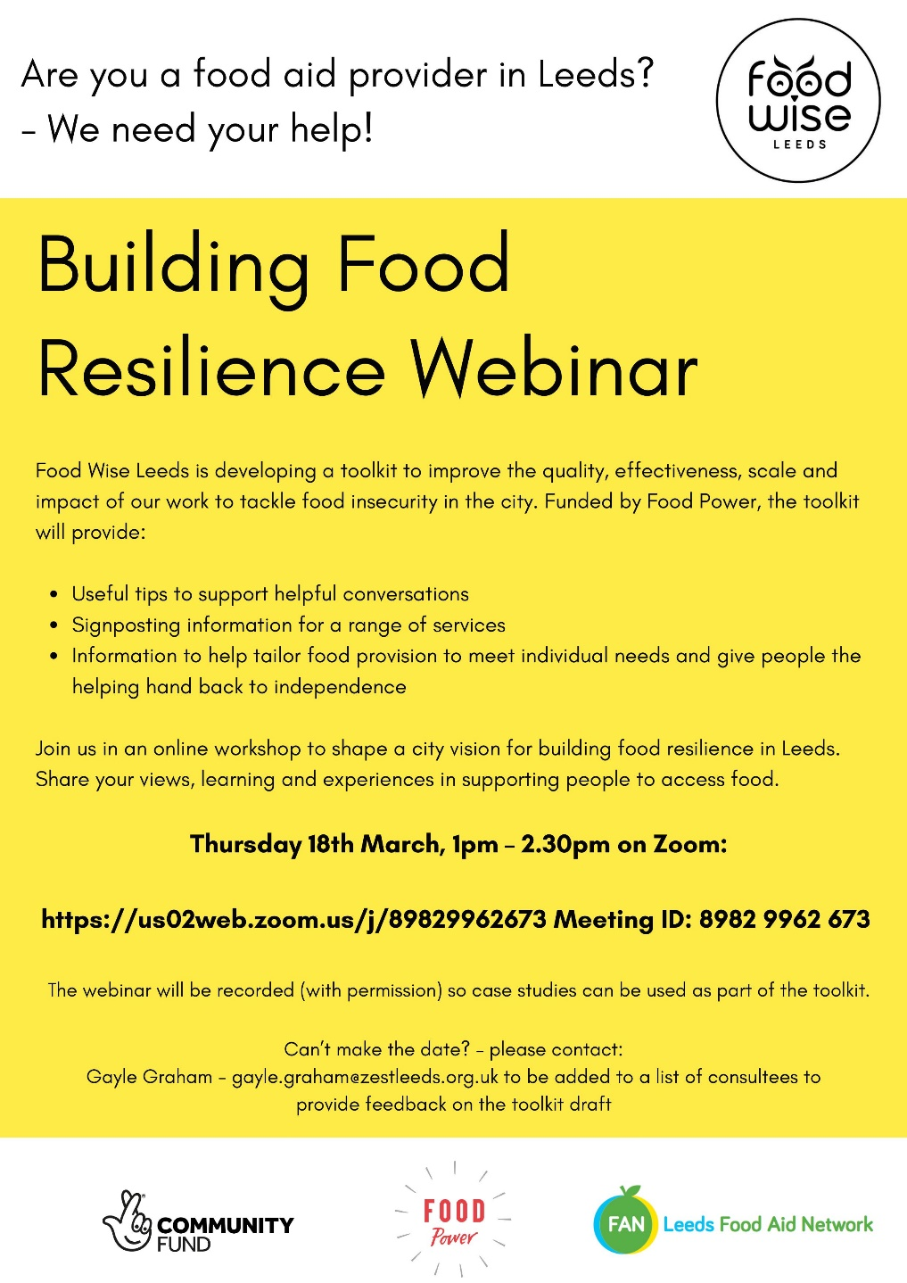
Why Food Resilience?
Excellent emergency provision
Strong partnership working
Ongoing discussions – supply – provision changing – increasing dependence
Toolkit

Slide 3
Principles and practice for resilience, food security and nutrition - FAO
Leadership; multi-stakeholder approach; combining crisis & longer-term approaches; protecting the most vulnerable; ongoing monitoring
Resilience-building is a continuous and long-term effort that addresses the underlying cases of vulnerability while building the capacity of people to better manage risks in the future.
ABCD – Asset Based Community Development
Asset Based; community led; relationship oriented; inclusion focussed; place based
Focus on community assets & strengths rather than problems & needs.
Empowers communities; gives confidence
Food Sovereignty
Explores the idea that we are not just consumers at the end of the food chain, but participants in the food system as a whole
Positive language, inclusive, food justice, empowering

Slide 4
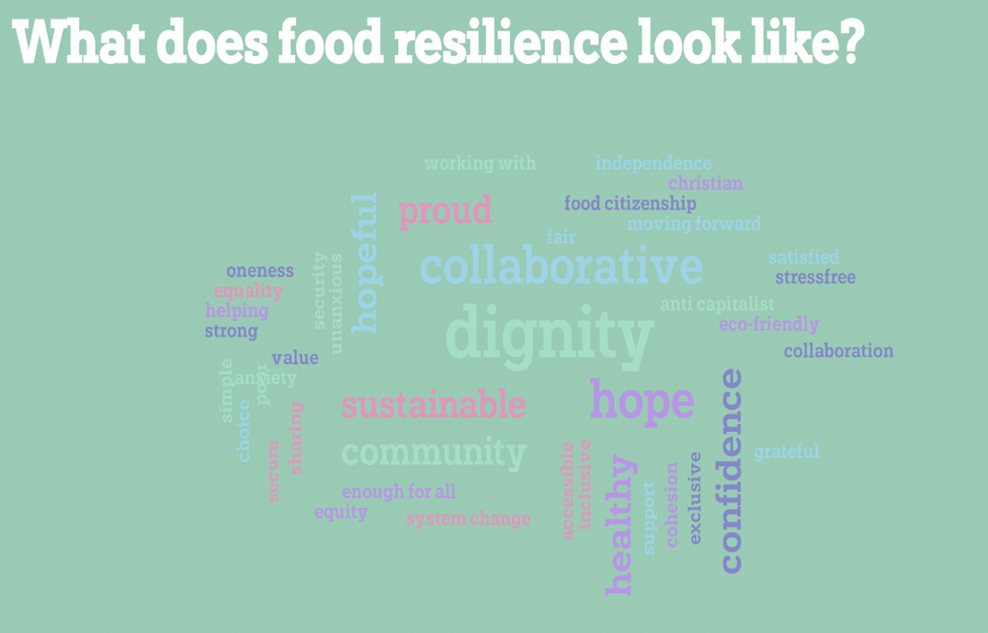
SWOT
Strength
supply, collaboration, versatility, speed
Weakness
signposting, duplication, buying in fresh produce
Opportunities
Improve provision, wrap around support; dig deep into reasons why
Threats
Food supply, exhaustion, free food model

Slide 5
Next Steps
2nd Webinar 21 April
Provide information on food pathways
New models of food aid provision
Determining what support is needed
Survey
Toolkit – online & printed
Monitoring

Slide 6
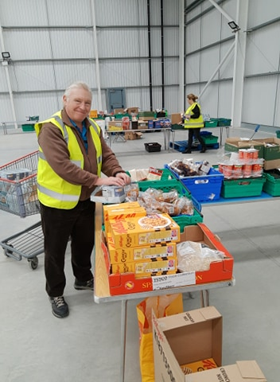
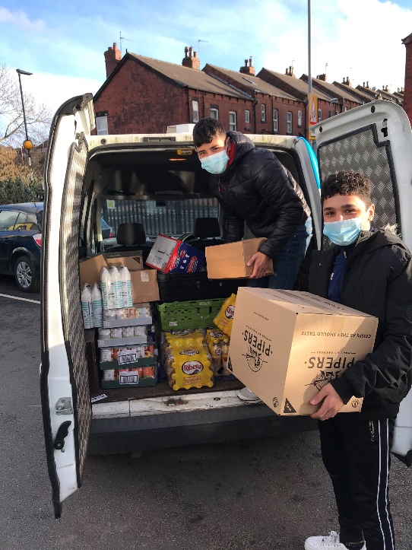
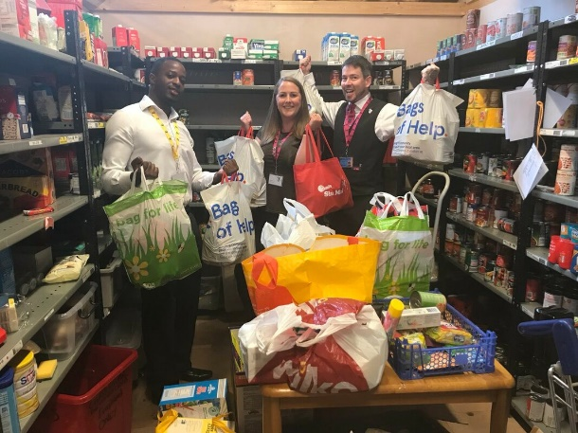
Questions?
Sonja.woodcock@zestleeds.org.uk

