Slide 1
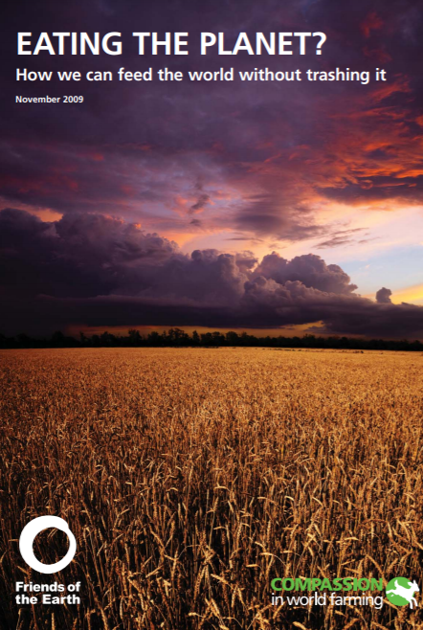
WE CAN EAT MEAT AND SAVE THE PLANET– NEW RESEARCH (2009)
We don’t need to go veggie to feed a booming world population and save the planet from climate change and forest destruction…
‘Eating the planet?’…reveals that we can still enjoy meat several times a week whilst feeding the world using planet-friendly and humane farming methods.
“…a diet equivalent to eating meat three times a week would allow forests to remain untouched, animals to be farmed in free-range conditions and greener farming methods to be used.”

Slide 2
The impact
Eat

Slide 3
The challenge >2x engagement

Slide 4
The taste >3x engagement

Slide 5
Language and framing
Hard facts and guilt don’t (tend to) work – backlash
Focus on what’s gained, not what’s lost
Highlight taste, pleasure, indulgent language (WRI/Better Buying Lab)
Use appealing food images (and have fun)
Wider benefits to environment etc. can reinforce

Slide 7
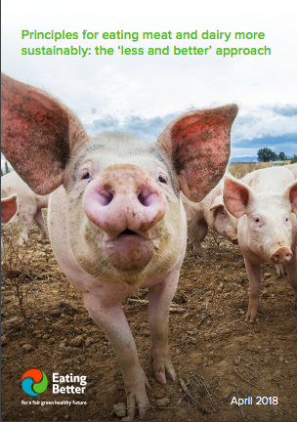
Less and better (of all meat) works:
Positive
Achievable
Holistic
Multiple wins
But language/comms need more work

