Slide 2
The Good Food 2030 Structure
Bristol Good Food Consultees
Bristol Good Food 2030 Steering Group
People with specific knowledge
some of whom were involved in getting the Gold SFP award but are unable to commit to regular meetings
Can be contacted for advice as and when.
Reports to the One City Boards
Comprised of leads from the working groups, Bristol Food Network and the council.
They monitor the partnership work
Working Groups
Based around the themes
The Working Groups formulate and deliver the Action Plan.
Take action for good food
Inspire others to do the same
May get involved temporarily for a specific project
May contribute to a working group for a short period.
Wider Bristol Good Food Movement
Notes:
Need to show how it links to the OCB - incorporate other slide from Heloise The steering group is made of (ideally) the leads from the working groups

Slide 3
Working Groups and Themes
Local Food Economy | Procurement |  | Food Infrastructure
Good Food Governance | Disaster Risk Reduction |  | Food System Data
Eating Better | Food Education & Climate Friendly Diets
Food Fairness | Food Equality Lead by Feeding Bristol
Food Waste | Food Waste Lead by Resource Futures
Urban Growing | Urban Growing

Slide 4
English Local Government
January 2023
www.local.gov.uk

Slide 5
Duties and structures
Councils provides more than 800 public services – with 1,200 legal duties
Children, vulnerable adults, cultural services, highways, transport, housing and the environment
Outside cities, these functions are split:
District/borough councils (housing, planning, licensing)
County councils (adult social care, waste disposal, transport)
In metropolitan areas these functions are delivered by a single authority (unitary)
In City Regions, such as London and Greater Manchester these local delivery functions are supported by sub-national strategic authorities
Greater Manchester Combined Authority
Greater London Authority
At the very small scale there are 9,000 parish councils
English local government
20,000 councillors
Over 2 million employees
~£50 billion annual expenditure

Slide 6
Local government in England
Two tier
County councils 24
District councils 181
Single tier
Unitary authorities 58
Metropolitan districts 36
London boroughs 32
City of London 1
Isles of Scilly 1
Total 333

Slide 7
Local government funding
Local authorities receive funding from a range of sources, including Government grants, council tax and fees and charges.
Council tax and business rates make up local authorities’ largest source of income.
Local government budgets have been under pressure since the financial crisis of 2008.
Councils are facing additional cost pressures of £2.4 billion in 2022/23 since they started to set their budgets in autumn last year.
In 2023/24 there is a funding gap of £3.4 billion which rises to a gap of £4.5 billion in 2024/25 just to maintain services at pre-COVID levels.
Funding through Government grants is fragmented, and councils often have to compete against one another.

Slide 8
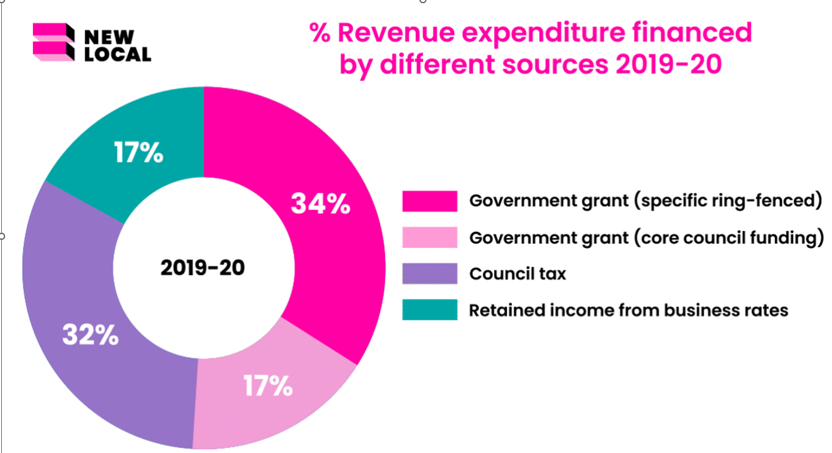

Slide 9
How is £1 of council funding spent?

Slide 10
Council decision making
Four models:
a leader and cabinet
a committee system
executive arrangements with a directly elected mayor
arrangements prescribed by the Secretary of State.
Council constitution sets out:
who is responsible for making decisions and how decisions are made
procedural matters (set out in the ‘standing orders’)
the role of officers
standards and ethical governance.
Notes:
Most councils operate a leader and cabinet model. The full council elects a leader who, in turn, appoints and chairs the cabinet. Each cabinet member has a specific area of responsibility – for example children and young people, housing or finance. The cabinet meets regularly (weekly or fortnightly) so decisions are made quickly. The cabinet may also be called the executive.
In some areas, an executive mayor is elected for a four-year term. The mayor has greater powers than a council leader and may or may not be a member of the majority party on the council. He/she proposes the budget and policy framework and appoints and chairs the cabinet, which can be single or cross-party.
Some councils opt for a committee system. The council establishes a number of committees, each with a specific area of responsibility. The political groups appoint elected members to those committees. More councillors are actively involved in decision-making, but it can take longer to reach decisions.
Increasingly, areas are creating joint decision-making arrangements such as combined authorities or joint leaders’ boards to deal with issues that cross local authority boundaries, such as economic growth and transport.
Whichever system an authority opts for, it must have a full council on which all councillors sit. This is responsible for setting the policy framework, agreeing the budget and spending plans, electing the leader and making constitutional decisions. It is also a forum for debate on major issues affecting the council and its local area. In councils with a directly elected mayor, the budget and framework are proposed by the mayor and can only be amended or overturned by the council with a two-thirds majority.
Councils that do not opt for the committee system must establish overview and scrutiny arrangements through which non-cabinet councillors can scrutinise decisions.
There are some regulatory and quasi-judicial functions over which the cabinet does not have responsibility – such as determining planning applications and making decisions on licensing. These are delegated to separate planning and regulatory committees.

Slide 11
The LGA
National voice of local government
Membership organisation with 435 members, including Welsh local authorities
Activities:
policy advice
public affairs and communications
improvement and development
leadership and support
Priorities:
a sustainable financial future
stronger local economies, thriving local democracy
putting people first
championing climate change and local environments
Different arrangements in Scotland (COSLA), Northern Ireland (NILGA) and Wales (WLGA)

Slide 12
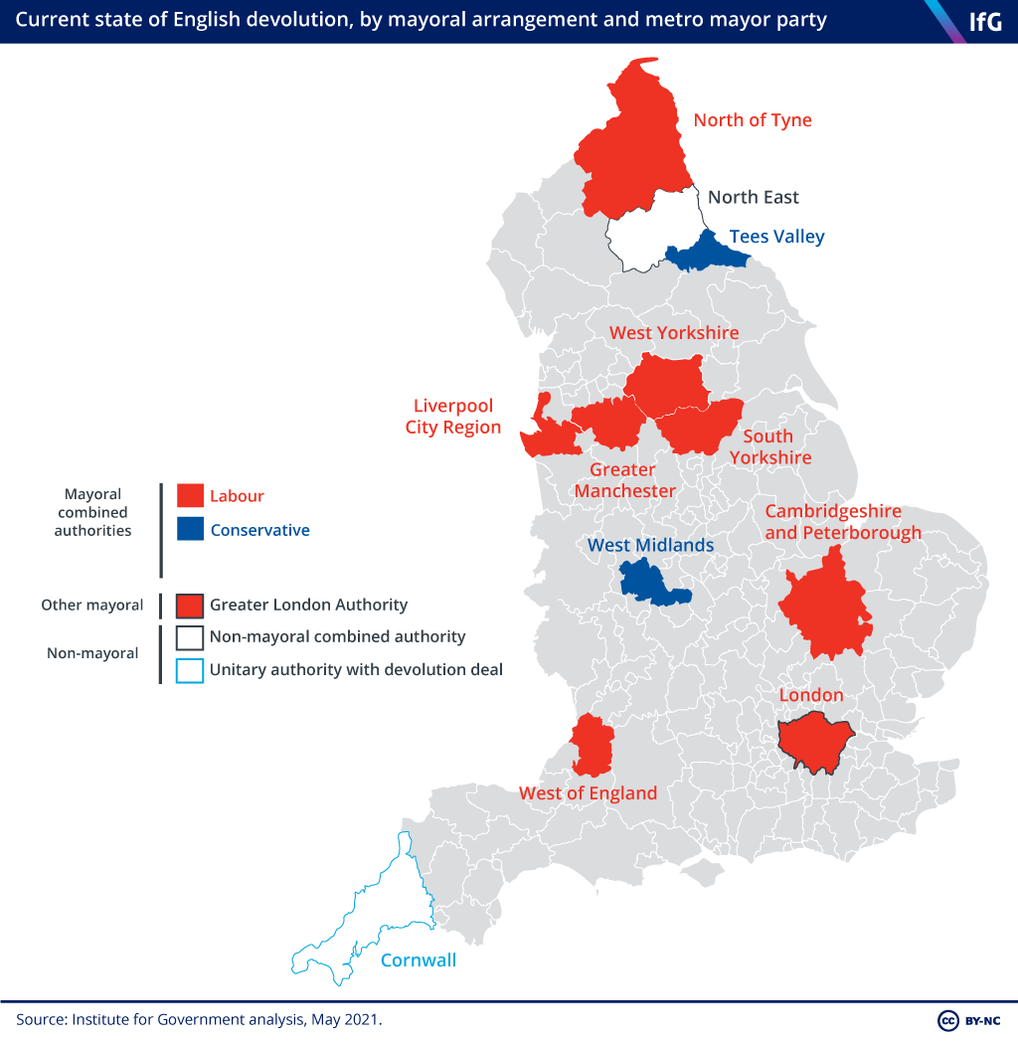
Governance of the UK
UK Government based in Westminster, highly centralised by comparable international standards.
In England there is no national devolution, but a spread of subnational ‘devolution deals.’
The 12 original deals were signed from 2014 onwards.

Slide 13
English devolution: powers
Focus on economic interventions: skills, growth funding, transport, housing
Some elements of public service reform: health, justice, police and crime
The content of devolution deals depends on the willingness of different government departments to devolve
Devolution deals negotiated within context of strong preference for a mayoral combined authority, division of powers at local level between Mayor and Combined Authority
Greater London Authority has powers and functions defined in primary legislation (transport, policing, economic development, fire)
Mayoral combined authorities a more mixed picture of policy co-design, secondary legislation and primary legislation (e.g. Greater Manchester health)

Slide 14
Where next?
Autumn statement better than expected but long-term financial challenges remain
Expected increase in pressure on services
Challenges in recruitment and retention
Need for better joint working on issues such as climate change, social care
Commitment to greater local empowerment across the political spectrum

Slide 15
Find out more
Follow us on Twitter: @LGAComms @LGALocalism
What is local government? | Local Government Association
An introduction to local government | Local Government Association
Join our campaign:
Save local services | Local Government Association
More on devolution: Devolution | Local Government Association
More on climate issues: Climate, environment and waste | Local Government Association

Slide 16
Zak Shinwarie
Health Improvement Project Officer
Medway Council
Zakaullah.Shinwarie@Medway.gov.uk
Foodpartnership@medway.gov.uk

Slide 17
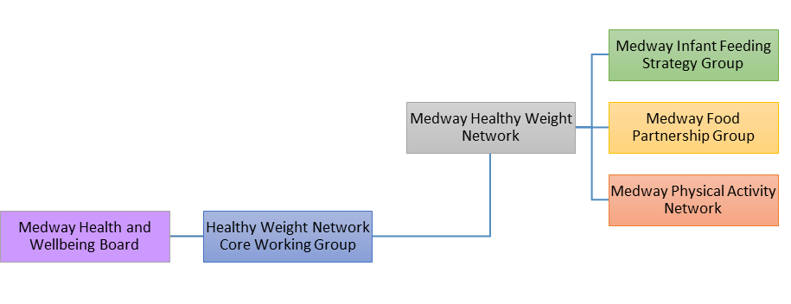
Structure

Slide 18
Medway Food Partnership
There are 5 subgroups within the Medway Food Partnership. Each subgroup works to ensure aims of the partnership are implemented and actioned, each by working through key priorities.
1 POVERTY, FOOD SECURITY AND EMERGENCY FOOD
2 HEALTHY FOOD FOR ALL AND EDUCATION SKILLS
3 CLIMATE CHANGE AND ENVIRONMENT
4
BUSINESS AND ORGANISATION CHANGE
5
ORAL HEALTH
Explore funding opportunities to pay for the food hub in Medway
Develop Local Offer for Surplus food
Update the mapping of food provision and access across Medway
Evaluate the uptake and usage of the culturally diverse Eatwell guidance and supporting information
Explore funding opportunities to support growing projects / allotments / edible trail across Medway
Develop recipes and their cooking methods that reduces energy consumption
Refill - Establish clear communications plan and toolkit with the aim of increasing the number of Medway businesses signed up to the Refill scheme.
Develop resource to explain the link between food and climate change to our residents and partners and develop a list of practical food solutions/pledges to help address climate change
Use the Sustainable Food Places application process as the catalyst for tracking, monitoring and co-ordinating food work into a strategic approach which aligns with Medway’s Climate Change Action Plan
Explore the Every Mouthful Counts toolkit for Local Authorities to identify where big emissions savings can be made through food and to help establish the next set of priorities.
Revise Healthy Vending toolkit and general business toolkit
Increase no of businesses on the Food Partnership
Engaging 30 schools to be part of the WSFP
Implement action plans from OH Strategy paper.
Reducing free sugars in diets of service users by working with stakeholders to implement in the community
Encourage Fluoride application through regular toothbrushing routines by working with partners and social media channels
Working with strategy group to increase dentist access and attendance

Slide 19
Medway Can
Feed 5 for £5
Have a Medway Can PDF cookery book with cost cutting and nutritional meals:
Tips on batch cooking Reduce food wastage Cold weather great for soups Portion size Healthier ways to cook the same foods Price comparisons of micro-meals compared to home cooked
Targeted campaign with messaging aimed at specific workforce using strong network connections.
Food, Fitness and Fun Coming to Pentagon Shopping Centre!
27th of January

Slide 20
Thank you!
Questions?

