Slide 1
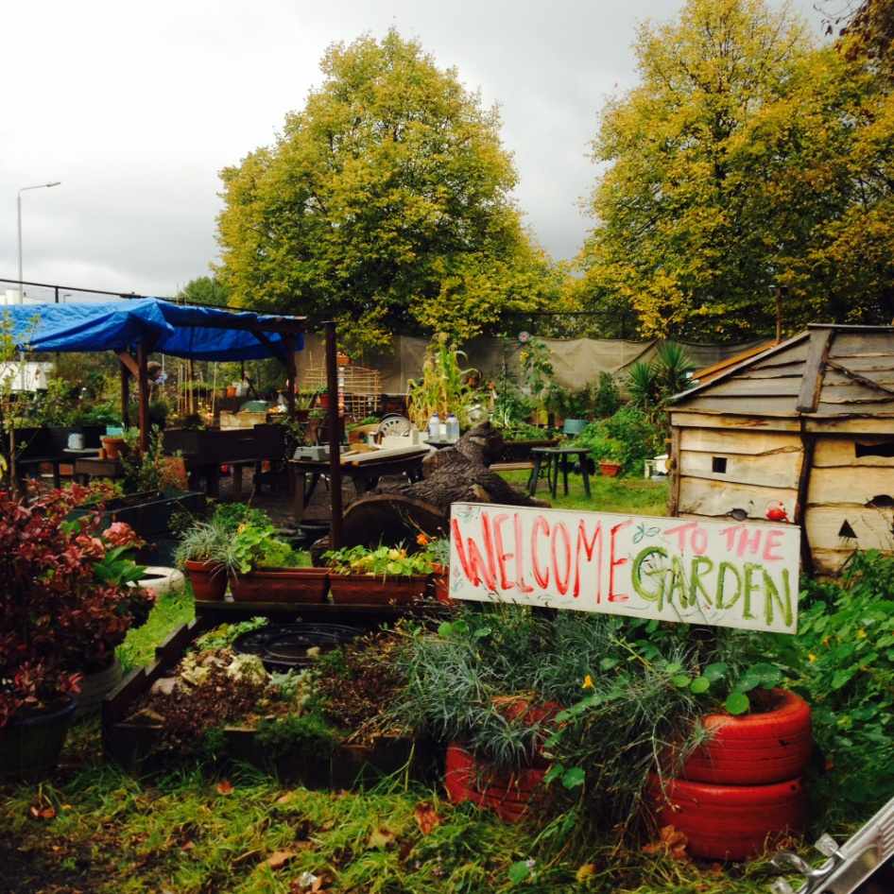
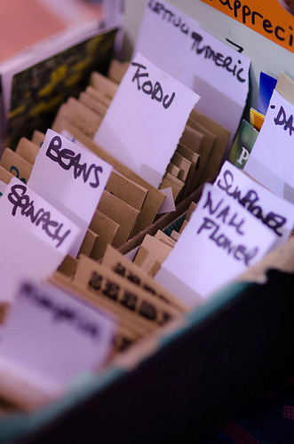
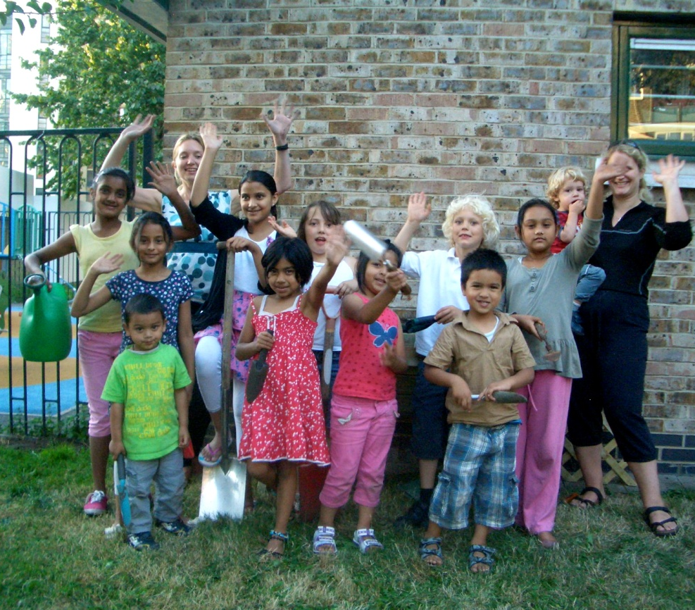
Gardens for Life Tower Hamlets Community Gardens

Slide 2
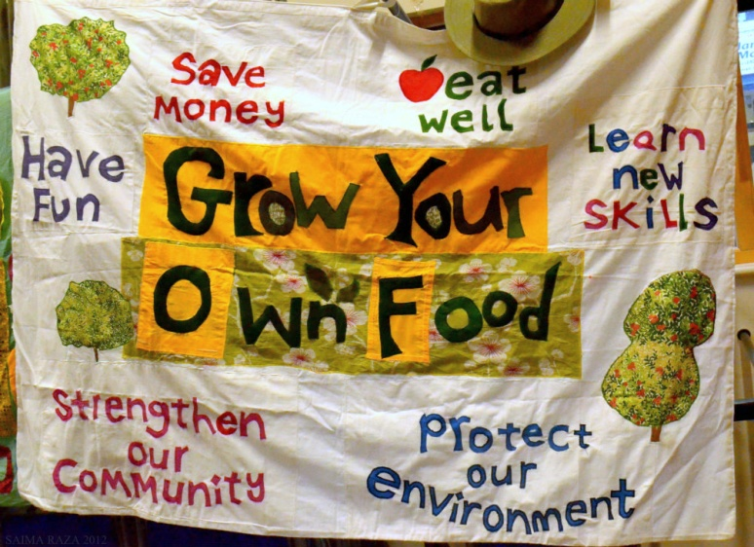
Gardens for Life: Tower Hamlets Community Gardens
Between April 2014 and June 2015:
Set up 15 new community gardens
150 residents actively engaged in food growing
2000 residents engaged in the project across a mixture of ages, genders, ethnicities
40 training sessions delivered/facilitated

Slide 3
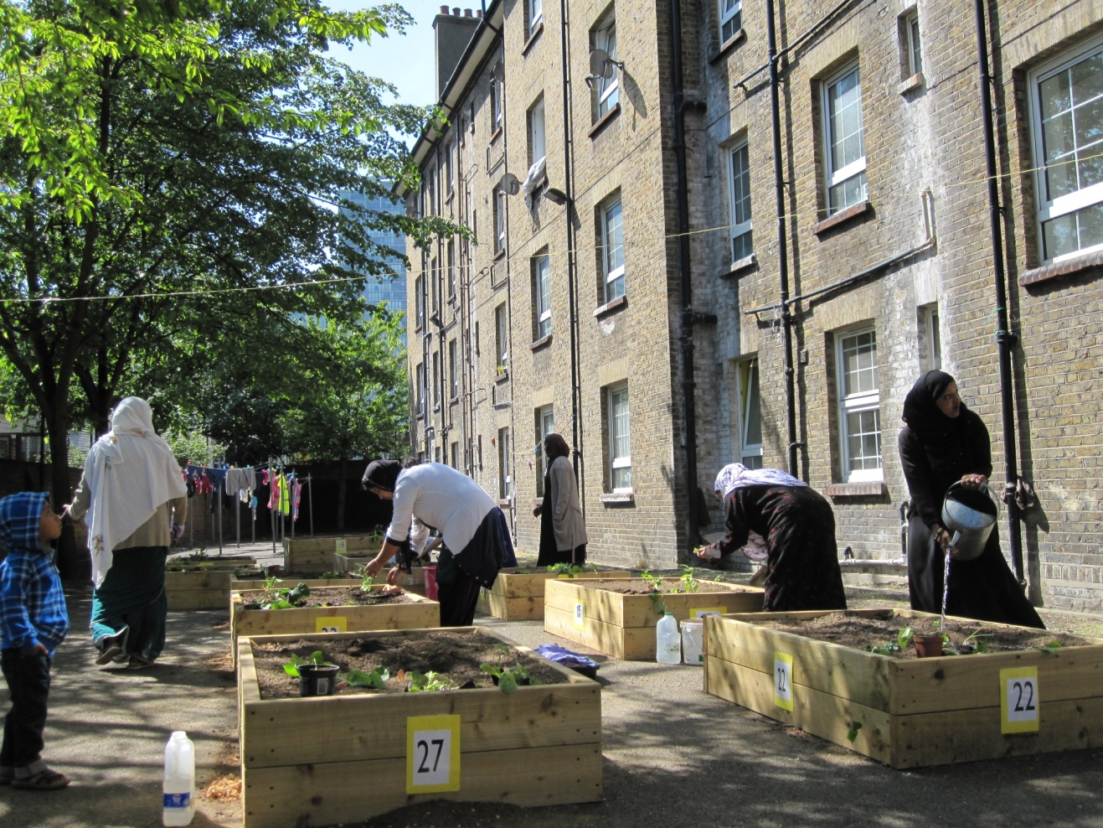
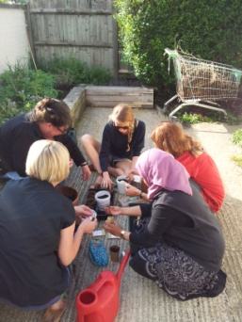
December 2013
15 years in Tower Hamlets supporting food growing
Coordinating the Tower Hamlets Food Growing Network (THFGN)
Made aware of tender by Public Health
Tenders Portal- not all boroughs the same
2 weeks to submit

Slide 4
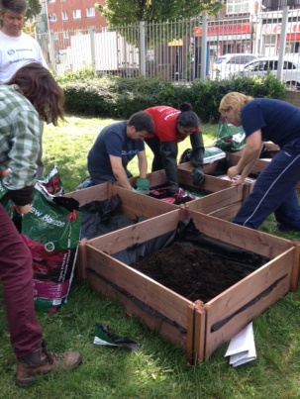
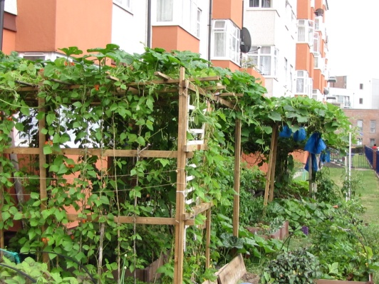
Putting together a successful tender bid
Partnership building- collaboration and competition
Building on strengths
- Locally based- reputation and track record
- THFGN- sustainability

Slide 5
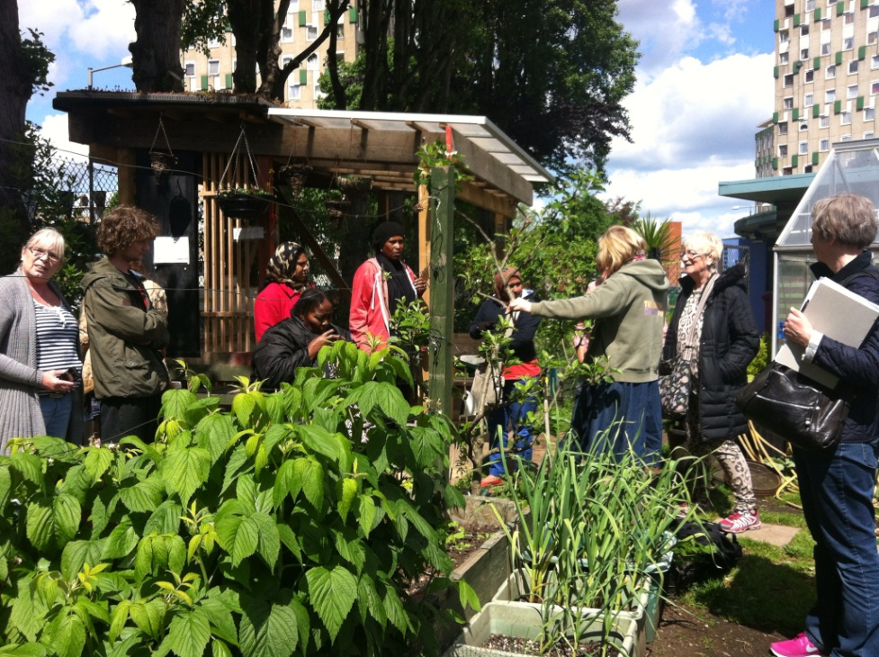
The Process
Submitting the application
- Invited to attend a Briefing Session
- Lengthy and bureaucratic
Passing first stage
- Invited to interview/present
Lack of clarity

Slide 6
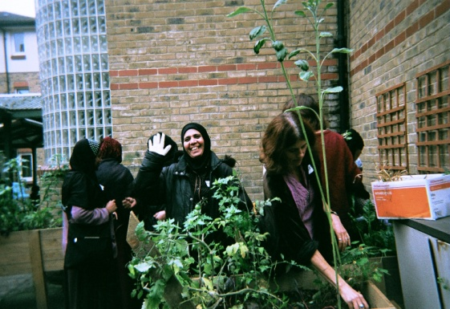
Challenges
Partnership building
Time frame to submit
Policies and procedures
VAT
Pre-defined project
Monitoring and evaluation
Council bureaucracy
Growing season

Slide 7
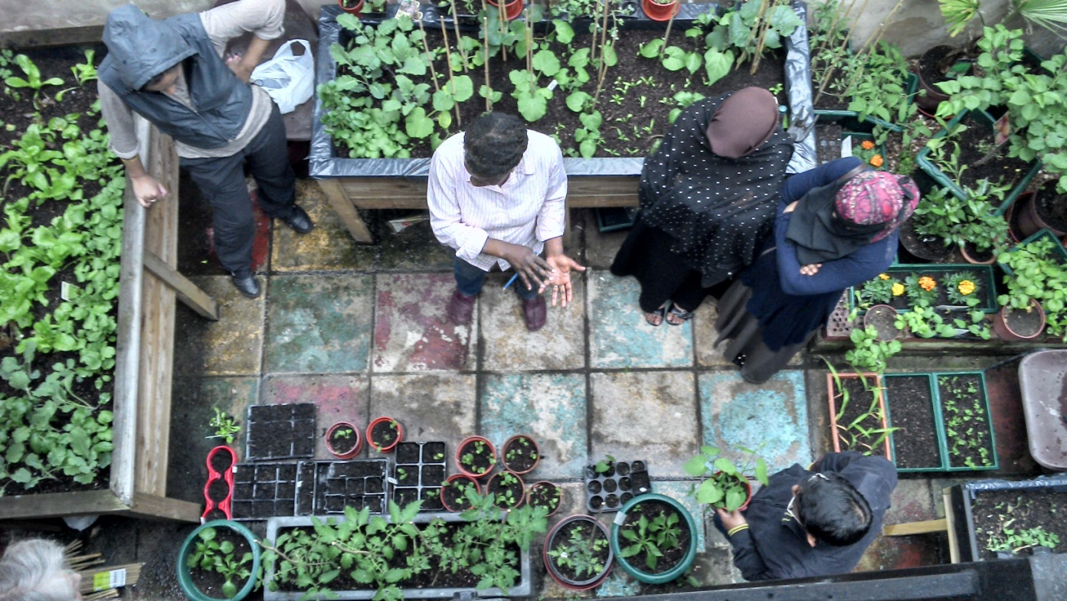
Strategies for success
Steering Group
M&E- wide range of methods
Planning ahead for sustainability

