Slide 1
We can feed 9 billion. If we do things differently

Slide 2
Big ideas for people, communities and local agencies
- what we can do make eating less and better meat possible and fun
Vicki Hird – Land Use, Food & Water Security Programme
Twitter - @vickihird

Slide 3
Key Considerations
The evidence is solid
But depressing and alarming
Make eating less and better the norm
Make it ‘fun’ and ‘easy’ (to shop and cook)
Make it irresistible and an attractive lifestyle or business or governance choice
And affordable.
And Part of a whole diet approach

Slide 4
Part of a whole better diet
Any push needs to be part of a sustainable diet? Ideally it would include the following:
More plants – go flexitarian
If you eat meat and dairy – eat less but better. Meat – red or white, should be a tasty complement to a fresh meal rather than the centre piece.
Waste less food – up to 30 per cent of the food we buy is thrown away.
Eat more fresh food, and reduce processed food
Eat food you can be sure of, such as goods that meet a credible certified standard – like MSC (Marine Stewardship Council certified label) fish or organic.
Notes:
A very useful framework for thinking about balanced food sourcing has been
developed by Growing Communities, in Hackney, London60. This framework
sorts provenance into six ‘Food Zones’ arranged as concentric circles radiating
outwards from the point of consumption

Slide 5
As individuals, at home, in your community

Slide 6
Tips as an individual
Look at Eat Smart – several pages packed with ideas, recipes and tips such as
Make more of your meat. Add grated vegetables, rice, lentils, barley, bran, breadcrumbs, oatmeal or beans to ground meat for a hearty meal.
Bean there, done that - Flageolet, cannellini, haricot, kidney, black-eyed and butter beans make great alternatives to the traditional baked variety.
Hold a recipe swap night – swap flexitarian + plant based recipes
Buy in a co-operative -Set up a food co-op and promote eating less and better meat, and other ideas to members. Use the infographic and materials in the pack to show people some of the issues. Find out how at www.sustainweb.org/foodcoopstoolkit
Notes:
A very useful framework for thinking about balanced food sourcing has been
developed by Growing Communities, in Hackney, London60. This framework
sorts provenance into six ‘Food Zones’ arranged as concentric circles radiating
outwards from the point of consumption

Slide 7
The Food Pledge
By making this pledge, I promise to take the below steps
to make my diet more sustainable for the good of my
health and that of the planet.
I, __________________________________________
Pledge to
•
•
•
•
Signature: ___________________________________
Date: _______________________________________

Slide 8
Communities
Discuss what you would like to do as a group and individually to promote less&better.
What fits your group profile? How could promoting a better diet connect with your existing audience and even a wider set of people?
How can you start encouraging your supporters and wider community to eat better (or go ‘flexitarian’) – and what are the issues you need to consider?
How can you get wider interest in all your work through food related activities?
Notes:
A very useful framework for thinking about balanced food sourcing has been
developed by Growing Communities, in Hackney, London60. This framework
sorts provenance into six ‘Food Zones’ arranged as concentric circles radiating
outwards from the point of consumption

Slide 9
Local promotions
Run a public event with ‘what you like to eat’ as the topic. See if you could encourage local chefs to talk about how they could introduce a flexitarian option. You could distribute the recipes and information included here.
Consider running a Low Carbon Cook-Off. They can be huge fun as well as informative.
Involve local farm shops and see if they will promote the infographic in their shop and give out the flexitarian recipes to customers. Would they chat to their customers about low meat recipes? Would they do the Pledge?
Use www.bigbarn.co.uk
Notes:
A very useful framework for thinking about balanced food sourcing has been
developed by Growing Communities, in Hackney, London60. This framework
sorts provenance into six ‘Food Zones’ arranged as concentric circles radiating
outwards from the point of consumption

Slide 10
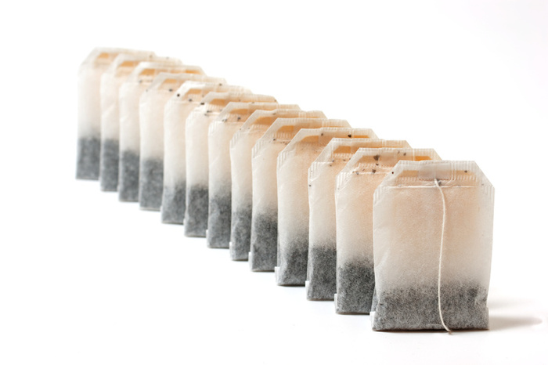
USE FUN FACTS and RECIPES
Replacing 800g chicken with 250g chicken + 240g of tinned chickpeas saves greenhouse gas (GHG) emissions
equal to making more than 580 cups of tea!!!!

Slide 11
Influence local businesses
Write to local stakeholders
Businesses, schools and hospitals need to hear that people care about sustainable diets
Having a meat-free or low-meat day, week or month would be a good way to promote the idea and show how easy it can be. You could ask local institutions to run one.
There is a letter in Eat Smart which you can adapt and send to local media and stakeholders.
Notes:
A very useful framework for thinking about balanced food sourcing has been
developed by Growing Communities, in Hackney, London60. This framework
sorts provenance into six ‘Food Zones’ arranged as concentric circles radiating
outwards from the point of consumption

Slide 12
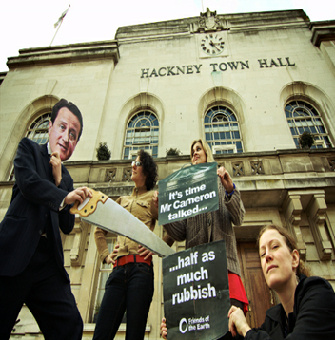
Campaigning and lobbying
write to your local newspaper about sustainable and flexitarian diets.
If you hold a meeting or event (like a Low Carbon Cook-Off) do invite your MP or other influential folk like councillors and canteen managers.
Design a pledge card and ask businesses and others to sign up
Get businesses interested –
Sodexo – the world’s leading food service company introduced Meatless Monday throughout its operations - 71% of sites said the campaign had made vegetarian options more appealing
Notes:
A very useful framework for thinking about balanced food sourcing has been
developed by Growing Communities, in Hackney, London60. This framework
sorts provenance into six ‘Food Zones’ arranged as concentric circles radiating
outwards from the point of consumption

Slide 13
Run a low carbon cook off
What is it?
a public event mimicking Ready Steady Cook:
two (or even more) teams cook a meal in a set time limit and the audience taste each dish and vote for a winner.
It’s used as a fun and engaging tool to talk about the environmental impact of what we eat –
You can discuss what are high/low carbon ingredients and tips to lower the impact of your favourite recipes.
Notes:
A very useful framework for thinking about balanced food sourcing has been
developed by Growing Communities, in Hackney, London60. This framework
sorts provenance into six ‘Food Zones’ arranged as concentric circles radiating
outwards from the point of consumption

Slide 15
Ideas for partnership work
Have a flexi day where eating less and better meat is celebrated – be the first Flexitarian City – and announce it. Ghent have done a meat Free Monday; Lancaster City Council proposals; in 29 countries around the world have Meat Free Mondays. Part Time Carnivore for students.
Get an official acknowledgement (in local strategy, plans etc) that this is a key issue and that they have some responsibility – as the Oxford Foodprint report did. And what they could gain (for reduced local GHG, reduced obesity levels)
Develop - with the council or local food partnership -a set of Sustainable diet principles which acts as a baseline for their procurement and includes reference to the ‘hard’ elements like meat and fish
Notes:
A very useful framework for thinking about balanced food sourcing has been
developed by Growing Communities, in Hackney, London60. This framework
sorts provenance into six ‘Food Zones’ arranged as concentric circles radiating
outwards from the point of consumption

Slide 16
A mapping of city consumption – knowing how much needs to change and in what areas, communities, income groups ? so can start to assess the level of changes needed to work towards a more sustainable diet. That should include farming in periurban region and of local food initiatives and whether they actively promote a Sustainable diet.
Initiatives for local businesses – eg an event (or display, website) to introduce the Flexitarian concept to local shops, restaurants and what they can do to encourage more SD – eg talks about recipes, laminated cards, slide show, targeted education initiatives maybe.
Identify local champions – who can help promote.
Procurement FFL catering - Work towards a definite commitment to gold in as many catering establishments as possible (as Gold includes eating less meat) standard FFL catering
Tackling food waste – worst thing to waste is meat so encouraging less..

Slide 17
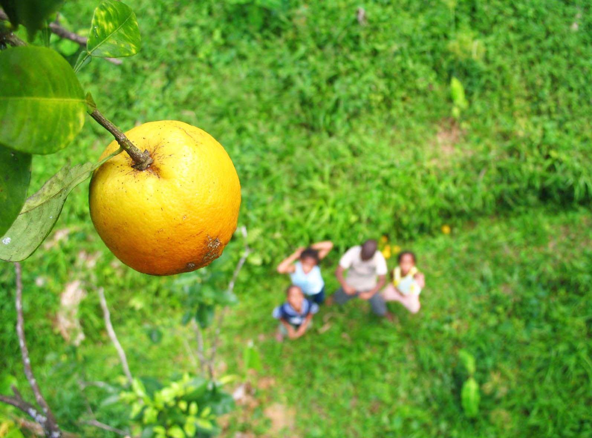
Get eating for the planet

Slide 18
4 hospital initiative
US Johns Hopkins School of Public Health ran a project in 4 hospitals to improve nutrition and benefitting the environment
Reduced meat purchasing by 20% within 12 months following introduction of a ‘Balanced Menu’, the pilot hospitals
reduced purchasing by an average of 28%, saving $400,000 on meat purchases in a year. Major GHG savings.
http://www.jhsph.edu/research/centers-and-institutes/johns-hopkins-center-for-a-livable-future/research/clf_publications/pub_rep_desc/balanced_menu.html

Slide 19
Enter Get Gobby & Get Gobby Local
http://www.foe.co.uk/page/get-gobby-2014
any student or group can apply – win £500/£750!!

Slide 20
Thanks for listening and do get involved
We have local groups, a forum (hub) and lots of actions to get involved with.
@vickihird

