Slide 2
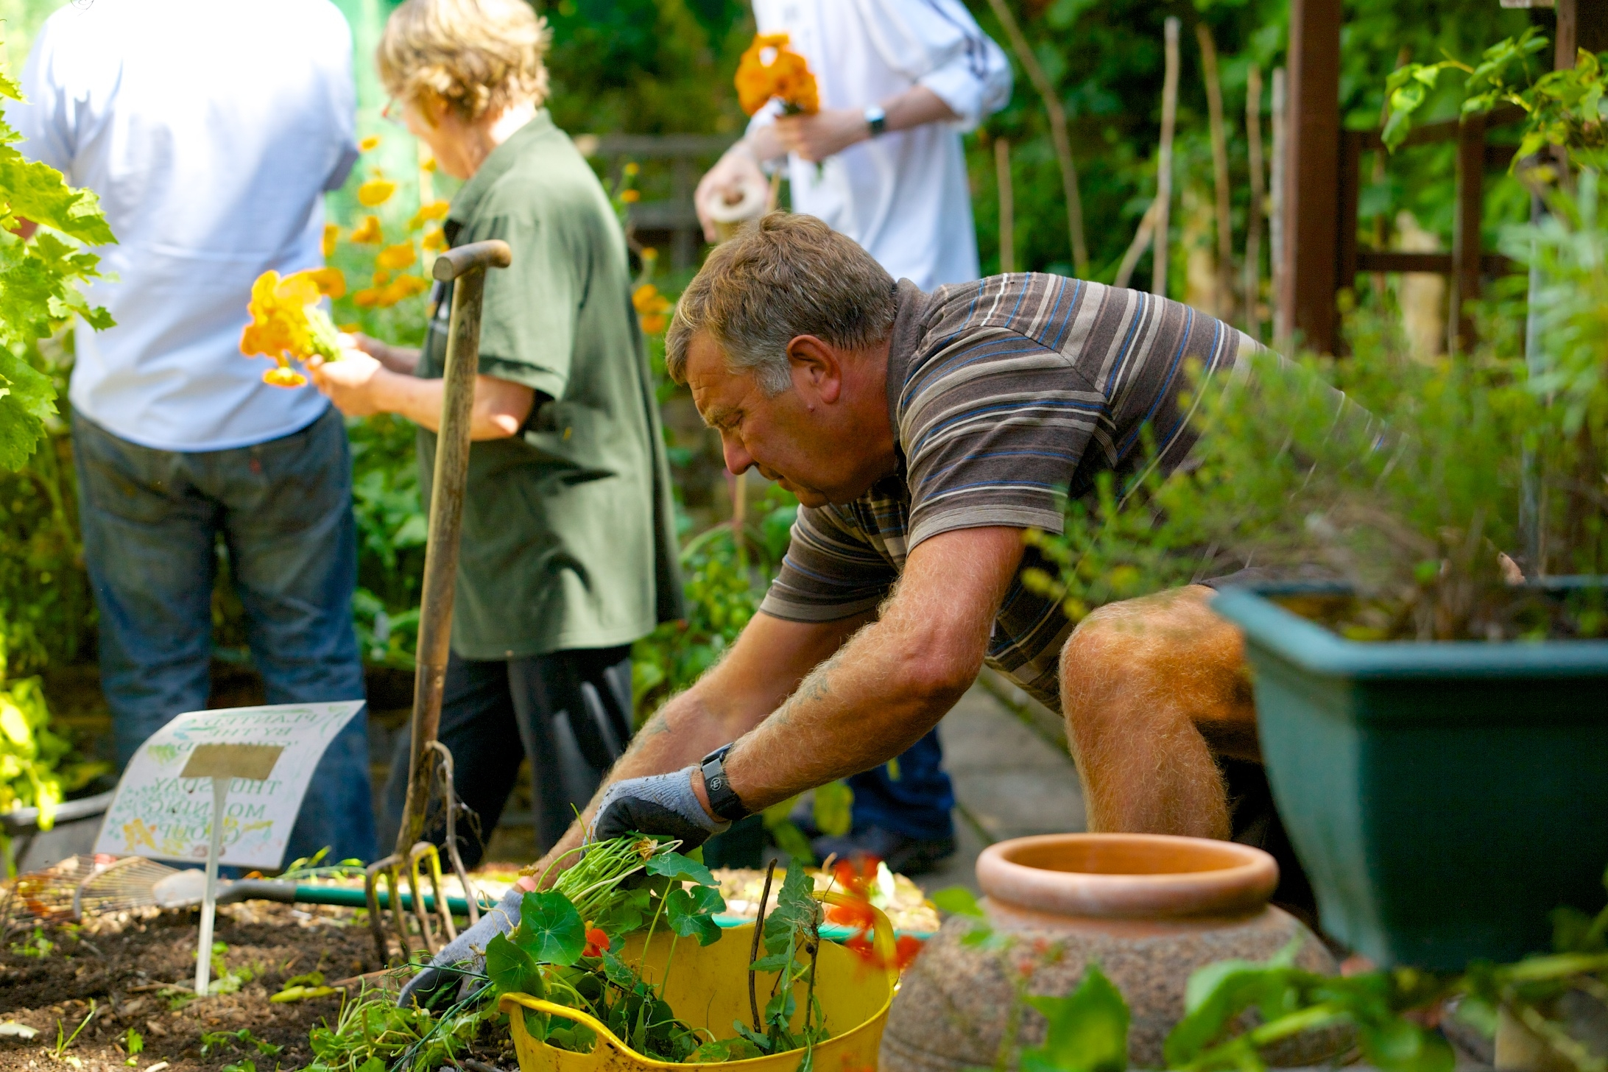

Slide 3
Projects:
1
1a
2
3
4
Garden (AMH (Adult Mental Health) commissioned service)
Garden (PTSD Stabilisation for Tamil asylum seekers (SLaM funded))
Sow & Grow (Dementia commissioned service)
Art & Craft (AMH service)
Growing Lives (Work and qualification based AMH service)
Supplementary weekly activities include: Tai Chi/Mindfullness, Counselling, Craft Workshops, Community lunches and Choir.

Slide 4
Garden
Outcomes measured for 48 participants per 12 months:
1
Improved Mental Health
2
Improved Social Inclusion
3
Improved Independence
I had become completely shut off from friends, I found it very hard to trust and have patience. You have provided me with a grounded, non-judgemental, safe place. You have allowed me to get to know people again and spend time with people. You have restored my faith in humanity.

Slide 5
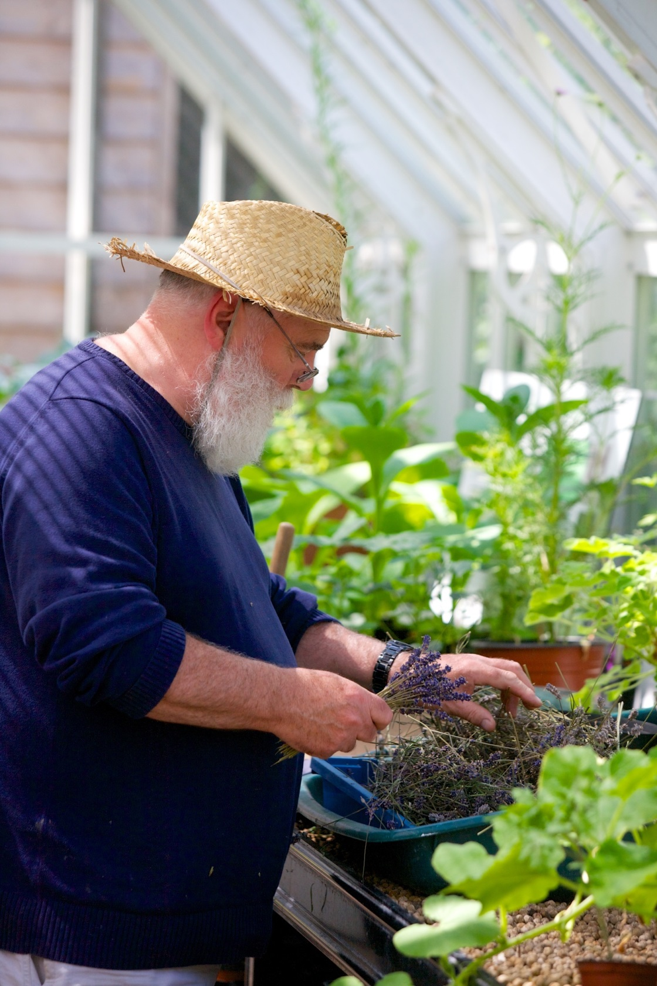
Sow & Grow
Outcomes measured for 24 participants per 6 months:
1
Improved or maintained cognitive function
2
Improved ability to undergo physical activity
3
Improved Independence
4
Improvements in wellbeing
The staff and volunteers in my group could understand me: They were giving me time to think, which was very important. I was in an environment where people could understand my dementia problems. When I first came I was not able to remember a lot of stuff but now I see that I can remember names of people that I don’t know for too long. I also believe that I can think clearly now.

Slide 6
Considerations:
1: National/Local strategy vs aims and objectives
2: Relational, yet transient
3: Reactive

Slide 7
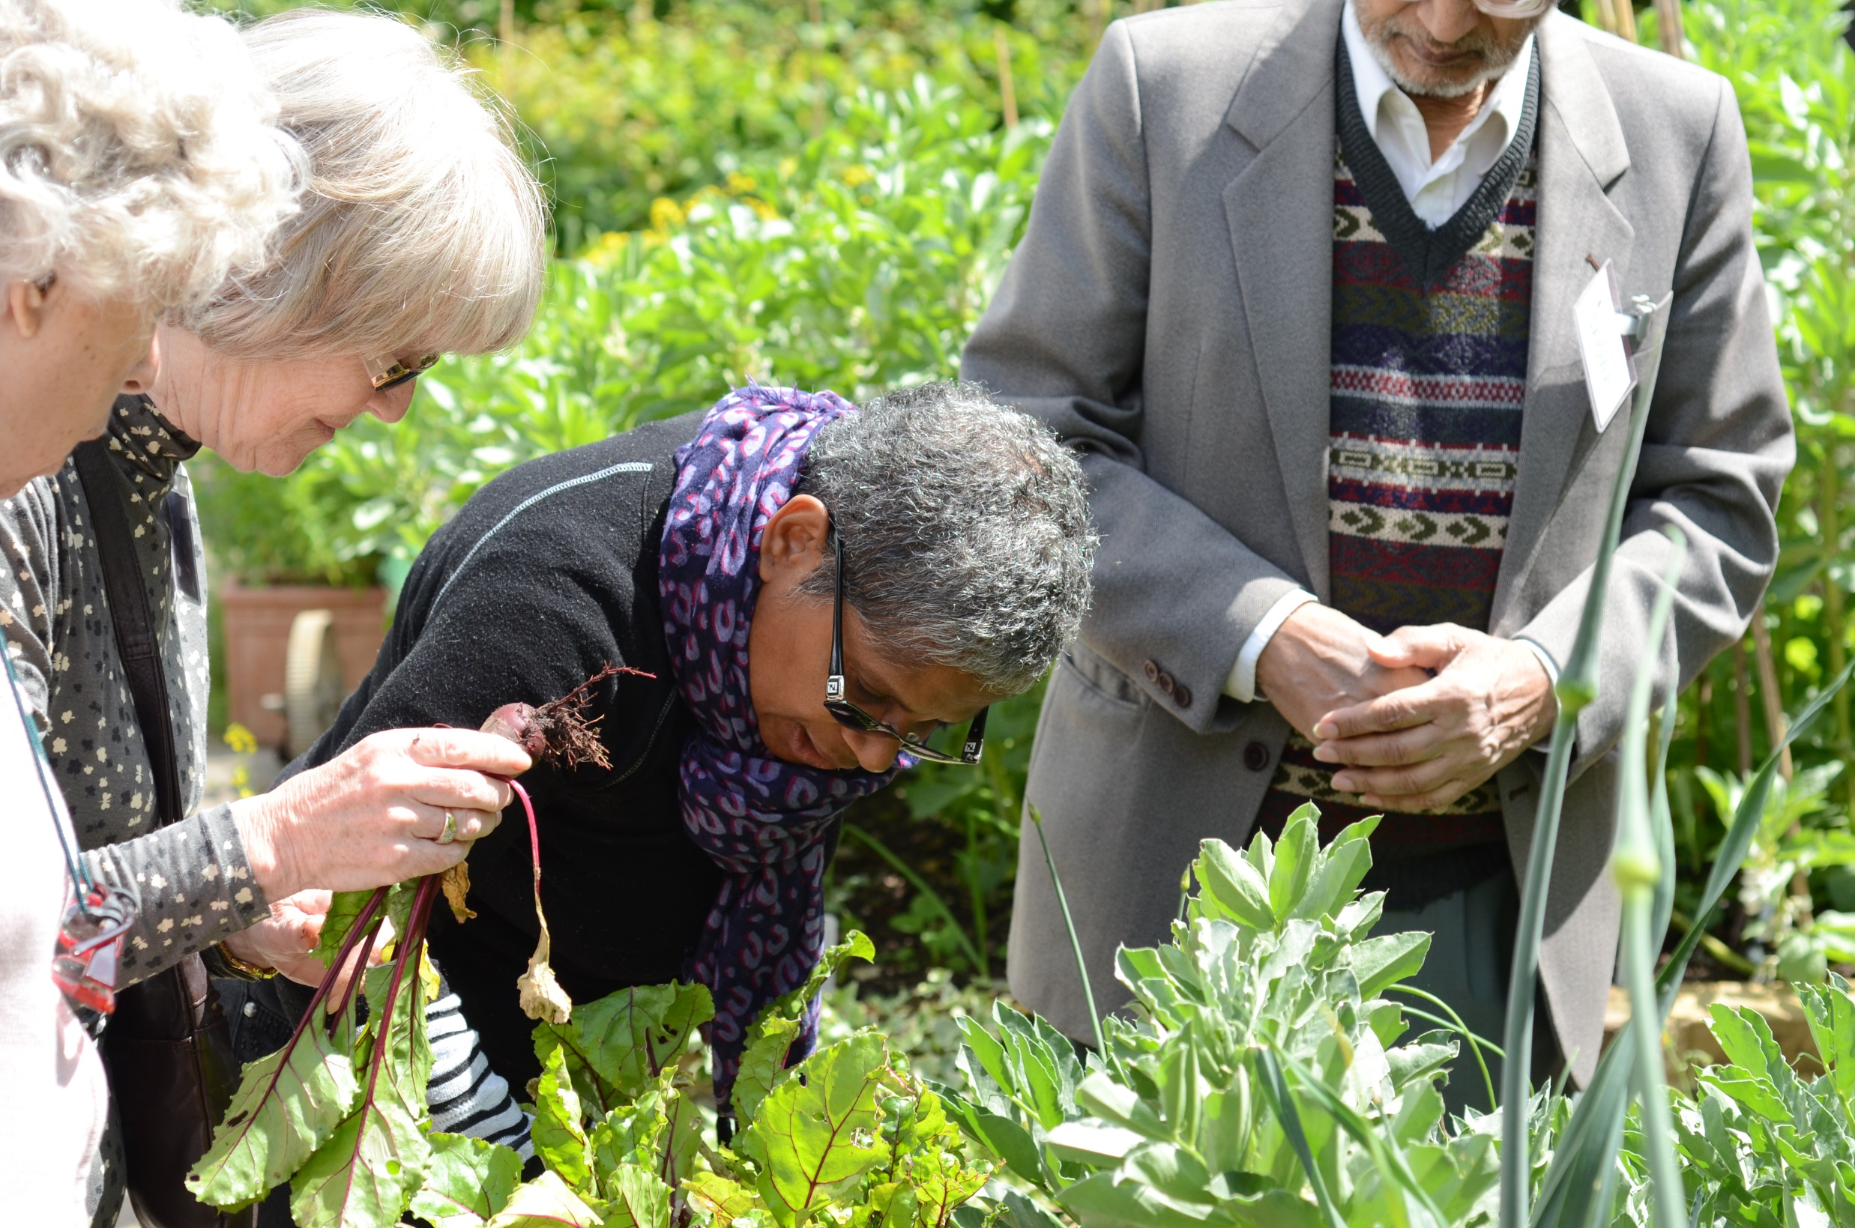
Vision

