Slide 1

Sugar Smart Devon Ambassador Programmes
Dr Clare Pettinger (#SugarSmartPlymouth campaign Manager; Food Plymouth)

Slide 2

Outline
Why we decided to take this approach?
Overview of training
Success of programme(s) ?
Resources for ambassadors
Support for ambassadors
Challenges

Slide 3
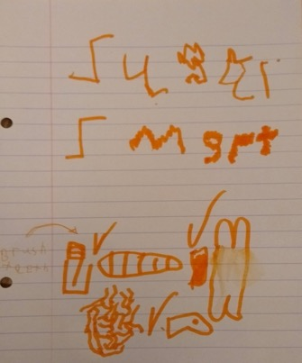
Why we decided to take this approach?
‘Bottom-up’ /community engagement approaches (co-production) = more likely to succeed
Facilitating local ‘train the trainer’ style Sugar Smart ambassador programme seemed best approach to:
  Spread Sugar Smart word (in line with local campaign aims)
  Maintain consistent Sugar Smart messaging (evidence based)
  Align priorities for regional food networks
  Enable standardisation of evaluation framework
To cascade messages to as many individuals and communities as possible
Notes:
REMINDER – Sugar Smart messaging
We want Plymouth and Exeter to become Sugar Smart Cities and create food environments which encourages healthy choices and reduces the promotion of foods high in free sugars (and roll out to Devon…)
Too much ‘free’ sugar is a major health concern and children currently consume triple the recommended amount.
Small changes to the way that food is provided, presented and advertised can make a big difference to consumer health and behaviour.
Consumers are aware of healthy eating messages and there is increasing media attention.
Consumers want to change their behaviour to improve their diet, but need the environment to support them to do so. We need to make healthy food and drink more accessible and affordable.

Slide 4
Sugar Smart Ambassador Role
‘Social movement’ to create healthier food environments
Actions to be taken are up to ambassadors themselves – use initiative and follow relevant interests
Any activity to promote Sugar Smart is useful, including running stalls, events, activities within your organisations/workplaces.
Meeting local campaign targets
(Actions made under the Sugar Smart branding must be in line with core campaign principles)
Notes:
Core principles and values
Actions made - under SugarSmart branding
Voluntary positions
Commitment – it is up to you
Consent (sign in sheet)

Slide 5

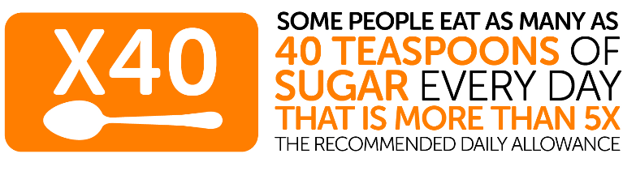
Overview of training
Working together to create a (standardised) Trainer Facilitator Handbook/toolkit
Agree on content (but consider need to tailor according to area/local campaign/specific setting needs)
Covering key concepts and insights
  Sugar and Health (obesity; oral health; glycaemic load; current intakes; recommended intakes); sugar ‘hot spots’ (in specific setting); tips for cutting down sugar; local campaign targets; communicating messages; ambassador roles; possible activities
Interactive – sharing knowledge – experts by experience – co-production
Notes:
Sugar hot spots
Sugary drinks (canteens, vending, outside food retail)…?
Confectionary ( canteens, vending, outside food retail)
Price promotions – are any of the above on ‘promotion’
Sugar in coffee and tea?
Cakes and biscuits being brought in for celebrations
Other….

Slide 6
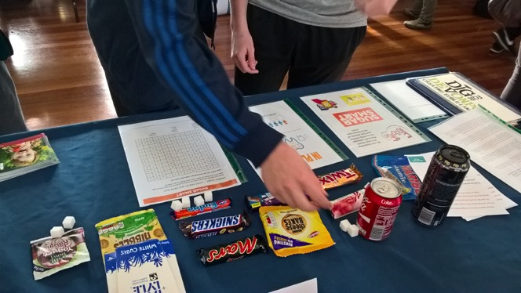
Example Activity (15mins)
– communicating messages
Get into pairs/small groups (3-4 people)
Think about your identified ‘#SugarHotSpots’ and the messaging for SugarSmart
Think about your own workplace – how can you support your workplace to become more #SugarSmart
What messages/principles would you highlight?
How would you communicate these?
Come up with good (and bad) examples
Use your local knowledge and ideas

Slide 7
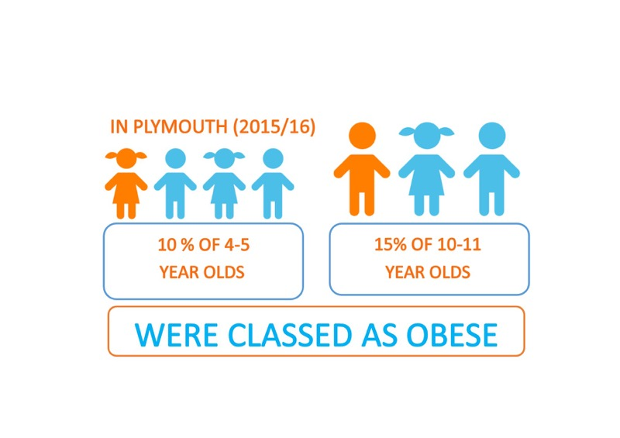
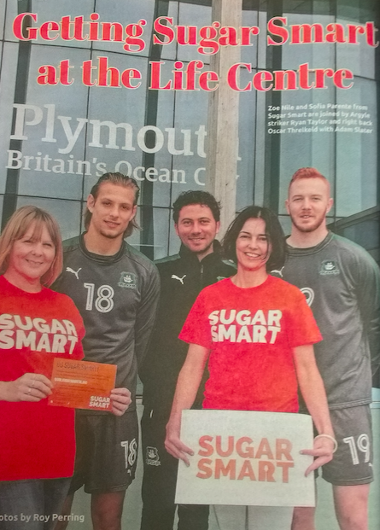
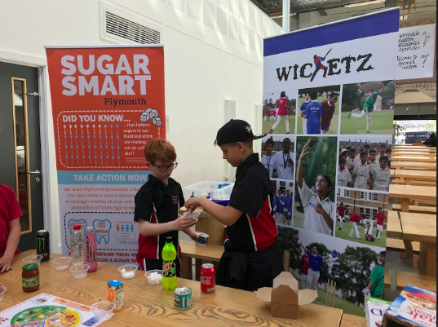
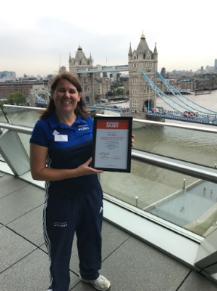
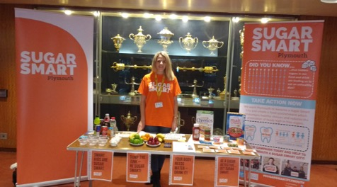

Local Context - Plymouth
Notes:
Using Food Plymouth CIC as a central connecting platform, we will facilitate a local ‘train the trainer’ style Sugar Smart ambassador programme that will involve four primary cross-sector partners with support from secondary partners from the Food Plymouth Network
Sugar smart plymouth aims to
Raise awareness and increase understanding amongst Plymouth communities and organisations about the detrimental effects of excess sugar
Support and encourage local organisations (your workplaces) to create a more ‘Sugar Smart’ mind-set and food environment and sign a pledge of commitment (see example pledge forms)
Strengthen local cross-partner alliances. By aligning with and building on already existing local networks and strategies, this campaign will provide consolidation and aide longevity for future campaigns.

Slide 8




Slide 9


Success in Plymouth
During actual campaign (Sept 2017-Aug 2018)
Nov 2017: Students (Setting – Universities) n=13
Jan 2018: Communities (setting - Argyle football club) n=16
May 2018: Workplaces (setting – workplaces) n=10
July 2018: School Catering Managers (CaterEd) n=14
53 ambassadors trained
Into future – ambassador activities continue
Ongoing project work (Thrive Plymouth 4-4-54); student activities (eg Foodie Fresher); community projects (e.g. Wicketz); Health Improvement work; School meals (CaterEd); Holiday hunger projects; Food Plymouth events (eg AllWays Apples); workplace wellbeing champions training
20/3/19 – ambassador training (open access)
Notes:
ACTUAL AMBASSADOR ACTIVITIES OF NOTE – PLYMOUTH YOUTH COUNCIL; SCHOOL MEALS SERVICE (REFORMULATION); FOODIE FRESHER EVENTS; WICKETZ – national delivery Lord Taverners
Help with future Sugar Smart Ambassador training
Running Sugar Smart stalls at events
Social media activity
Plymouth based materials (quiz)
Events (e.g. youth council)
Derriford?
Schools….OTHER

Slide 10


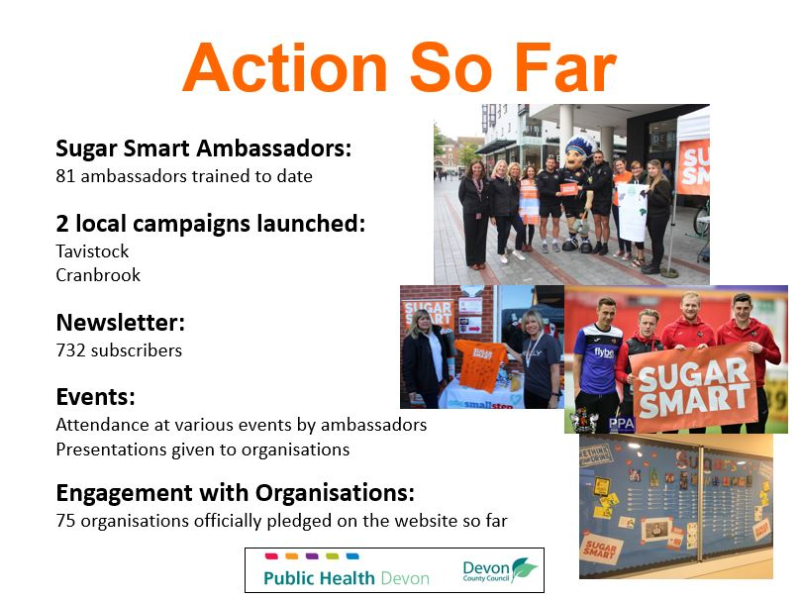

Slide 11
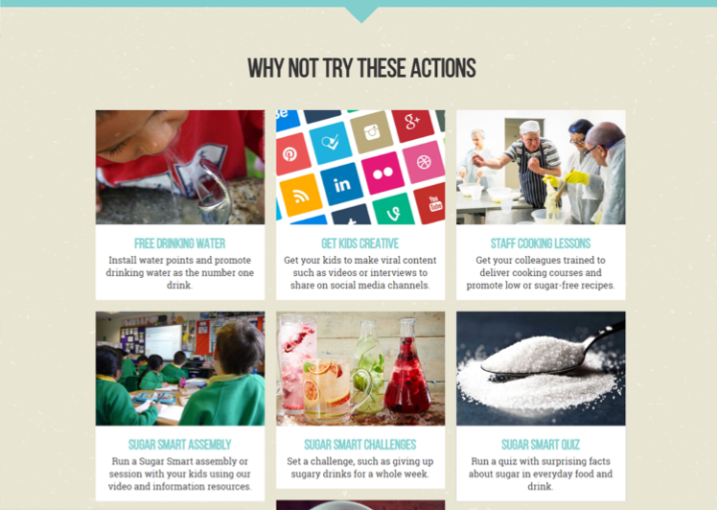
Resources for ambassadors
Sugar Smart UK Website
Dashboard (to support organisations pledges)
Resources and assets available to download from website
https://www.sugarsmartuk.org/about/
Local (bespoke) resources
Support from local SugarSmart Team
e.g. in Plymouth:
  Clare Pettinger (Manager)
  Zoe Nile (coordinator)
  Steering group
  Ambassador network (facebook group)

Slide 12
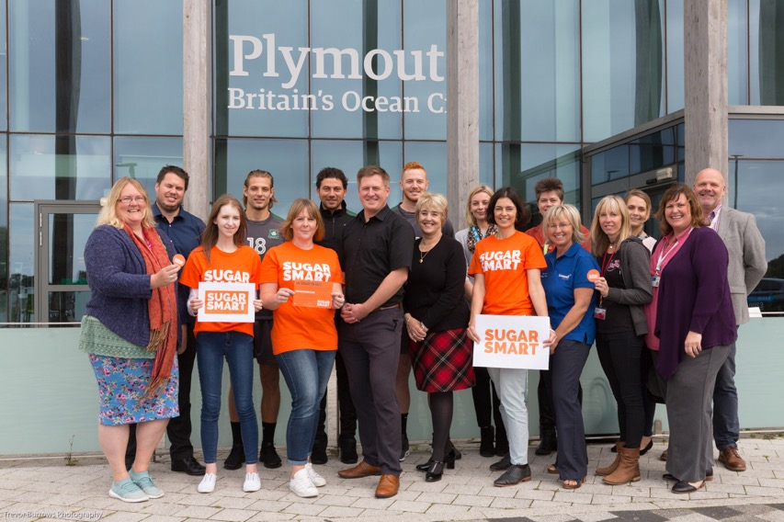
Sugar smart ambassador network
Important to share knowledge/info/events/ideas
Virtual network
  Facebook closed group
  (Devon SS ambassadors)
Other options considered:
  WhatsApp
  Face to face
  Email list? (GDPR!)

Slide 13

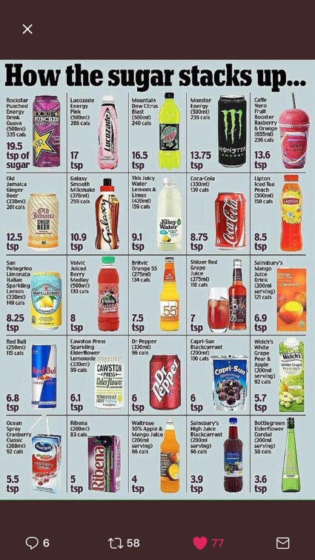
Challenges
Time (busy working schedules and shifts)
Varied expertise/background
Uncertainty of precise role and how to go about it
Lack of confidence (need to signpost when necessary)
Conflicting sugar and health information (media)
Sugar messages being confused - perception
  “Sugar police”…?
  Individual behaviour change focus
  Confusion with other campaigns
Limited resources

Slide 14

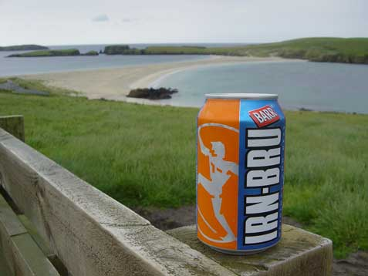
Questions?

