Slide 1
Eating Better: for a fair, green, healthy future
Sue Dibb
Sustainable Food Cities webinar
20 October 2014

Slide 2
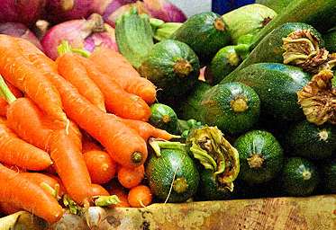
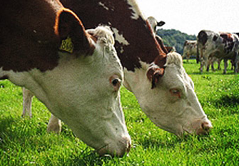
Eating Better: for a fair, green, healthy future
Eating Better is a new alliance to demonstrate that shifting diets to more plant-based eating with ‘less and better’ meat is:
Better for health
Better for environment and resource use
Better for animal welfare
Better for feeding the world fairly
Better for sustainable livelihoods and provides business opportunities

Slide 3
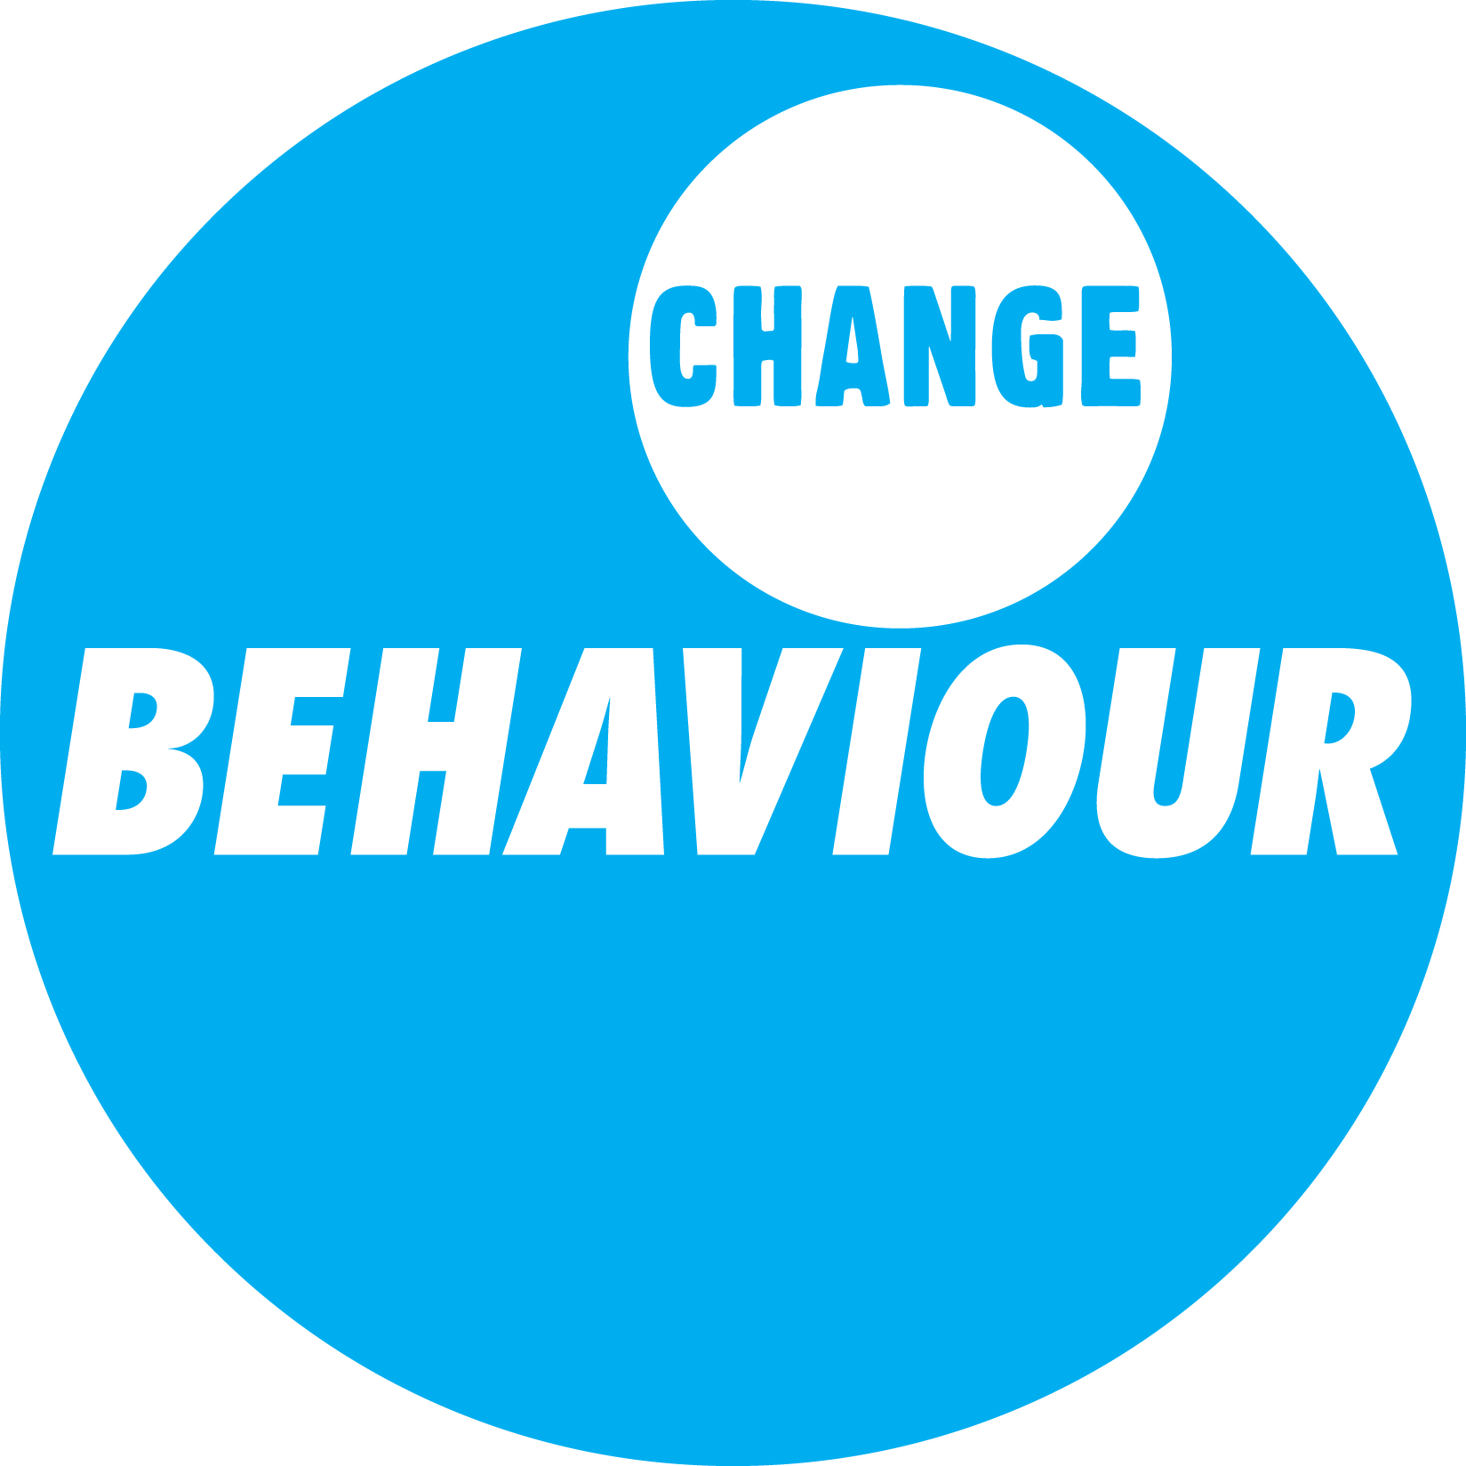
43 supporting organisations and partner networks

Slide 4
Why we have come together?
Raise awareness of why we need to talk about a shift to more plant-based eating and less and better meat as part of healthy sustainable diets
Build support to demonstrate to policy makers, businesses and others who can make a difference that the time is right to incorporate Eating Better’s approach into policies and practices.
Stimulating long-term cultural shifts in eating patterns. How do we make ‘eating more plants & less and better meat’ the norm?

Slide 5
What we mean by ‘less and better’
Less (for high meat consuming countries/individuals) of all meat – red, white or processed
Better: eg
Known provenance, ‘local’/British, quality, taste, naturally/grass-fed, produced to higher animal welfare and environmental standards, less waste/nose-to-tail eating.

Slide 6
Why sustainable diets?
To feed the world healthily, fairly and within environmental limits now and in the future.

Slide 7
Five simple rules can make a difference to our health and the planet
1) Eat more plants - enjoy fruit and veg 2) Waste less food - 33% of food planted worldwide is wasted 3) Eat less meat - Meat, be it red or white, can be a tasty complement rather than just a centre piece of a good meal 4) Eat less processed food - as they tend to be more resource intensive to produce and often contain high levels of sugar, fat and salt 5) Eat certified food - buy food that meets a credible certified standard - like MSC for fish or RSPO for palm oil or RSPCA Freedom Foods for meat and eggs.

Slide 8
Barilla Institute Double Pyramid

Slide 9
Global meat consumption has almost doubled in the last 50 years from 63g (person/day) in 1961 to 115g (person/day) in 2009 (FAOSTAT 2013).

Slide 10
Why we need to talk about meat
UK consumption of meat is high approximately twice the global average.
Health: High levels meat (particularly red & processed meat) linked to bowel cancer, heart disease, diabetes.
UK Gov advice is to eat no more than 70g red & processed meat a day. 6 out of 10 men and 1 in 4 women exceed this.
GHG hotspot: livestock 14.5% of global GHG emissions
Nature: livestock production responsible for 30% of global biodiversity loss
Water, grain and land intensive: 1/3rd of global grain harvest/97% soya used for animal feed.
Food security: If we halved our meat consumption in rich world we could feed 2bn more people
Animal welfare: Cheap meat = factory farms
Quality/traceability/safety: horsemeat/campylobacter
“Raising meat takes a great deal of land and water and has a substantial environmental impact. Put simply, there’s no way to produce enough meat for 9 billion people.”
Bill Gates, the Future of Food (2013)

Slide 11
How can we get there?
Growing public interest & awareness in ‘flexitarian’ eating:
1 in 3 (34%) people willing to consider eating less meat (YouGov, 2013)
Half willing to pay more for ‘better’ meat: if tastes better, healthier, produced to higher welfare standards, provides better financial returns to farmers.
Companies: IKEA ‘greening’ its meatballs, Pizza Express/Sodexo Meat-free Monday friendly menu.
Public sector catering standards:
Food for Life Catering Mark: healthy, sustainable meals at no extra cost eg Baxter Storey Gold award
NHS: eg Sussex Partnership NHS Foundation Trust: reduced meat bill by 10% & higher welfare using less used cuts of meat, cooked longer.
Government policies: Need for policies that integrate health, environment & fairness & support sustainable food systems.
Official healthy sustainable dietary guidelines to provide health professionals, educators, food businesses etc with integrated advice.

Slide 12
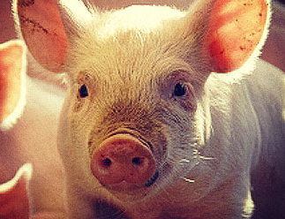
How you can make a difference
Eat more, and a greater variety of plant-based foods
Eat more meat-free meals
Eat meat in smaller portion sizes
Use small quantities of meat to add flavor
Keep meat for special occasions
Choose ‘better’ meat ie naturally-fed, known provenance, produced to high animal welfare, environmental and quality standards.
A ‘less but better’ approach to meat eating can help support farmers without being more expensive for consumers.

Slide 13
Join us!
Sue Dibb
www.eating-better.org
Twitter: @Eating_Better
Email: sue@eating-better.org

