Slide 1

About the Food Research Collaboration (FRC)
Tim Lang, City University London
Mary Atkinson
Victoria Schoen
Nadia Barbu

Slide 2
Introduction to the Food Research Collaboration (FRC)
3 yrs funding (core Esmée Fairbairn Fdn)
Joint working of academics with civil society
Encourage research for civil society needs
Sharing food evidence and thinking to improve coherence and ‘voice’
Encourage longer-lasting / regional collaborations
Based physically at City Univ London but an interdisciplinary, inter-University collaboration
Steering Grp: 3 academics + 3 civil society
Advisory Panel: wider

Slide 3
Deliverables
Briefings on topics chosen and steered by project teams (CSO + academics)
Meetings
  joint with ESRC process
  Food Symposium – December 15 2014
  Food Thinkers – seminars
Website
  Interactive / network / linked up with others (eg G Tansey video-lectures)

Slide 4
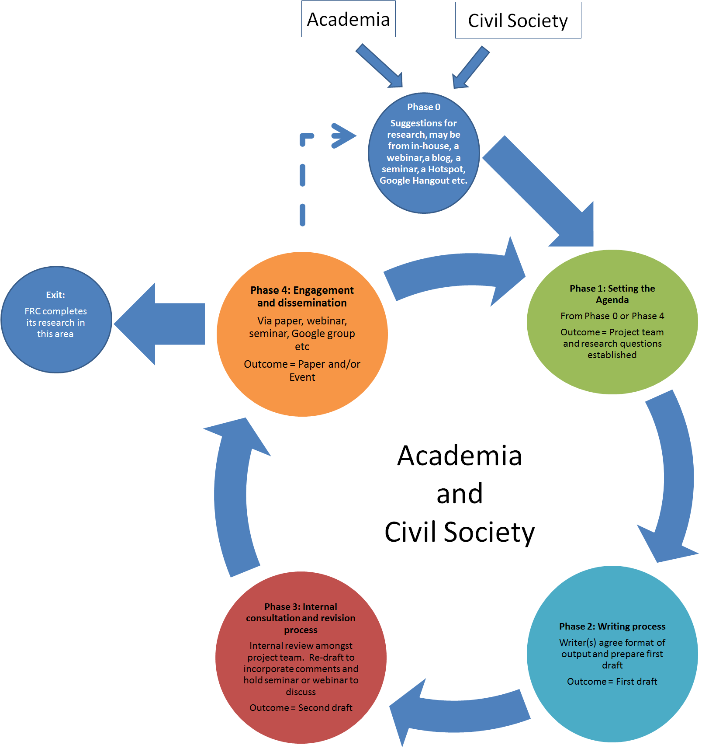
The Process for FRC Research

Slide 5
Topics for Research Emerging from Meeting with CSO Representatives, 28 April 2014
Agri-Food Topics of a natural science rather than social science nature as well as the farmer’s role in pricing and shaping of the research agenda.
Education and Culture Research into the current situation regarding food education provided to school age children as well as encouraging lifetime learning on the origins and value of food.
Governance The role of the UN, government and corporations in shaping the current UK food system, how to influence this and in what direction.
Policy Review of current UK agricultural and food policy and alternatives to this and the CAP and how to direct policy to achieve a move towards more sustainable diets.
Society Researching what a socially sustainable diet would comprise and the extent of society’s access to this.
Sustainability The balance between crops and livestock in production and between livestock and humans in the distribution of grains, the true cost of food production and the improvement and maintenance of integrity in supply chains.

Slide 6
Briefings underway: some examples
Done:
  Square Meal
  Food Prices
In train:
  State of sustainable diets policy
  Sugar, health, enviro & justice
  Civil society’s role in transition
  Food and labour
  Consumers as unwaged labour
  Food poverty: what next after
  What’s effective advocacy?
  What the evidence says is needed

Slide 7
About the ESRC seminar series
Steffen Boehm, University of Essex
Zareen Bharucha, University of Essex
Tim Lang, City University London
Terry Marsden, Cardiff University
Antonio Ioris, University of Edinburgh

Slide 8
ESRC seminar series
‘The Future of our Food’
Economic and Social Research Council (ESRC)
£30k for 2 years, 2014-2016
Collaboration between universities in England, Wales and Scotland
Joint working of academics with civil society organisations and policy makers
Key issues: resilience, sustainability, nutritional security, health and well-being, justice

Slide 9
ESRC Deliverables
5 seminars are planned to
  Provide overview of, and discuss, state of the art research on the UK food system
  Explore links between UK and global food system
  Define key future trajectories of sustainability and resilience of UK food system
  Close engagement between academics, civil society organisations as well as policy makers
Seminar
  Food as work – Essex, Nov 2014;
  Place based analysis – Cardiff, Nov 2014
  Cultural differences in food sovereignty - Edinburgh Feb 4 2015
  Food and corporations – City, March 2015
  ??? - Manchester, mid 2015
Website (joint with FRC)
Issue Summaries Briefs

Slide 10
Goals of FRC
Making a difference
Helping a new generation of researchers
Show academics the value of CSO engagement
Broker some research
Be a useful voice

