Slide 1
GROWING COMMUNITIES START-UP PROGRAMME
JULIE BROWN

Slide 2

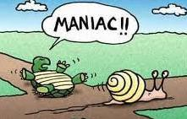

Slide 3
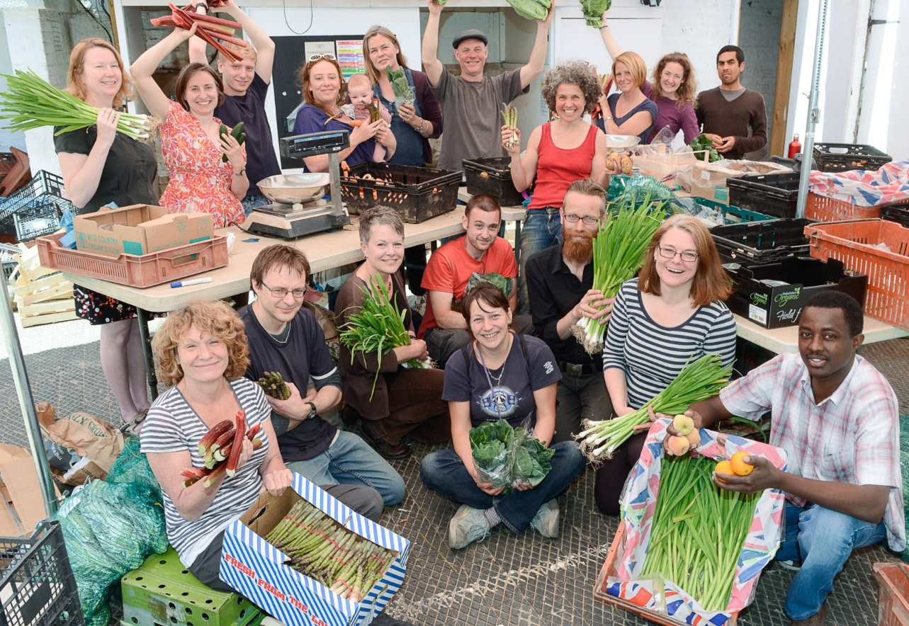

Slide 4
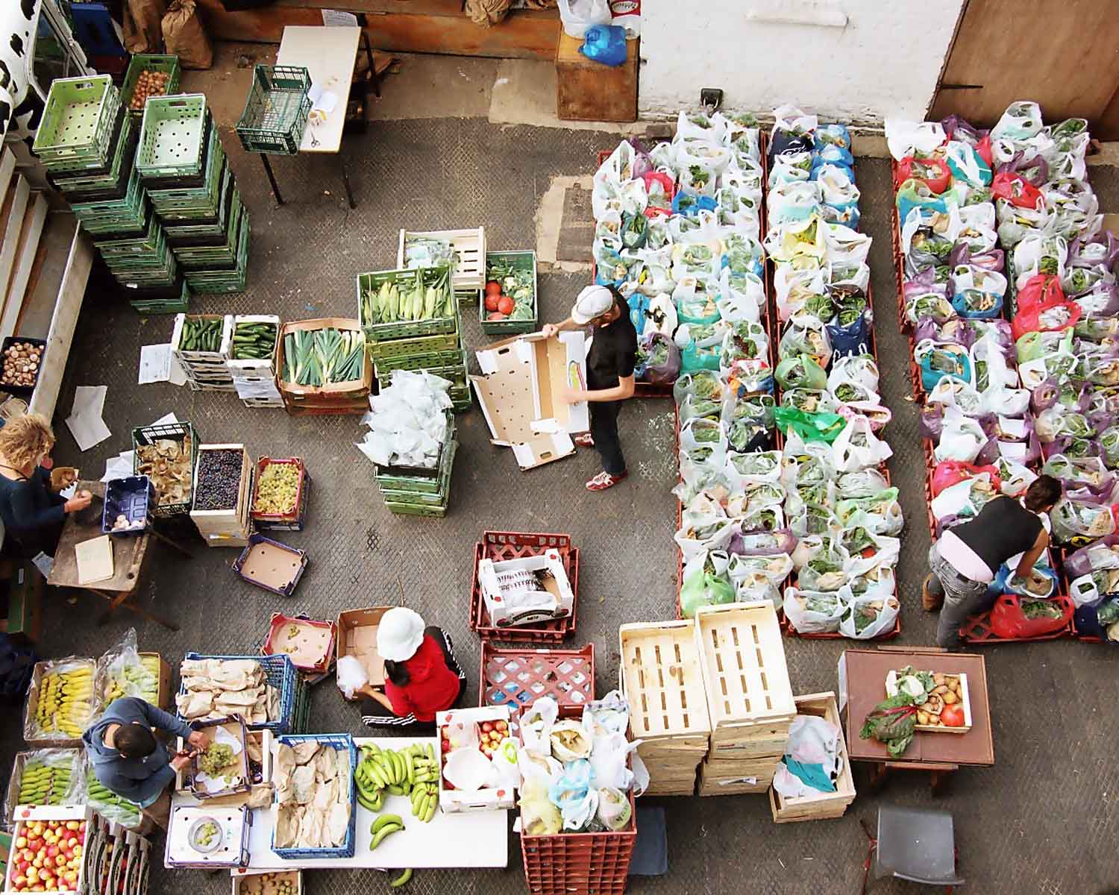
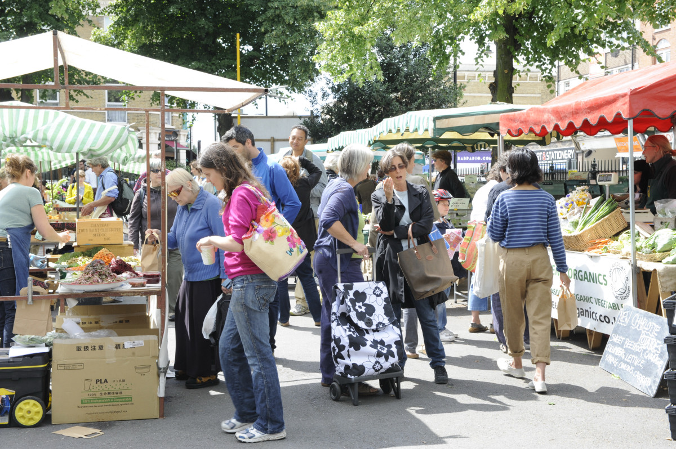
Box scheme
Farmers’ market
29 farmers, 3500 people

Slide 5
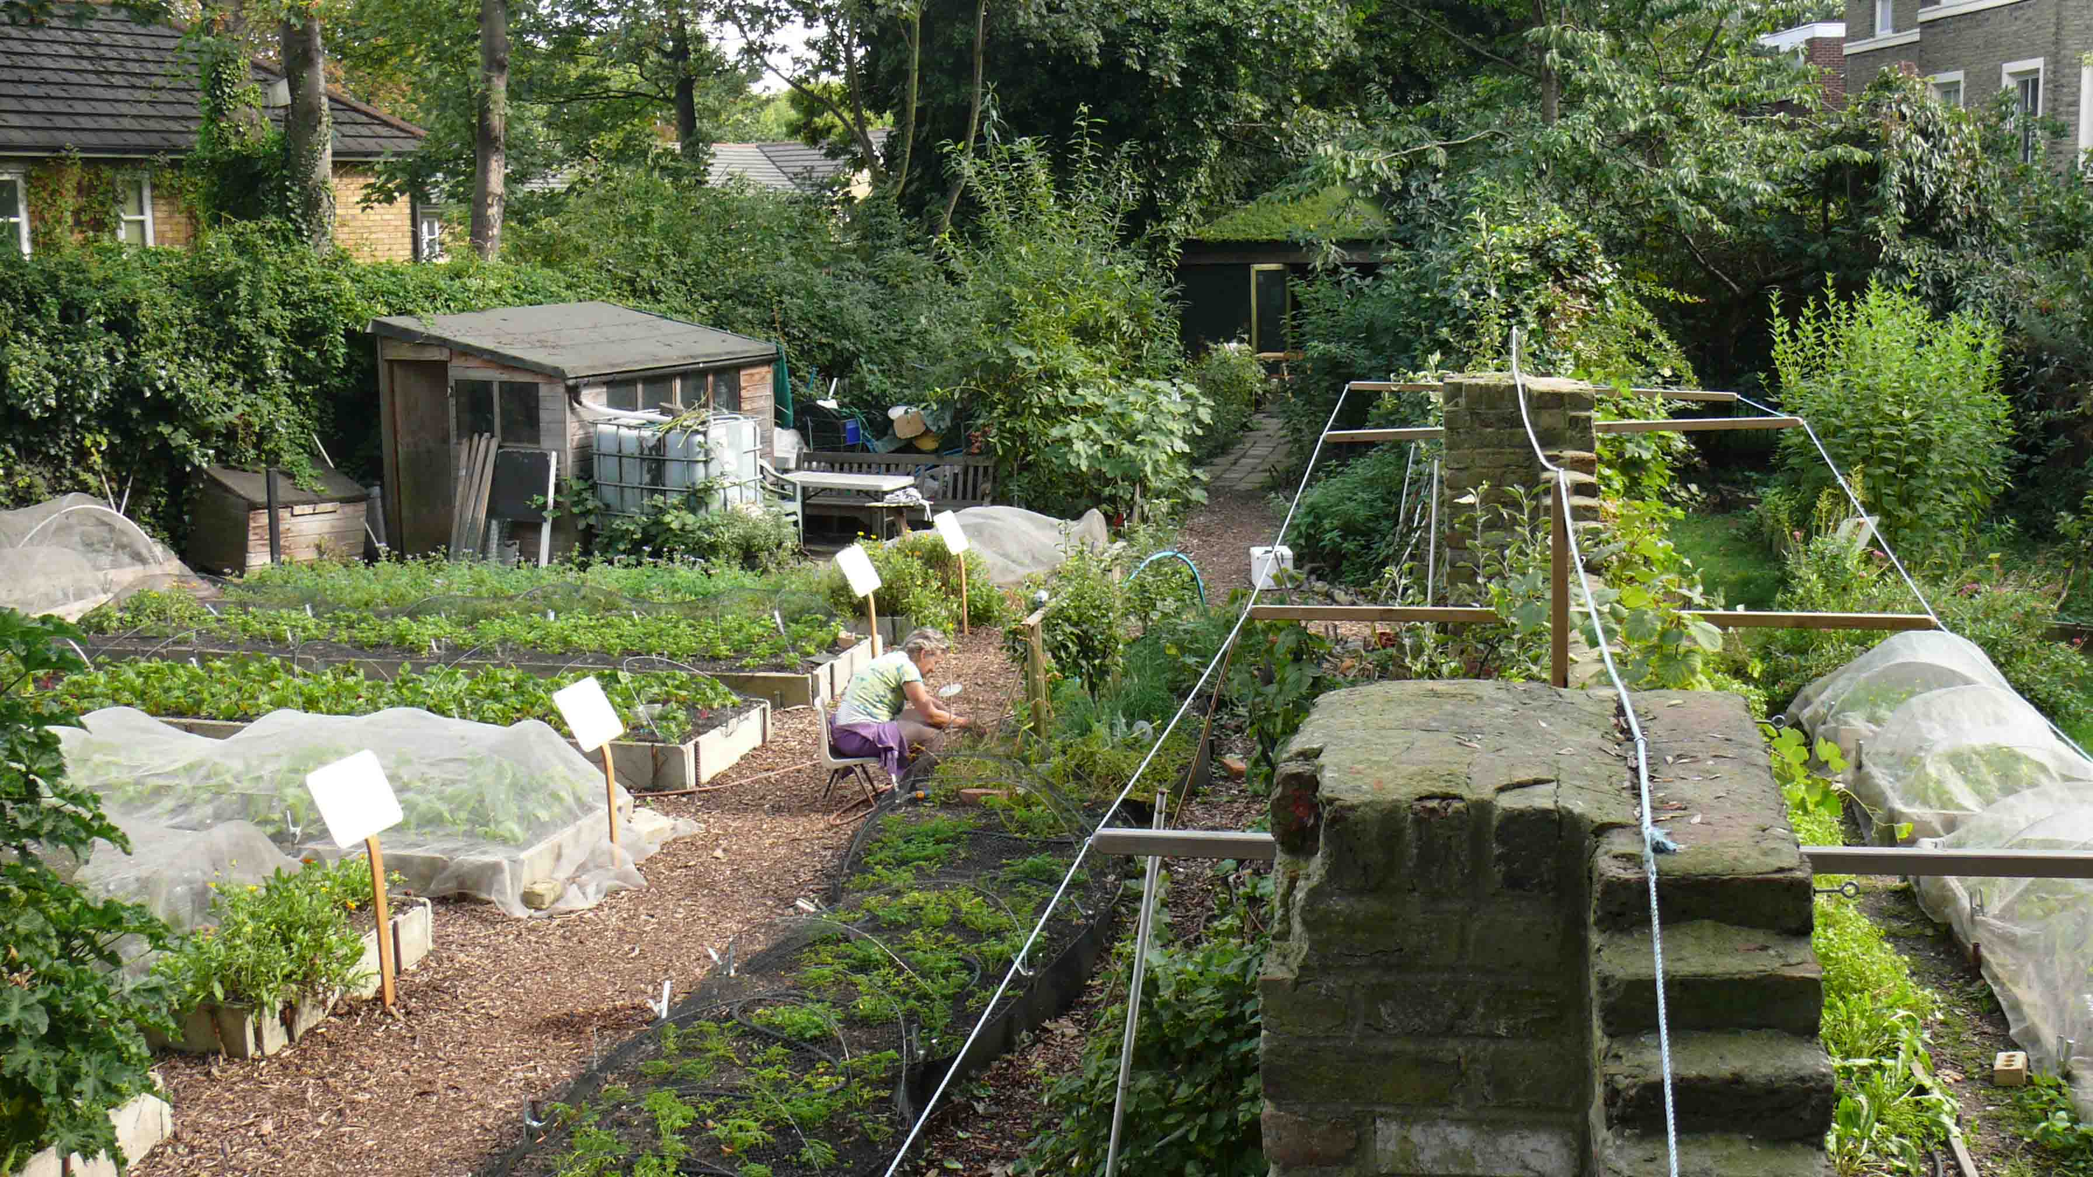
Urban market gardens

Slide 6
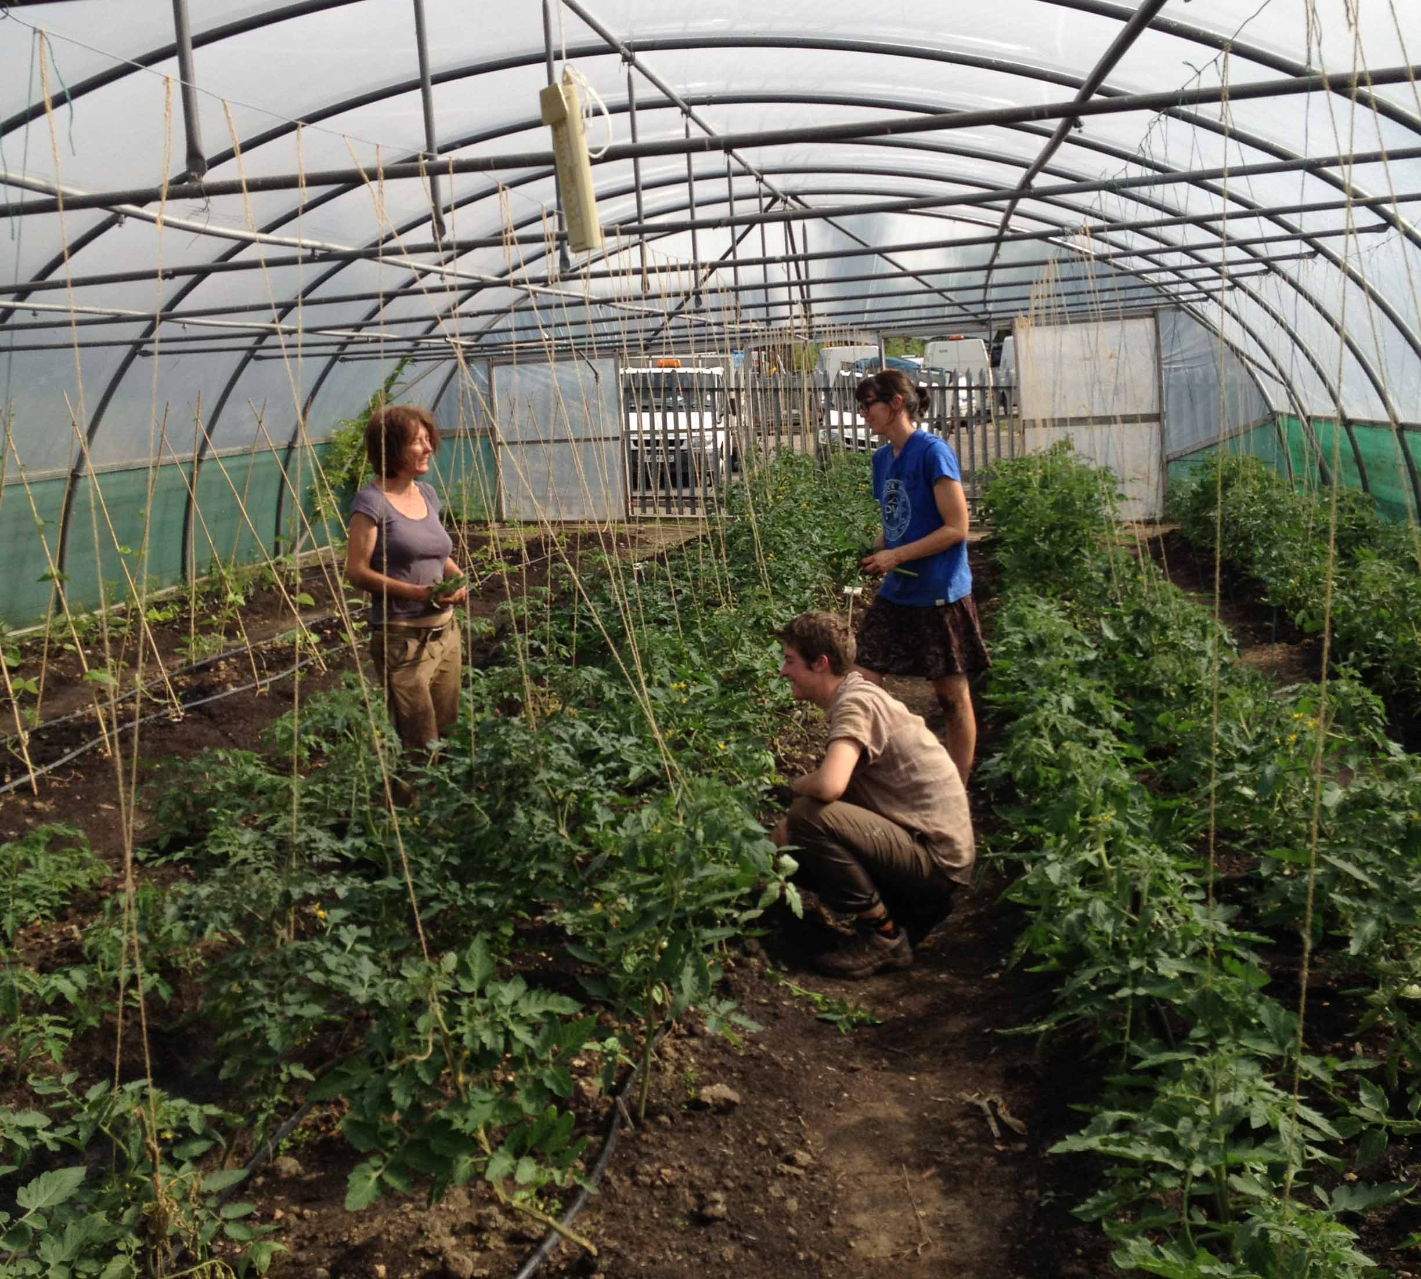
Starter farm

Slide 7
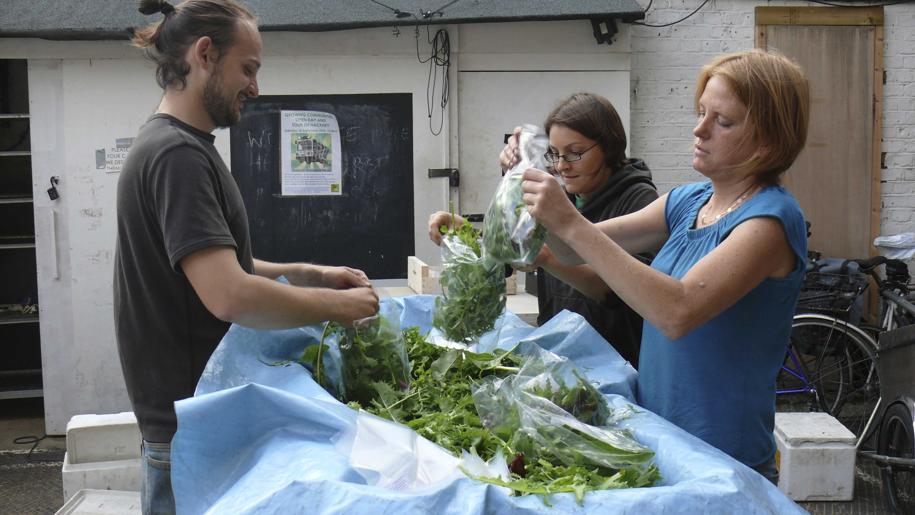
Apprentice growers

Slide 8
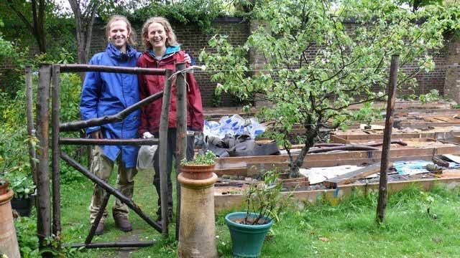
Patchwork farm

Slide 9

Financial self-sufficiency
£700,000 turnover, 24 part-time staff, 29 farmers, 3500 people

Slide 10
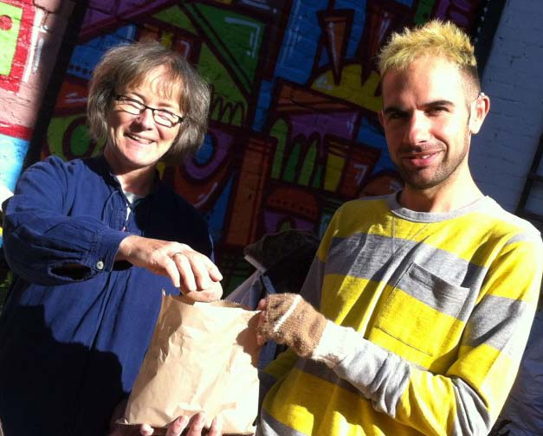
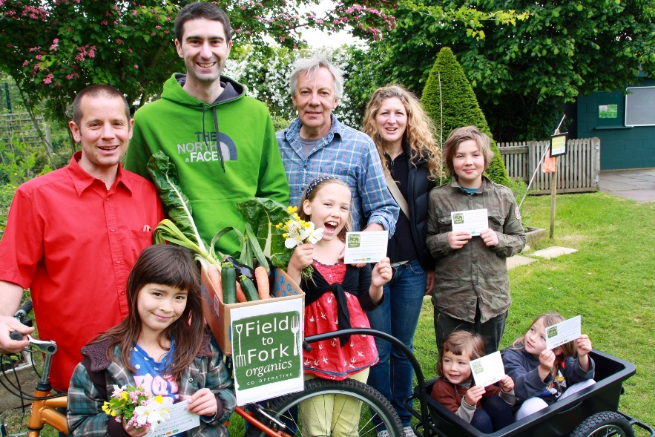
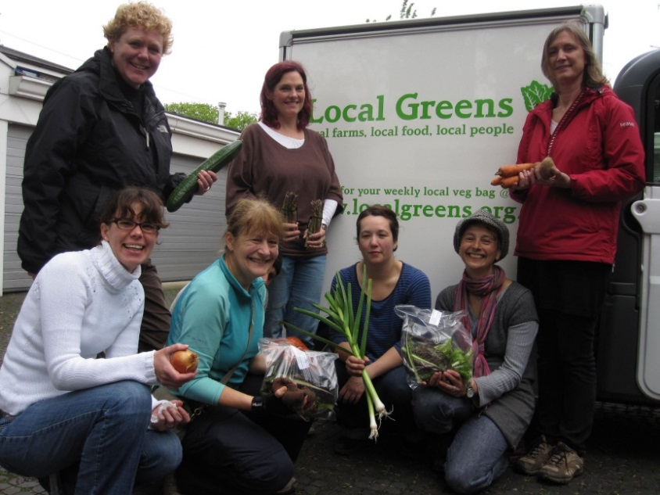
Start up Programme
VegBox Kentish Town
Field to Fork
Local Greens

Slide 11
Not a CSA scheme….

Slide 12
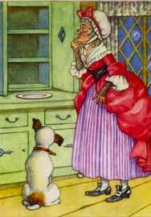

Slide 13
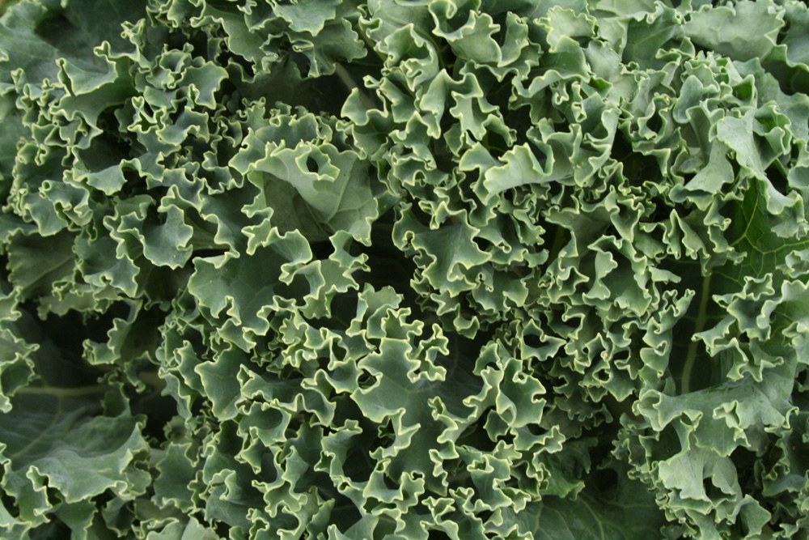
We love kale………
But not that much………

Slide 14

Money….jobs

Slide 15
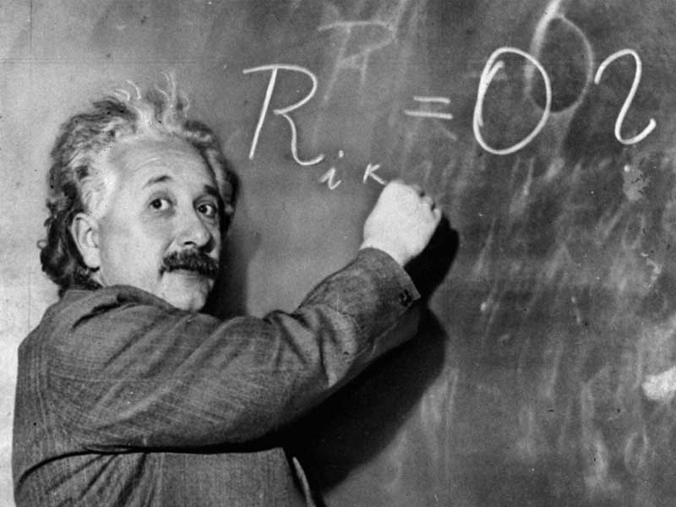
It may not be rocket science…..
But it isn’t easy growing food….

Slide 16
Not a CSA scheme….
Not an organic food coop…..

Slide 17
Not a CSA scheme….
Not an organic food coop…..
Not a local food scheme…..

Slide 18
Not a CSA scheme….
Not an organic food coop…..
Not a local food scheme…..
Not a food access project…..

Slide 19
Not a CSA scheme….
Not an organic food coop…..
Not a local food scheme…..
Not a food access project…..
Not just a growing project…..

Slide 20
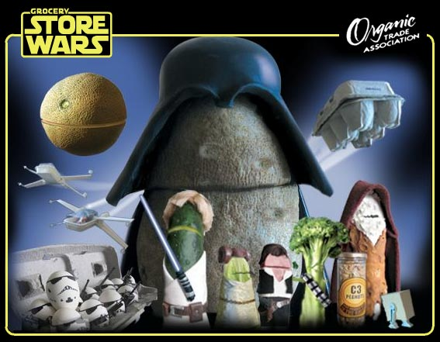
Not just any old veg…..

Slide 21
Principles
Involve food farmed and produced 'ecologically'
Involve mainly plant-based food
Involve fresh/minimally processed food
Involve trade between appropriately scaled operations
Increase the consumption of food sourced as locally, seasonally and directly as practicable
Use resources in an environmentally friendly and low-carbon way
Trade fairly
Be transparent and promote trust throughout the food chain
Promote knowledge
Foster community
Strive to be economically viable and independent
Enshrine the principles

Slide 22
The Growing Communities’ model

Slide 23
The Growing Communities’ model
The core concept behind the Growing Communities’ Model is the use of community-led trading as a practical mechanism for improving our food system: changing it from one which is damaging to one that is more sustainable and resilient.

Slide 24
The Growing Communities’ model
The core concept behind the Growing Communities’ Model is the use of community-led trading as a practical mechanism for improving our food system: changing it from one which is damaging to one that is more sustainable and resilient.
The model aims to be a flexible one which starts with a basic box scheme and enables other activities to be built on according to local circumstances and aspirations.

Slide 25
The Growing Communities’ model
The core concept behind the Growing Communities’ Model is the use of community-led trading as a practical mechanism for improving our food system: changing it from one which is damaging to one that is more sustainable and resilient.
The model aims to be a flexible one which starts with a basic box scheme and enables other activities to be built on according to local circumstances and aspirations.
Based on our principles, systems and approach but locally owned and driven

Slide 26
The Growing Communities’ model
The core concept behind the Growing Communities’ Model is the use of community-led trading as a practical mechanism for improving our food system: changing it from one which is damaging to one that is more sustainable and resilient.
The model aims to be a flexible one which starts with a basic box scheme and enables other activities to be built on according to local circumstances and aspirations.
Based on our principles, systems and approach but locally owned and driven
Designed so all pulling in same direction, while doing our own thing.

Slide 27
What you can do with a box scheme
The box scheme on its own, when working within the framework of the Growing Communities principles can enable other communities to:

Slide 28
What you can do with a box scheme
The box scheme on its own, when working within the framework of the Growing Communities principles can enable other communities to:
Support small sustainable farmers and help them to thrive.

Slide 29
What you can do with a box scheme
The box scheme on its own, when working within the framework of the Growing Communities principles can enable other communities to:
Support small sustainable farmers and help them to thrive.
Generate income with which to create jobs for them and their community and to be financially viable

Slide 30
What you can do with a box scheme
The box scheme on its own, when working within the framework of the Growing Communities principles can enable other communities to:
Support small sustainable farmers and help them to thrive.
Generate income with which to create jobs for them and their community and to be financially viable
Increase/stimulate sustainable food production in and around urban areas

Slide 31
What you can do with a box scheme
The box scheme on its own, when working within the framework of the Growing Communities principles can enable other communities to:
Support small sustainable farmers and help them to thrive.
Generate income with which to create jobs for them and their community and to be financially viable
Increase/stimulate sustainable food production in and around urban areas
Build community

Slide 32
What you can do with a box scheme
The box scheme on its own, when working within the framework of the Growing Communities principles can enable other communities to:
Support small sustainable farmers and help them to thrive.
Generate income with which to create jobs for them and their community and to be financially viable
Increase/stimulate sustainable food production in and around urban areas
Build community
Provide their community with affordable, great food

Slide 33
What you can do with a box scheme
The box scheme on its own, when working within the framework of the Growing Communities principles can enable other communities to:
Support small sustainable farmers and help them to thrive.
Generate income with which to create jobs for them and their community and to be financially viable
Increase/stimulate sustainable food production in and around urban areas
Build community
Provide their community with affordable, great food
It can generate a surplus with which to invest in further change and set up more projects.

Slide 34
The Start-up Programme: 9 groups so far
4 groups just finishing their third year of trading
1 in their second year of trading
3 in their first year of trading
1 recently launched
Seeking 5 more London groups

Slide 35
What we provide

Slide 36
What we provide
Our Financial Model that can be tested and adapted to local circumstances.

Slide 37
What we provide
Our Financial Model that can be tested and adapted to local circumstances.
Support developing a business plan.

Slide 38
What we provide
Our Financial Model that can be tested and adapted to local circumstances.
Support developing a business plan.
Access to a loan pot for start-up funding of around £5000

Slide 39
What we provide
Our Financial Model that can be tested and adapted to local circumstances.
Support developing a business plan.
Access to a loan pot for start-up funding of around £5000
An interactive toolkit to take groups through all the elements of setting up and running a community-led box scheme.

Slide 40
What we provide
Our Financial Model that can be tested and adapted to local circumstances.
Support developing a business plan.
Access to a loan pot for start-up funding of around £5000
An interactive toolkit to take groups through all the elements of setting up and running a community-led box scheme.
One to one mentoring and training for 6 months in the run up to launch and throughout their first year of trading.

Slide 41
What we provide
Our Financial Model that can be tested and adapted to local circumstances.
Support developing a business plan.
Access to a loan pot for start-up funding of around £5000
An interactive toolkit to take groups through all the elements of setting up and running a community-led box scheme.
One to one mentoring and training for 6 months in the run up to launch and throughout their first year of trading.
Peer support from a growing network of groups

Slide 42
Financial Model

Slide 43
Financial Model
Farmers Route to market + Fair price

Slide 44
Financial Model
Food
Sustainable + Affordable
Farmers Route to market + Fair price

Slide 45
Financial Model
Food
Sustainable + Affordable
Farmers Route to market + Fair price
Jobs for local people

Slide 46




Financial Model
Food
Sustainable + Affordable
Farmers Route to market + Fair price
Jobs for local people

Slide 47



Financial Model
Food
Sustainable + Affordable
Farmers Route to market + Fair price
Jobs for local people

Slide 48
Key elements

Slide 49
Key elements
Important to establish a direct trading relationship with the kind of suppliers you want to support. Food costs more to produce. Pay them more, but less than wholesale price. Both win.

Slide 50
Key elements
Important to establish a direct trading relationship with the kind of suppliers you want to support. Food costs more to produce. Pay them more, but less than wholesale price. Both win.
Important to us to start with the amount we need to pay our farmers in order that they can make a living and then to work back from that by putting on enough mark-up to cover costs and create employment.

Slide 51
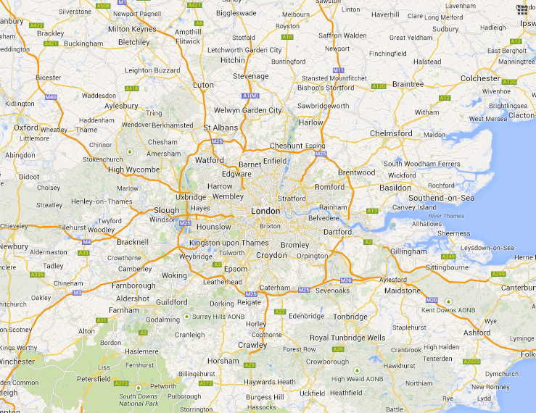

Slide 52
Enfield Veg Company
Crop Drop
Growing Communities
Field to Fork Organics
Organic Ilford
Veg Box Kentish Town
Local Greens

Slide 53
Enfield Veg Company
Crop Drop
Growing Communities
Field to Fork Organics
Organic Ilford
Veg Box Kentish Town
Local Greens
Ripple Farm

Slide 54
Enfield Veg Company
Crop Drop
Growing Communities
Sara Green Organics
Field to Fork Organics
Organic Ilford
Veg Box Kentish Town
Local Greens
Ripple Farm

Slide 55
Enfield Veg Company
Westmill
Crop Drop
Growing Communities
Sara Green Organics
Field to Fork Organics
Organic Ilford
Veg Box Kentish Town
Local Greens
Ripple Farm

Slide 56
Enfield Veg Company
GC Market Gardens
Westmill
Crop Drop
Growing Communities
Sara Green Organics
Field to Fork Organics
Organic Ilford
Veg Box Kentish Town
Local Greens
Ripple Farm

Slide 57
Forty Hall
Enfield Veg Company
GC Market Gardens
Westmill
Crop Drop
Growing Communities
Sara Green Organics
Field to Fork Organics
Organic Ilford
Veg Box Kentish Town
Local Greens
Ripple Farm

Slide 58
Forty Hall
Enfield Veg Company
GC Market Gardens
Westmill
Crop Drop
Growing Communities
Sara Green Organics
Field to Fork Organics
Organic Ilford
GC Starter Farm
Veg Box Kentish Town
Local Greens
Ripple Farm

Slide 59
Forty Hall
Enfield Veg Company
GC Market Gardens
Westmill
Crop Drop
Growing Communities
Sara Green Organics
Field to Fork Organics
Organic Ilford
GC Starter Farm
Veg Box Kentish Town
Local Greens
Calabaza Growers
Ripple Farm

Slide 60
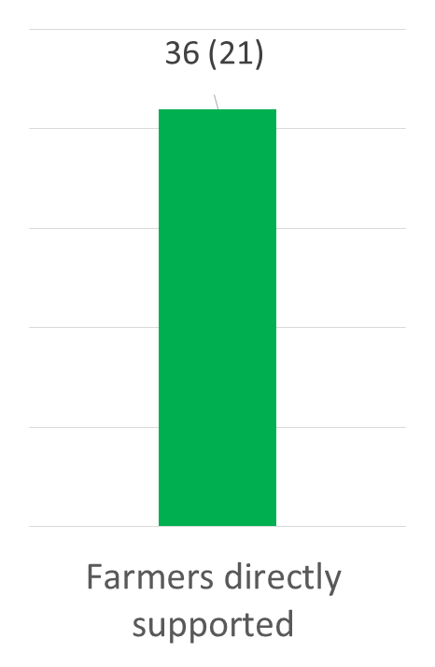
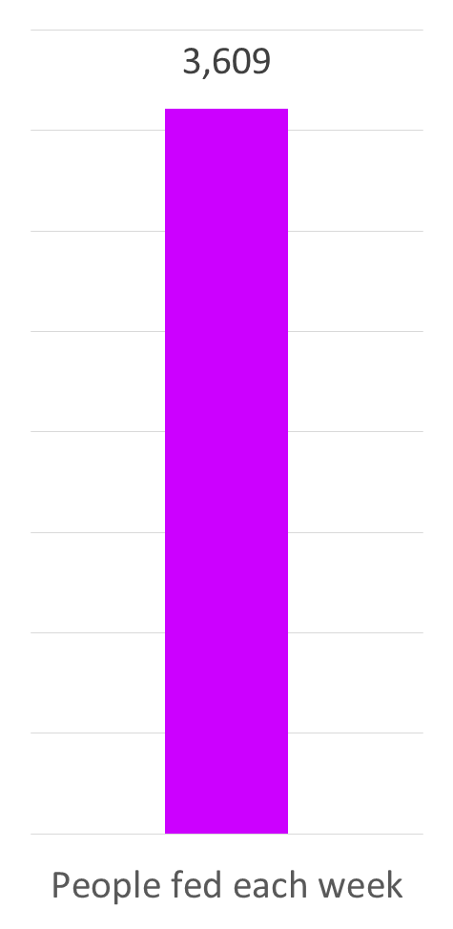

Slide 61
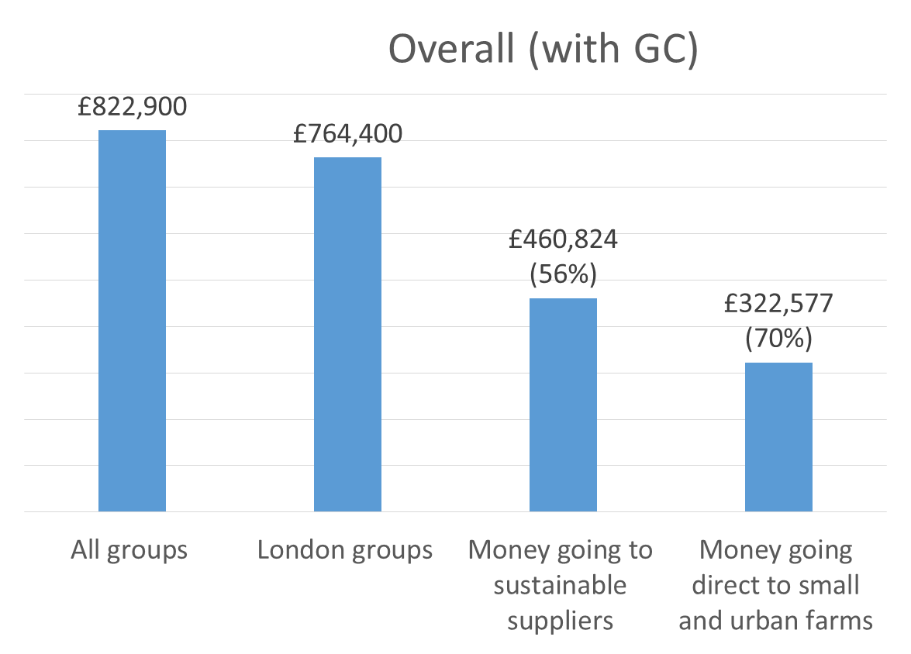

Slide 62
Small, but growing…….
……….certainly not insignificant……
……..possibly significant…….

Slide 63
Julie Brown or Kerry Rankine
Growing Communities growcomm@growingcommunities.org www.growingcommunities.org/start-ups

