Slide 1

Maria Devereaux
Project Officer Sustain
Growing Health

Slide 2
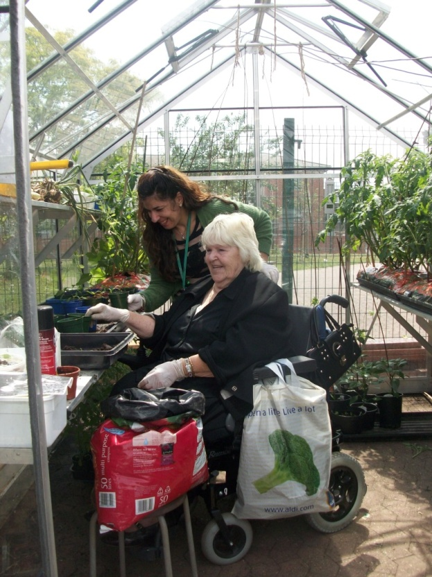
Growing Health
Project run by Garden Organic and Sustain, funded by the Tudor Trust
To get food growing to be more
routinely used to deliver health
outcomes
Identify barriers & solutions
Finding ways to make it happen

Slide 3
Why isn’t NHS commissioning food growing?
NHS & Public Health
Lack of awareness of food growing and the benefits
Unsettled times and new structures
Need measurable outcomes and impact
Food Growing Groups
Don’t have the contacts or awareness of routes to commissioning
Not set up to make it easy, partners and measuring outcomes

Slide 4
Finding ways to make it happen
Evidence of benefits – literature and practical examples
Tools to measure outcomes
Case studies
Reaching health professionals and health commissioners
Support for food growing groups

Slide 5
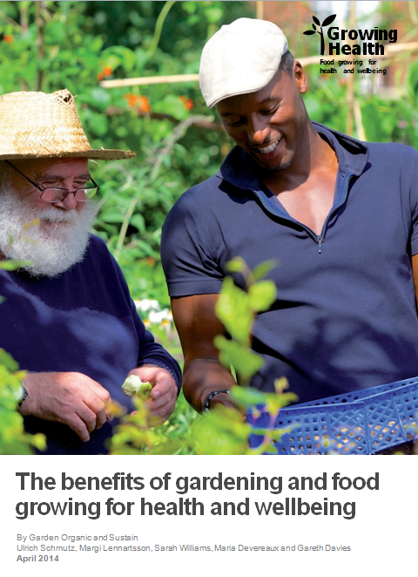
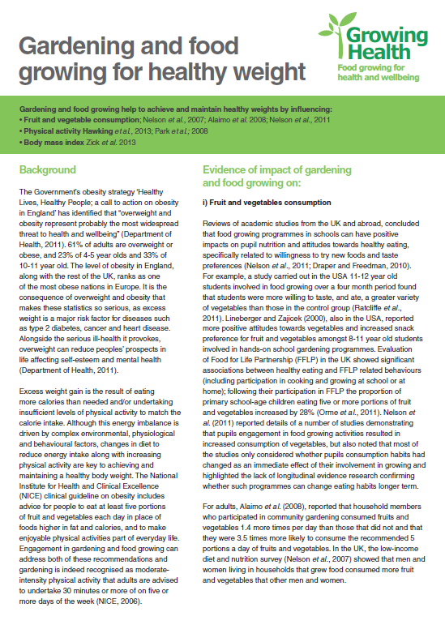
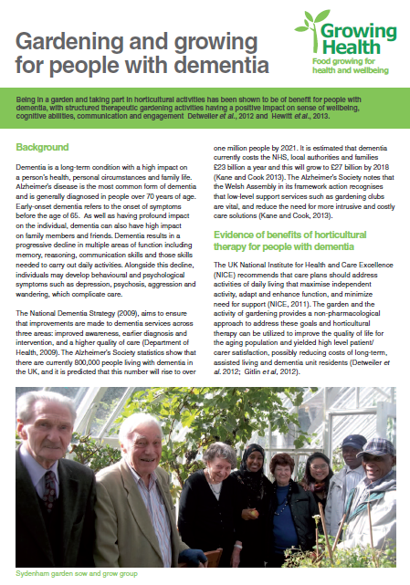
Evidence for health and wellbeing

Slide 6
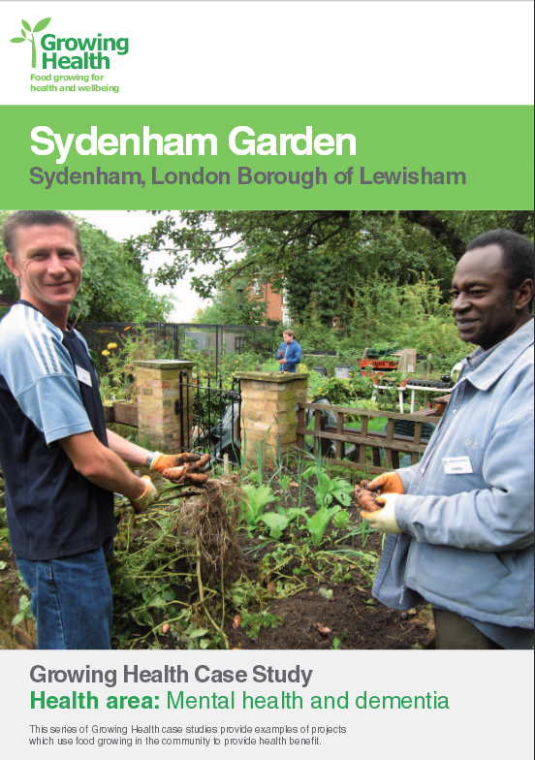
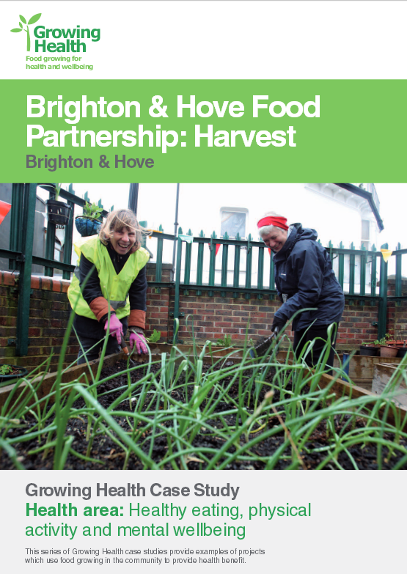
Case studies

Slide 7
Community growing groups
Share and learn events
On-line tool kit
Case studies
Seminars – food growing groups/commissioners at local level
Evidence of the benefits of food growing for health

Slide 8
Health Professionals / Commissioners
Raise awareness
Seminars – food growing groups/commissioners at local level
Evidence of the benefits of food growing for health

Slide 9

Growing Health – Call to Action
Join the network
Provide info for the newsletter
Become a champion
Use the toolkit
Follow us and like us
Join us on Linked In
– Growing Health
@growing_health
Growing Health

