Slide 1
Routes to Commissioning
Sarah Williams
Programme Manager
Sustain

Slide 2
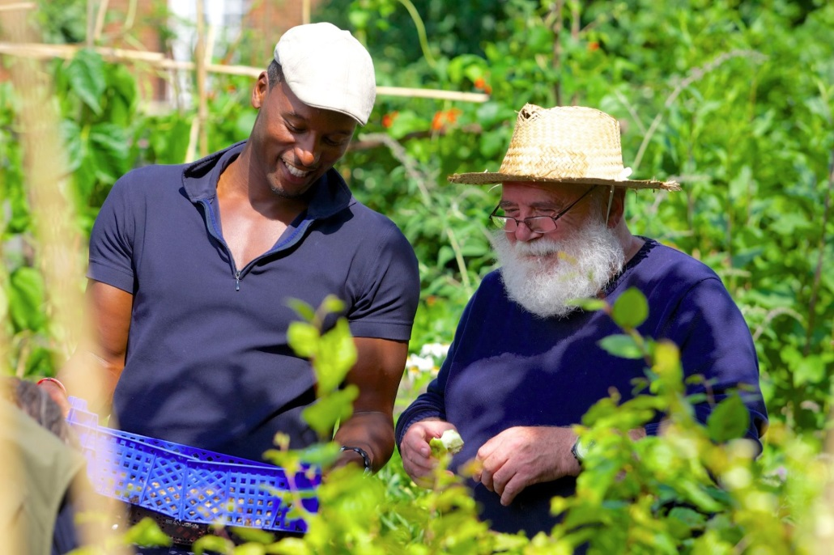
Aim of presentation
Background on clinical and public health commissioning
Understand the current situation and opportunities
Ideas/ top tips for engaging with NHS and Public Health commissioners
Notes:
Aim of the session:
To give an overview of commissioning
To help groups to understand the opportunities that commissioning presents
To give ideas as to how to approach commissioners or develop links with commissioning groups

Slide 3
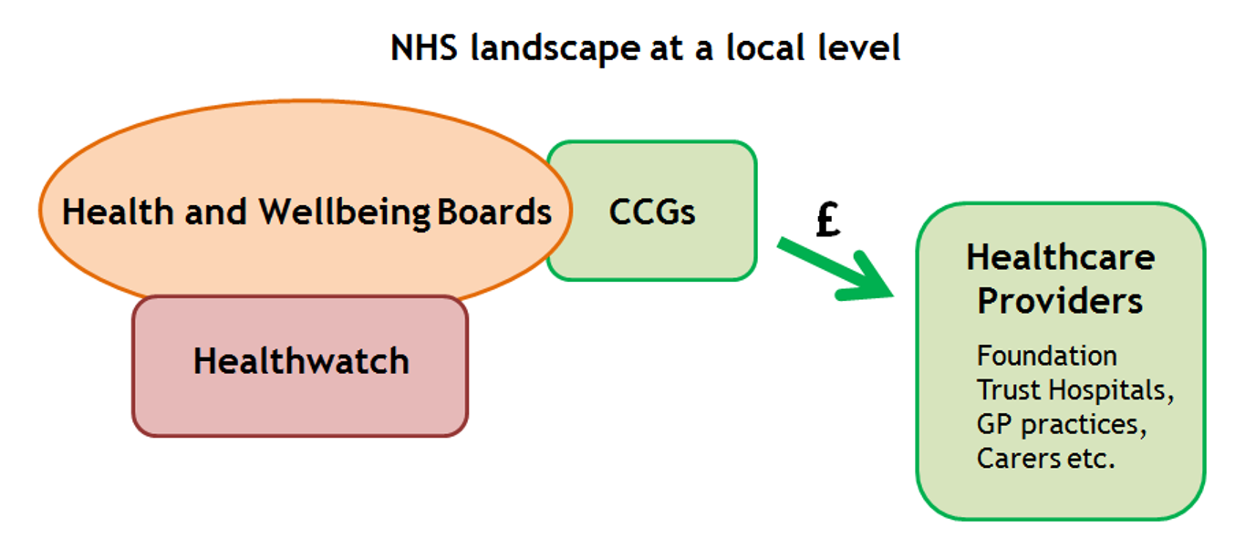
Changes to the NHS 2012
Move to Commissioner and Provider model for all ‘NHS’ services.
‘NHS’ moves to be more of a brand – but sharing same legal principles and contractual connections.
Creation of CCG’s to commission ‘most’ local health services.
Notes:
Aim of the session:
To give an overview of commissioning
To help groups to understand the opportunities that commissioning presents
To give ideas as to how to approach commissioners or develop links with commissioning groups

Slide 4
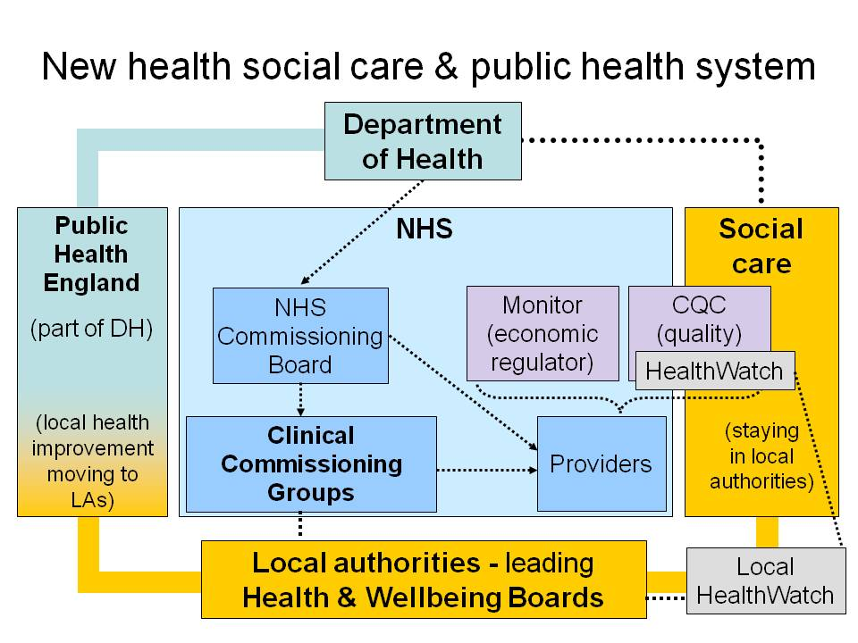
Health and Social Care Act (2012)

Slide 5
What’s new?
  Clinical commissioning groups (CCGs) - replaced the primary care trusts (PCTs) and control around two-thirds of the NHS budget.
    The CCG boards (made up of GPs, other health professionals and lay members) are responsible for making decisions on priorities for commissioning local health services.
  Local Authorities - Commissioning For Public Health and responsible for providing some public health services
  Health and wellbeing boards – bring together NHS and local authority decision making and responsible for
    Joint Health & Wellbeing Strategy - forms the basis of the commissioning plans
      Joint Strategic Needs Assessment (JSNA) - an ongoing process by
      which set out needs of population and priorities
Notes:
The new structures
The Health and Social Care Act 2012 made changes to how local health and social care planning and commissioning happens.
(diagram)
NHS Commissioning Board: The Board will have a dual role in that it will both deliver its own commissioning functions and ensure
that the whole of the architecture is cohesive, coordinated and efficient. Alongside the clinical commissioning groups and the Board, there will be commissioning support infrastructure, which will be able to provide many of the support functions that underpin the commissioning undertaken by commissioning groups and the Board.
There have been around 8000 staff performing functions which will be the responsibility of
the Board and this is likely to reduce to around 3500. Of these approximately two thirds will be deployed locally within the “field force” managing relationships with clinical commissioning groups and performing direct commissioning and other associated functions.
Clinical commissioning groups (CCGs) - one of the main components of the government’s reforms established in April; 2013 to replace the primary care trusts (PCTs) as the commissioners of most services funded by the National Health Service (NHS) in England and control around two-thirds of the NHS budget.
All general practices in England are now legally obliged to be a member of a CCG. Encourage clinicians to play a greater role in deciding how funds are spent in order to shape services to meet local needs.
The CCG boards (made up of GPs, other health professionals and lay members) are responsible for making decisions on priorities for commissioning local health services.
Local Authorities - Commissioning For Public Health
Local authorities are now responsible for public health commissioning and responsible for providing some public health services in conjunction with Public Health England.
Act also introduced a new local decision-making forum - the health and wellbeing board and gives it duties and powers in relation to Joint Strategic Needs Assessments (JSNAs) and Joint Health and Wellbeing Strategies (JHWSs).
Health and wellbeing boards – bring together NHS and local authority decision making – develop a JHWS underpinned by the JSNAs to improve the local communities health and wellbeing – this forms the basis of the commissioning plans of the Clinical Commissioning Groups CCGS and local authority.
JSNAS - commissioning frameworks or strategies. Voluntary service Organisations can have input into these.
JSNA: A Joint Strategic Needs Assessment (JSNA) is an ongoing process by which local authorities, clinical commissioning groups and other public sector partners jointly describe the current and future health and wellbeing needs of its local population and identify priorities for action.

Slide 6
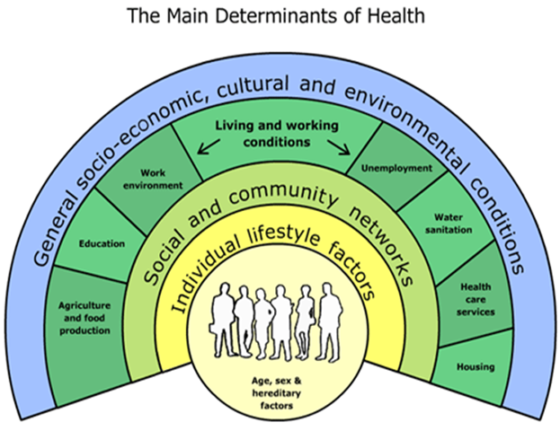
What is public health?
‘The science and art of improving the population’s health through the organised efforts of society’

Slide 7
The vision for local government leadership of public health
Building on local government’s long and proud history of public health leadership, our vision is for local authorities to use their new responsibilities and resources to put health and wellbeing at the heart of everything they do, thereby helping people to lead healthier lives, both mentally and physically
DH Guidance on Public Health in Local Government
(Dec 2011 p3)

Slide 8
Drivers for change
Value for money, targets and efficiency
Quality assurances
Good solutions to complex problems
Shift decision making close to patients
The reality
Still evolving - Sceptics/ conflict of interest
Personal relationships
Public Health still more relevant (but less £!)
Off the shelf models still prioritised for Clinical approaches

Slide 9
Commissioning Processes
Data creates a picture of community needs and assents (JSNA)
  Feed in evidence/ get the community involved
Identify priorities (JHWSs)
  Feed in evidence/ get the community involved
  Influence members
Develop Commissioning plans
  Offer innovative services/ support redesign
  Review/ scrutinise how will they meet needs
Review
Use as baseline to prepare evidence for new JSNA

Slide 10
Local Authority process
  Making the case (Internal competition vs added value/links with other departments)
  Developing a specification (Budget, outputs and outcomes, timescales, evaluation of delivery and impact)
  Tender process (Structures and bureaucracy, Financial constraints)
  Review and evaluation

Slide 11
Why does the NHS and PH work with voluntary and community sector?
Already doing it!
VSC receives £3.4 billion from NHS (Kings Fund)
We are effective because:
  Expertise: by working with geographic or thematic communities
  Value driven: the ultimate goal is to meet the needs of it beneficiaries, so it will often deliver added value.
  Innovation: identify problems and experiment with solutions
  Prevention: excel in early intervention, prevention &holistic services
  Contact with underrepresented groups
Notes:
Why does the NHS work with voluntary and community sector?
The voluntary and community sector already operates extensively within health and social care
The NHS currently spends around £3.4 billion annually on services from the voluntary and community sector (VCS) (Kings Fund).
Community-based organisations provide excellent examples of how health issues can be tackled at a local level.
Effective because:
detailed understanding of local need
trust they have in these communities
provide services which extend beyond traditional, clinical health interventions to a broader range of approaches, such as community support, social participation and support for independent living.
wider concern for wellbeing, rather than solely the immediate medical problem.
ability and willingness to work holistically across multiple services

Slide 12
Success Stories
Strong Partnerships with voluntary sector in areas
Prevalence in some disciplines
  O.T., Social & Therapeutic Horticulture
  Public Health – food environments, healthy eating, mental health
Commissioning and/or referral relationships
  Healthy Weight, mental health
  Substance misuse, dementia

Slide 13

Working with CCGs & commissioners

Slide 14
Plan your approach:
Are you ready?
  Are you ready to be commissioned, receive referrals?
  Do you have evidence and a product?
  Do you know about the priorities?
  Develop a pitch
  Summarise your points on 1 side of A4 / develop a product sheet
  www.naturalhealthservice.org.uk/naturalhealthservice_productsheets.pdf
Who do you want to contact?
  Commissioners – CCG or Public Health
  Voluntary Sector umbrella group
  Partners
Notes:
Planning your approach:
Decide who you want to develop a relationship with; is it CCG board members or commissioning staff? If CCG have assigned leads for aspects of commissioning, it may be easier to engage those leads on their specialism
When meeting people, spend time preparing the groundwork to ensure you create the right impression. Think about your message and make it as clear and relevant as possible. To do this you should:
find out CCG priorities so you can tailor your message to them
develop your 30 second and 5 minute pitches
summarise your points on 1 side of A4
Do your homework?
What are your local Health and Well being priorities
JSNA

Slide 15
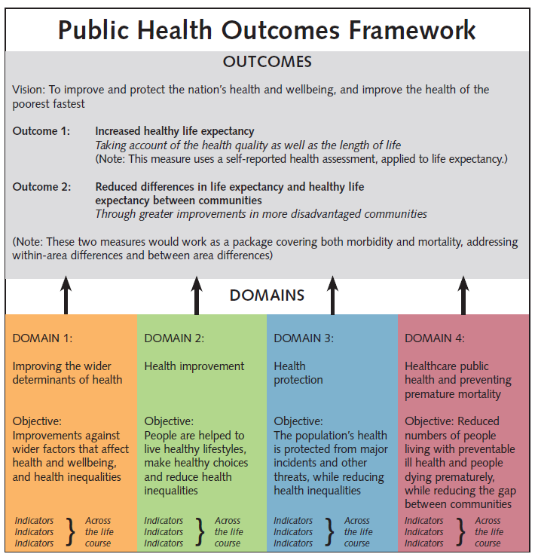
Notes:
Key documents

Slide 16
Build relationships:
Assume commissioners know very little about this area
Commissioners: www.navca.org.uk/localvs/lcp/briefings/
Use existing contacts in the health sector
  Invite people to events, site tours etc.
Partnerships can be effective
  Smaller organisations becoming sub-contractors to large ones
  Consortium that can deliver larger contracts
  Think about coverage - geographical and approaches
Notes:
Don’t rely on there being someone within the local authority or local NHS with the job title ‘commissioner’.
How to find a commissioner’ gives useful pointers to help you find the right people:
Unless you already have a relationship with your local GPs, assume they know very little about your organisation, the service you provide or the specific issue of the community you serve. Be clear about your clients’ needs and how your organisation meets those needs.
Use any relationships you already have in the health sector
The more you can work with other organisations to demonstrate how many people or organisations share your concerns and how well your ideas fit in with the priorities of the statutory organisations, the more notice CCGs are likely to take of you.
Smaller organisations becoming sub-contractors to large ones, and several organisations forming a consortium that can deliver larger contracts. Partnerships can be effective ways of delivering large contracts
Demonstrate what you can do?
satisfy commissioners , Don’t wait for them to ask you about your evidence, make sure they see / hear it regularly (invite them to events, send them newsletters, links to reports, etc.), Construct your evidence around their outcomes / structures not around your traditional organogram or budget headings. You can still do your own thing but when talking to them, show you meet their requirements
If you want to influence service provision, the more you can demonstrate beneficial outcomes and value for money the better, which includes how many people receive the service, what difference it makes to them and how much it will cost.
Think about partnerships and allies
Healthwatch, CVS., other groups etc.

Slide 17
What your CCGs should be doing?
Required to demonstrate that they have mechanisms in place to work with voluntary-sector groups
The Public Services (Social Value) Act January 2013.
  Requirement on commissioners) to consider the economic, environmental and social benefits
Healthy people, healthy places briefing.
  Obesity and the environment: increasing physical activity and active travel Public Health England Nov 2013
Sustainable, Resilient, Healthy People & Places
  A Sustainable Development Strategy for the NHS, Public Health and Social Care system
Notes:
Other important Acts/Reports – useful info
The Public Services (Social Value) Act January 2013. ‘Social Value’ Act places a requirement on commissioners of public services (including NHS
services) to consider the economic, environmental and social benefits of their approaches to procurement.
Healthy people, healthy places briefing. Obesity and the environment: increasing physical activity and active travel Public Health England Nov 2013
Sustainable, Resilient, Healthy People & Places
A Sustainable Development Strategy for the NHS, Public Health and Social Care system
It describes the opportunities to reduce our environmental impacts, improve our natural environment, increase readiness for changing times and climates and strengthen social cohesion. The Sustainable Development Unit SDU Jan 2014
Three goals have been identified to support this vision:
1 A healthier environment
2 Communities and services are resilient to changing times and climates
3 Every opportunity contributes to healthy lives, communities and environments.

Slide 18
What your CCG could be doing?
Co production & Innovation
  Building Health Partnerships, Social Prescribing
Grant/developmental/pilot funding
  by commissioners in order to allow innovative solutions to develop
  CCGs have the power to give grants to voluntary sector organisations (section 14Z6(1) Health and Social Care Act 2006 (as amended)).
Working with support organisations (e.g. CVS)
  acting as a broker between commissioners and voluntary sector providers
Notes:
What should your CCG be doing?
Good practice –
Co production ( I have found a little bit about this)
Building Health Partnerships (if we can find anything)
Social Prescribing
grant/developmental/pilot funding by commissioners in order to allow innovative solutions to develop
Support organisations (such as Councils for Voluntary Service) acting as a broker between commissioners and voluntary sector providers
Tim is covering this in workshop

Slide 19
Top Tips for getting commissioning
Do your homework
Familiarise yourself with the JSNA/ local priorities?
What are current issues, local statistics, and current services.
Get prepared
Position yourself – where do you think your activities fit?
What evidence do you have of improving outcomes on the issues they care about?
Can you show social value and value for money?
Get the numbers right, but also use qualitative evidence.
Notes:
What should your CCG be doing?
Good practice –
Co production ( I have found a little bit about this)
Building Health Partnerships (if we can find anything)
Social Prescribing
grant/developmental/pilot funding by commissioners in order to allow innovative solutions to develop
Support organisations (such as Councils for Voluntary Service) acting as a broker between commissioners and voluntary sector providers
Tim is covering this in workshop

Slide 20
Top Tips for contacting commissioners
Create a communication channel
Use their language
Who else is engaging with CCG? Can you coordinate or ask them?
Patient or community consultation meetings
Are you prepared to cold call?
GP practice managers, trainee GPs, cluster meetings
Know what the good practice (the could) is in other areas
Keep an eye on the CCG website, follow them on twitter
Don’t be afraid to ‘pitch an idea’ to a commissioner
Be prepared to have to work at it!

Slide 21
