Slide 1

Improving access to fresh, healthy food.

Slide 2


The opportunity:
A voluntary set of independent standards
Inspected annually
A clear framework for sustainability, local procurement and health
Technical and Supply chain support
Marketing and PR support
Celebration and reward

Slide 3


Slide 4

Impacts - summary
Independent evaluation:
Good for the local economy – NEF
Good for climate change – Manchester University
Good for healthy eating – Cardiff University and UWE

Slide 5


A Growing Movement
150 million Catering Mark meals served a year
Over 5,000 schools
300 early years nurseries
Workplaces including Pearson Publishing, Sainsbury’s, Jaguar Land Rover, PepsiCoWalkers.
Working with 30+ universities
National Trust and RSPB working to achieve bronze across business
6 hospitals - with 17 in our best practice network
70% of London Boroughs

Slide 6
Catering Mark benefits
Independent assessment and endorsement
Quality assurance, ingredient traceability
Increasing meal uptake
A powerful marketing tool - reassures customers
Opportunity to demonstrate your credentials
Genuine Corporate Social Responsibility
Marketing/communications support from Soil Association
Supply Chain support and staff training

Slide 7
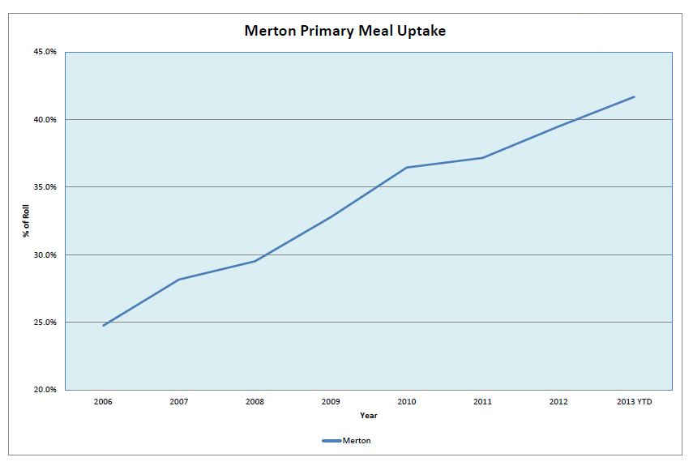

Slide 8

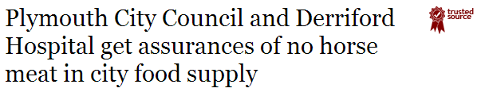
Public reassurance.
“Our Education Catering Service is proud to hold the Soil Association's Gold Catering Mark”

Slide 9
Staff empowerment
Pascal Meril, Catering Manager, St Joseph’s Hospital:
“The staff are happier.
Who wants to be opening boxes and boiling food in the bag all day?
Using our skills to cook properly is much more interesting.”

Slide 10



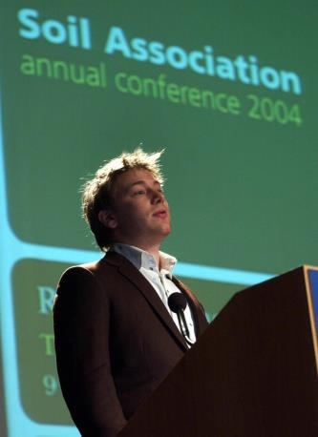

Slide 11


Slide 12


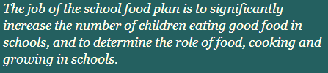

Slide 13
“The Plan’s three guiding principles: 'the Head teacher leads the change’; ‘see it through the eyes of the child’; and ‘a whole school approach to food’, are embodied in the values and approach of the Food for Life Partnership” MYLES BREMNER, DIRECTOR OF THE SFP
“these organisations have a proven track record of increasing take-up. Schools enrolled in the Food for Life Partnership during 2008, for example, experienced an average increase in take-up of 3.7% in the first year, growing to 5% in the second year, at a time when take-up was declining nationally.”
“Make it a contractual requirement for your caterer to achieve a certain standard of quality, as judged by an external organisation – e.g. Food for Life Partnership”

Slide 14



Notes:
Expert panel
CQUINN

Slide 15


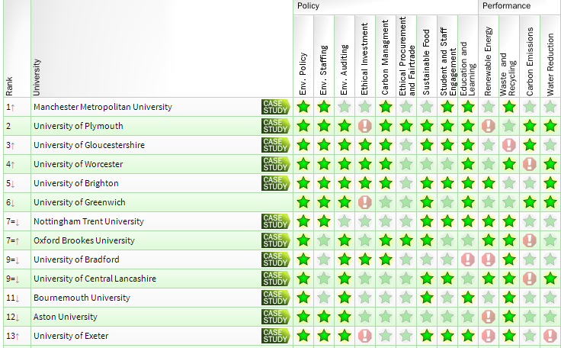

Slide 16

“We believe it is important for companies to take practical action.
We identified how food is produced, and supporting sustainable, organic agriculture as having a significant impact on our environmental footprint”
Peter Hughes, Director of CSR at Pearson
http://www.sacert.org/catering/whatisthecateringmark/casestudies

Slide 17


























Slide 18
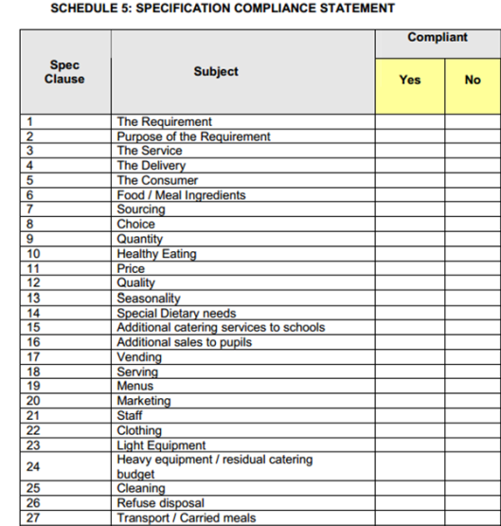
Make the Catering Mark a contractual prerequisite.
A compliance statement taken from an example school catering contract tender.
The Catering Mark covers more than a third of the requirements
Backed by independent annual inspection

Slide 19
Example contract wording
“Bidders will achieve a Bronze Food for Life Catering Mark within the first year of the contract being awarded. An application to the Soil Association for this must be made within the contract’s first three months. Bidders should have a plan and budget for achieving Silver within two years, and Gold within three years. Gold to be maintained for the remainder of the contract.”

Slide 20






Slide 21



The standards
No undesirable additives or trans fats
At least 75% of dishes are freshly prepared from unprocessed ingredients
Meat is traceable to farms which satisfy UK welfare standards
Eggs are from cage-free hens
Menus are seasonal and in-season produce is highlighted
Catering staff are supported with skills training in fresh food preparation and the Catering Mark
No GM ingredients are used
Free drinking water is prominently available
No fish is served from the (MCS) ‘fish to avoid’ list
Information is on display about food provenance
All suppliers have been verified to ensure they apply appropriate food safety standards
Caterers in schools and academies, early years and residential care settings and hospitals can demonstrate their compliance with national standards or guidelines on food and nutrition
Menus provide for all dietary and cultural needs
Notes:
Gerry will go into stds detail in his talk about costs

Slide 22


Silver and Gold Catering Mark
Recognising continuous improvement and excellence
Sourcing ethical and environmentally friendly food
Championing local producers
Making healthy eating easy

Slide 23






Silver and Gold Catering Mark
Sourcing ethical and environmentally friendly food

Slide 24
Silver and Gold Catering Mark
Recognising continuous improvement and excellence
Sourcing ethical and environmentally friendly food
Championing local producers
Making healthy eating easy

Slide 25
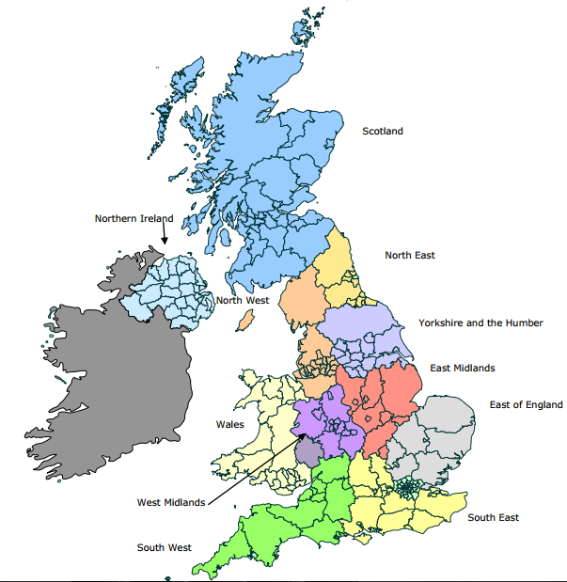

Slide 26
Silver and Gold Catering Mark
Recognising continuous improvement and excellence
Sourcing ethical and environmentally friendly food
Championing local producers
Making healthy eating easy

Slide 27
Making healthy eating easy
Meat-free day or equivalent
Steps to serve meat in moderation
Steps to minimise salt
Actions to cut plate waste/support eating well
Actions to promote meal take-up
Monitoring against food & nutrient-based standards
Healthy vending
>50% bread is wholemeal or granary
Fruit cheaper than dessert (where sold)

Slide 28
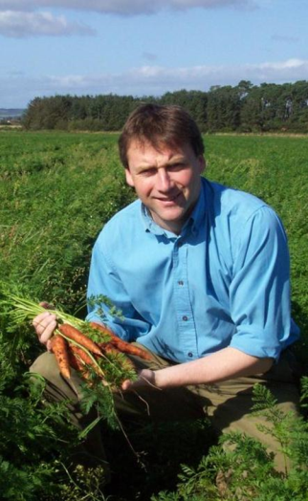

Catering Mark Supplier Scheme
For suppliers who have the products that caterers need.
Finding new routes to market
Supporting caterer’s needs
Support available to find new products
Strong marketing tool - PR value – enhanced reputation across supply chain
Helps to meet customer’s CSR objectives

Slide 29
In summary
Step-wise Award – achievable and rewards best practice
Brings together key issues of health, sustainability and local economy
We want to support you and work with your caterers to raise standards.

Slide 30
Where next?
Please contact us if you would like more information or a one off free consultancy meeting.
Michael Bond
catering@foodforlife.org.uk
07795 523384

Slide 31
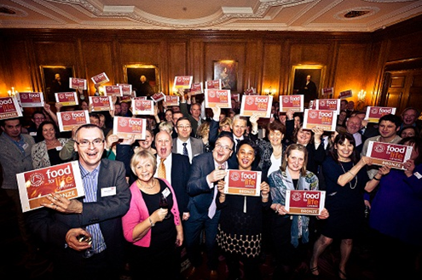
Thank you!

