Slide 1
Past experiments, current predicaments
Dr Rachael Durrant,
University of Sussex

Slide 2
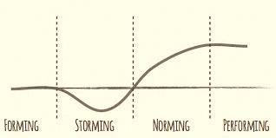
History of the network…
2011 Origins
2012 Making connections
2013 Making a splash
~~Hiatus!~~
2014 Re-orientation (2014)
?

Slide 3
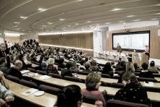
Origins
Needs:
Make a difference
Overcome isolation
Needs:
Evidence
Strategic research

Slide 4
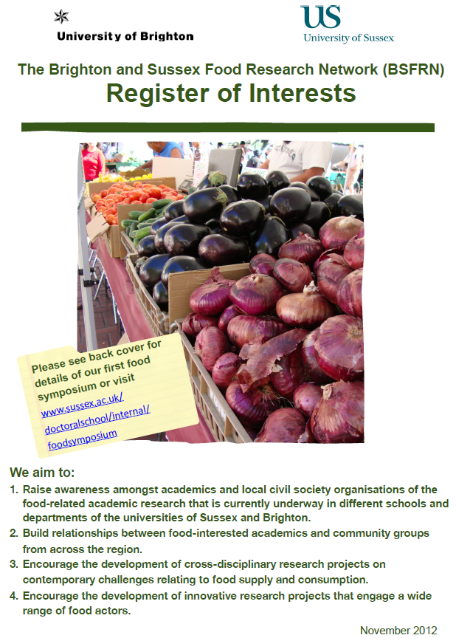
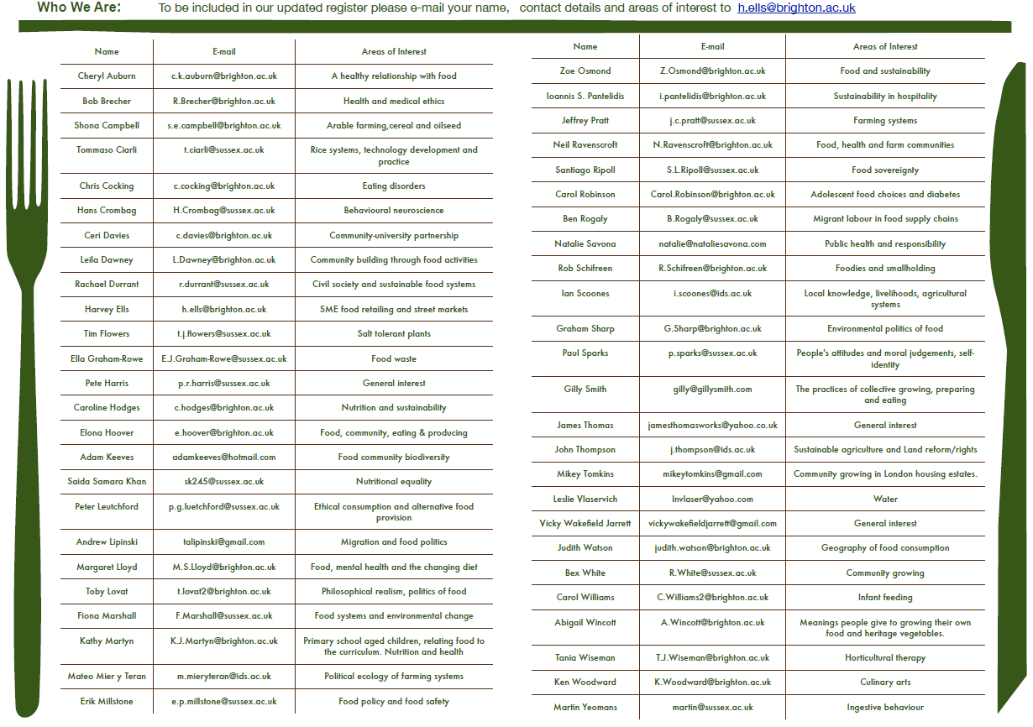
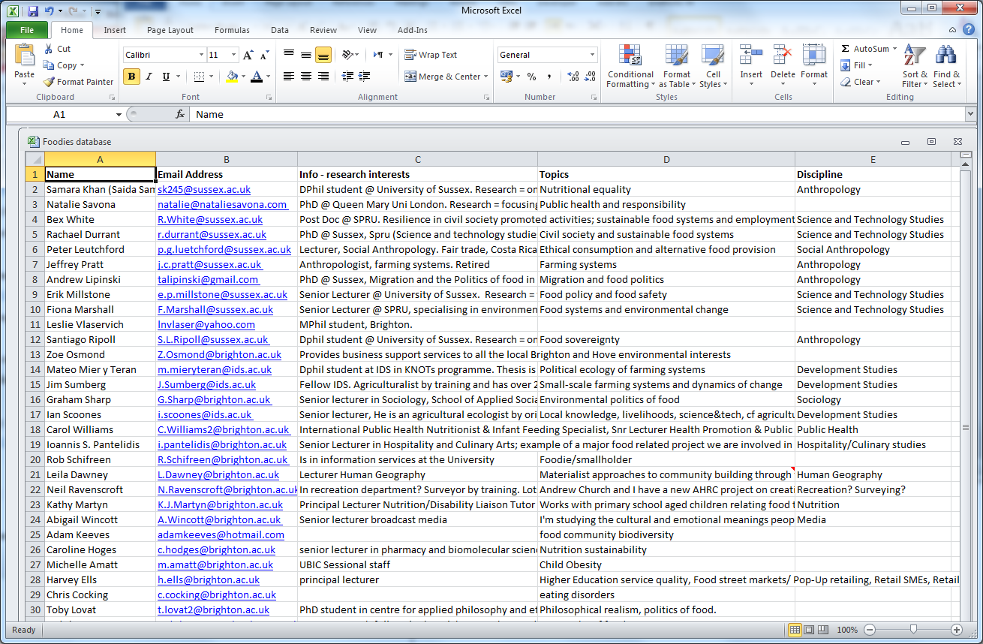
Making connections
Opportunities:
Funding for events
Access to facilities
Desire to present
Challenges:
Academic silos
Poor communications
Lack of time

Slide 5
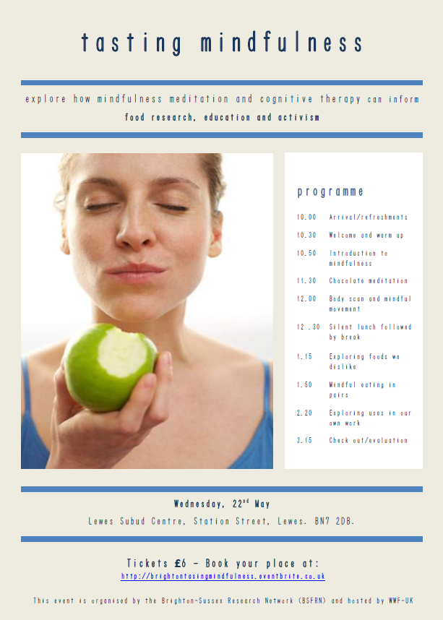
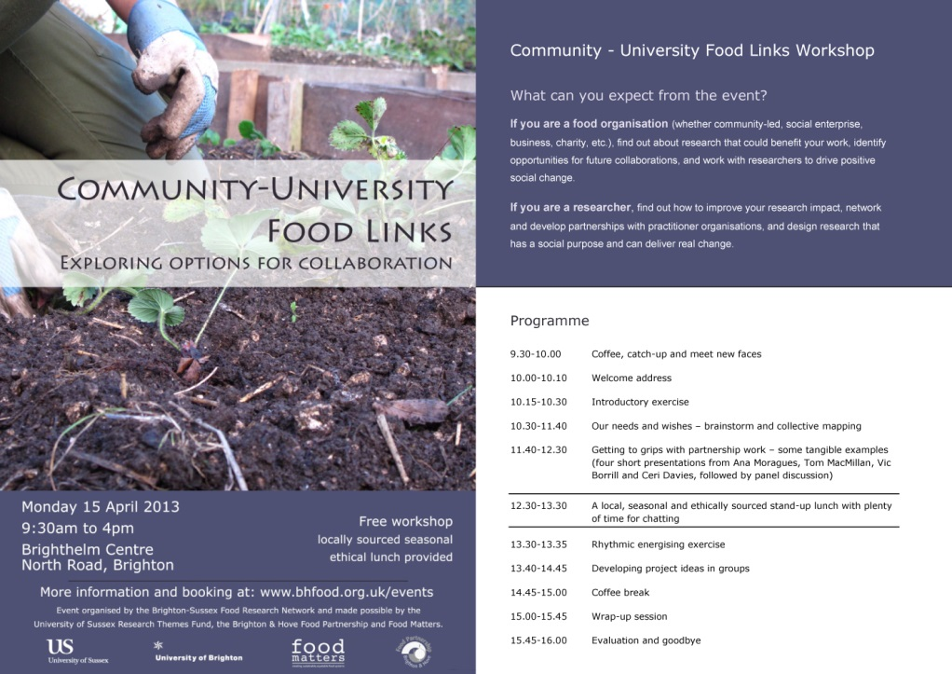
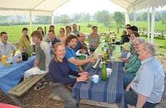
Making a splash
Challenges:
Lack of understanding
No precedent – how to do this?
Opportunities:
Momentum
Inspiring projects
Events:
“Producing food and community”: visit to Tablehurst Farm
“Community-University Food Links”: exploring options for collaboration
“Tasting Mindfulness”

Slide 6
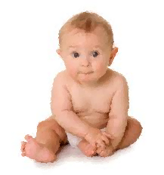
Hiatus!
Challenges:
Reliance on key individuals
No core funding
Opportunities:
Time for reflection
Chance to re-set

Slide 7
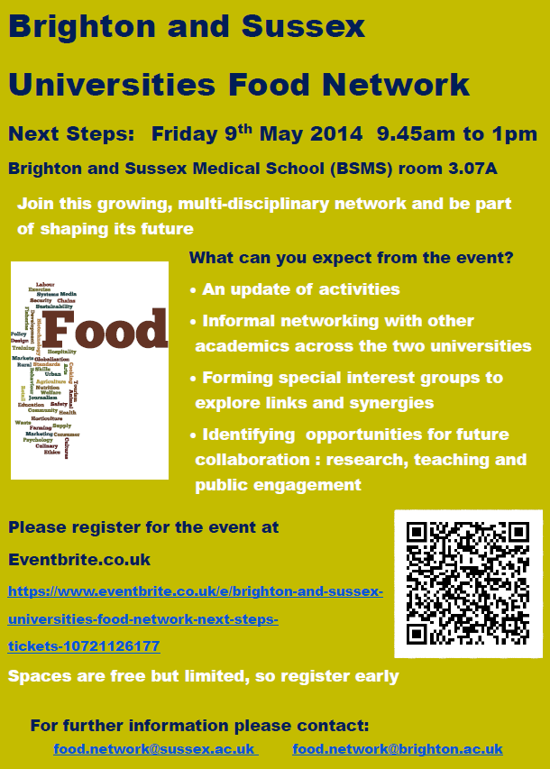
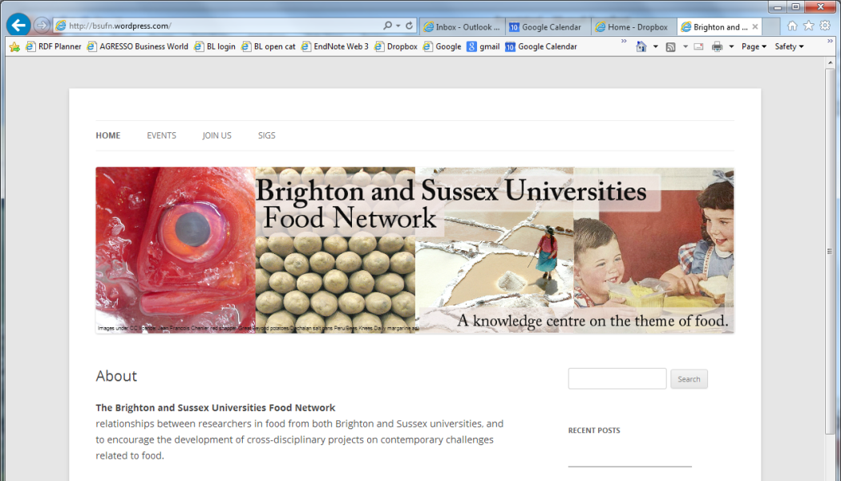
Re-orientation
Challenges:
Sharing responsibility
Agreeing identity
Opportunities:
Established profile
Doctoral students
Three years of learning (records)

Slide 8
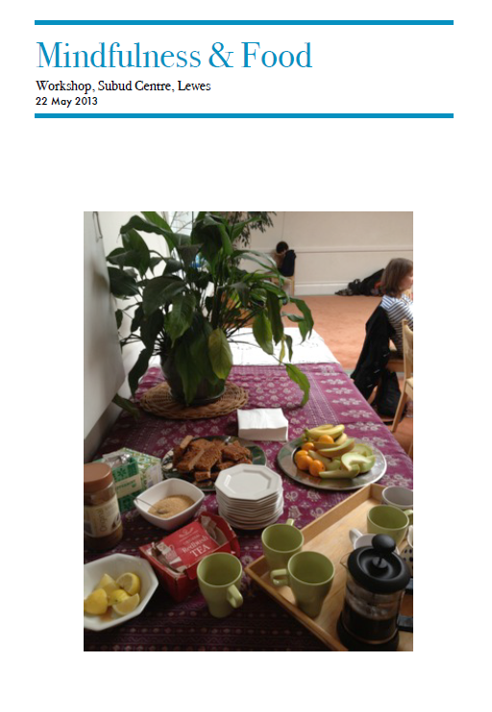
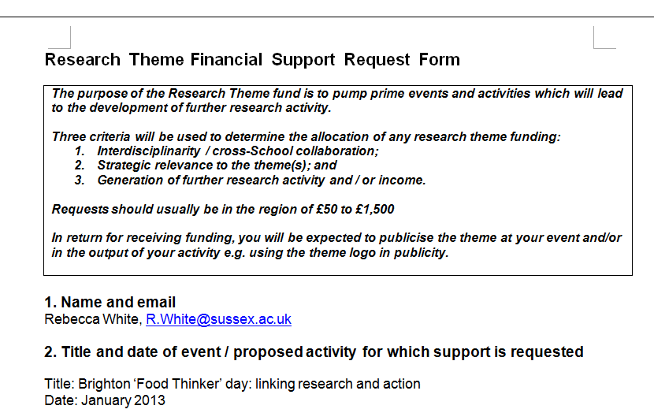
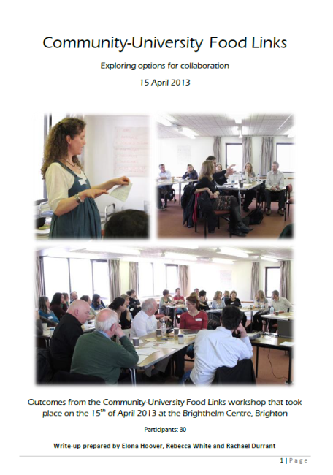
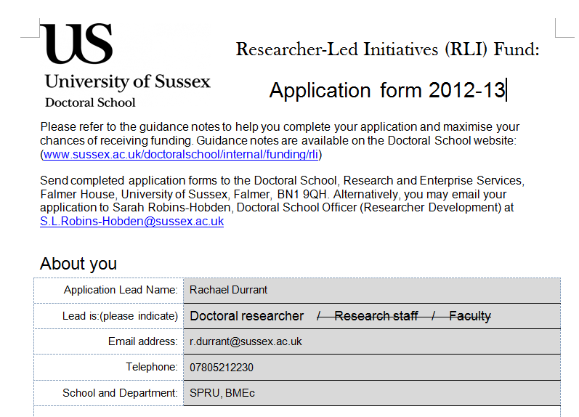
Key lessons
“Past experiments, current predicaments”
Needs are still the same:
Make a difference
Overcome isolation
Challenges are still the same:
Academic silos
Poor communications
Lack of time and incentives
Organisational/sustainability
Tips:
Keep records
Access funding
Be experimental
Persevere
Special Interest Groups (SIGs):
Food Cultures & Technologies
Global Food Nexus
Food Health and Education
Food Research Methods and Theories
Horizons
Get funded?
Get engaged!

