Slide 1
What is commissioning?
“Commissioning is the cycle of assessing the needs of people in an areas, designing and then achieving outcomes”
Cabinet Office, 2011
Notes:
Growing Health has been working with food growing projects to help them understand the new health service structure which came about after the Health and Social Care Act 2012 and the process of Commissioning.
Commissioning is the process of deciding what public services are needed and their priority, what resources to allocate to provide these services and why, how and where.
Service users, communities and voluntary and community organisations often have knowledge, ideas and skills that can be vital to the design and implementation of the best services possible.
Commissioning is commonly described as the whole cycle of identifying and delivering services, with four main stages

Slide 2
Why is it needed?
During the last few years the roles and functions of public bodies have been changing. Increasingly, instead of providing many services directly, public bodies are now looking to external organisations and companies to provide services on their behalf.
Public bodies have been moving in the direction of becoming purchasers, rather than direct providers of services, for a number of years. Commissioning involves making decisions about whether to commission, what to commission and from whom, so enabling priorities and strategies to be translated into services delivered by different organisations and companies.
Commissioning is therefore not just a set of technical exercises to purchase services, but is also profoundly shaped by the political environment and priorities of a local area.
Notes:
* John Dawson, NAVCA

Slide 3
Analysis
Monitoring & Review
Planning
Sourcing
Stages of Commissioning
Notes:
This diagram is a simple model of how commissioning works. In other words, the public body decides what it wants to achieve (its strategy), what
services it wants (analysis), how much money it has for them (planning) and how it is going to get the services (planning), and then goes about putting them in place (sourcing) and making sure they are delivered properly (monitoring and review). This can be done in several ways, but it usually involves buying them (otherwise known as procurement) or giving a grant to another organisation to deliver them. How this unfolds in practice will be more complex and vary widely across public bodies, departments, service areas and geographic areas. Some stages may overlap, and a thorough commissioning process can be time consuming. The term ‘commissioning’ is often misunderstood and used interchangeably with other terms, such as ‘procurement’. The stages above emphasise that commissioning involves more than just ‘procurement’, ‘grants’ or ‘tendering’, even if these appear the most visible aspects. A lot of work also goes into the other stages of commissioning and will impact on how it operates.
You need to make sure you Understanding your local context, You may not have much time to spend reading lots of documents but if you only do two things: Identify your local Clinical Commissioning Group: Health and Well Being Board and Public Health contacts.
Find out your local health priorities: Do a web search using the name of your local CCG and search for JSNA (Joint Strategic Needs Assessment). The JSNA analyses the local needs and priorities to inform and guide the commissioning process. It underpins the local health and wellbeing strategies.
A quick way to remember is Analyse, Plan, Do and Review.

Slide 4
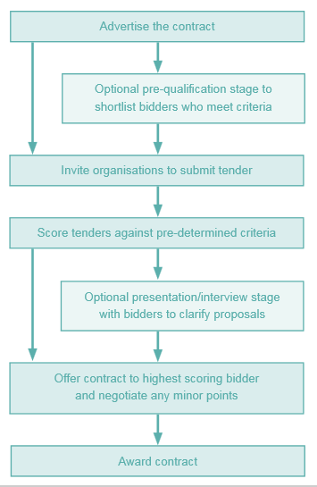
What is procurement?
“The stage of the commissioning cycle that involves buying the service and leads to the award of a contract”
Notes:
Image taken from the NACVA publication for a beginners guide to commissioning highlights the key stages of procurement.
Procurement is one part of the commissioning process. It is a contract between the public body buying the service and the organisation delivering the service. There are many legalities in procurement and one of them is to ensure competitive tendering. A Tender is a formal offer to provide services through the procurement process, it is generally a response to a formal specification and can be for a stated price but it may also allow organisations to give their price to ensure value for money

Slide 5
Why is it important to the voluntary and community sector to learn about commissioning?
Reduction in public spending
Reduced number of grants
Terminology
More competition
Notes:
The changes brought about by commissioning have had a major impact on parts of the voluntary and community sector. The effect has varied, depending on place, size of organisation and sub-sector, but the increase in competitive tendering has probably had the most significant impact. Open competition with only the winner being awarded a contract means there is a ‘winner takes all’ situation, resulting in organisations winning tenders (and thus funding) at the expense of others. If organisations are unable to win tenders, and therefore do not gain the income from contracts, their sustainability may be threatened
The voluntary and community sector’s work contributes towards public bodies’ outcomes. Voluntary and community organisations have useful intelligence that can contribute towards and shape what is commissioned, and they should therefore be involved in commissioning, by contributing to and influencing local decisions, priorities and services.

Slide 6
Further information and guidance:
http://www.sustainweb.org/growinghealth/commissioning
http://www.sustainweb.org/growinghealth/the_health_service/

